Slide 1
DUCTILE DETAILING AS PER CODE (IS CODE:- 13920-1993)
Presented by:-
Manisha Kumari Meena
Neeraj Kumar Singhal
Nikesh singh
Nitesh Mittal

Slide 2
Introduction
The requirments for designing and detailing of monolethic reinforced 1concrete building so as to give them sufficient toughtness and ductility to resist severe earthquake shocks without collapse.

Slide 3
DEFINATION OF DUCTILE MATERIAL
The material which can undergo large defomation and elongation while resisting while ductile material gives sufficient warning befoe collapse.

Slide 4
General Specification
The design and construction of reinforcement concrete building governed by IS 456-2000 except as modified by this code.

Slide 5
Flestrxural(bending) members
IS 456-2000 the beam and slabs of any structure are flexural member which are designed to
resist flexural.
The member a width to depth ratio of morn than 3.0. width of member not be less than 200mm.
The depth D of the member shall be not more than 1/4th of clear span.
Notes:
<number>

Slide 6
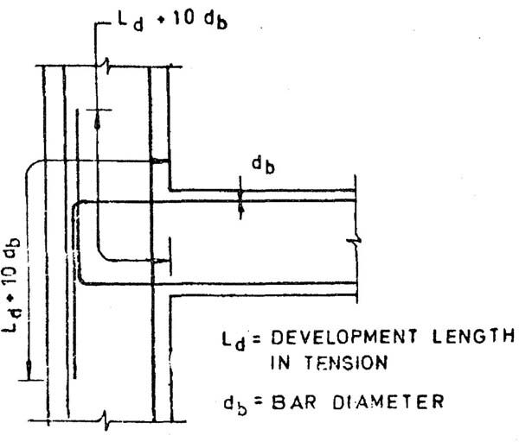
Longitudinal Reinforcement
These bars are provided in the beam to resist bending cracks.
The top and bottom reinforcement shall consist of at least two bars throughout the member length
Notes:
<number>

Slide 7
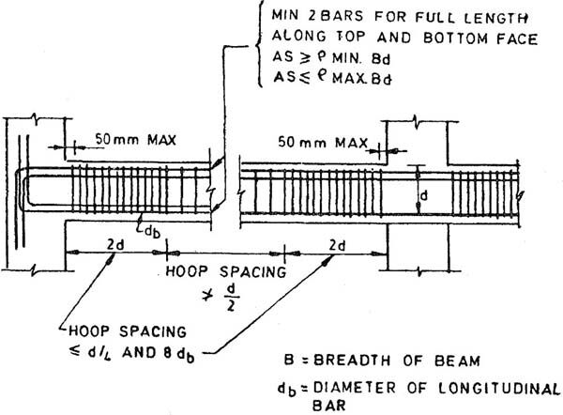
Web Reinforcement(Transverse Reinforcement Stirrup)
The main function of such reinforcement is to prevent concrete from bulging outwords and also prevent longitudional bars from buckling

Slide 8
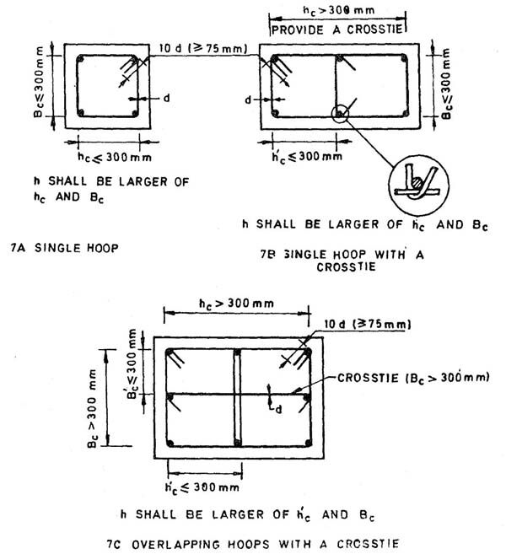
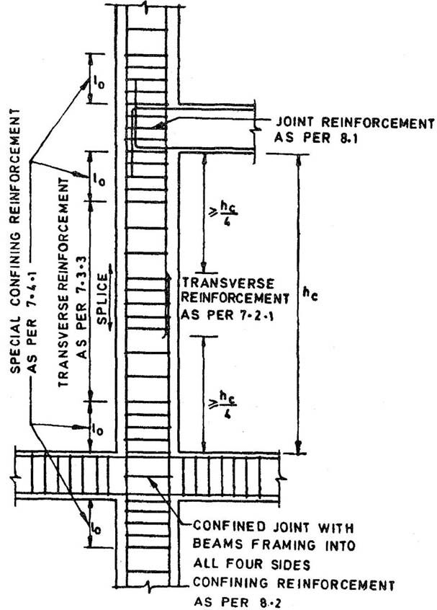
TRANSVERSE REINFORCEMENT OF COLUMNS
These reinforcement prevent columns from buckling of vetical bars and keep together.

Slide 9
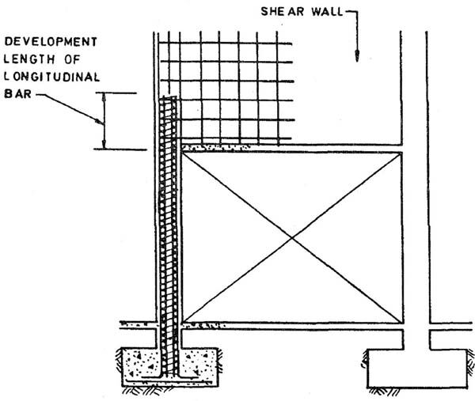
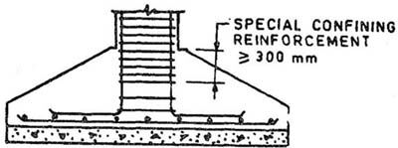
SPECIAL CONFINING REINFORCEMENT

Slide 10
THANK YOU

