Slide 1
INTRODUCTION TO IS 13828 : 1993
A PRESENTATION BY,
AKSHAY GAURAV(D3CE/120147)
GARIMA(D3CE/120156)
AMRITA(D3CE/120007)

Slide 2
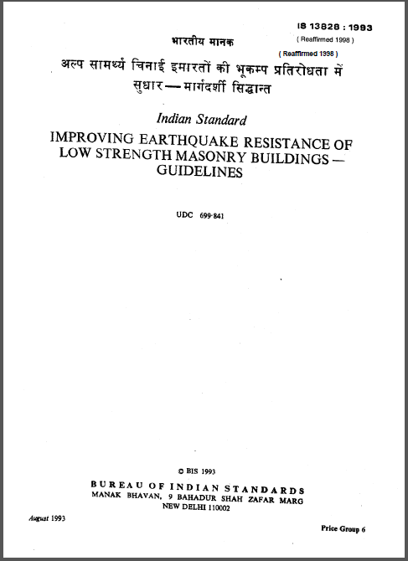

Slide 3
CONTENTS
TERMINOLOGY
GENERAL PRINCIPLES
SPECIAL CONSTRUCTION FEATURES
CATEGORIES OF BUILDINGS
LOW STRENGTH MASONRY BUILDINGS
REFERENCES

Slide 4
TERMINOLOGY
LOW STRENGTH MASONRY – Includes fired brickwork laid in clay and mud mortar; uncourse, undressed or semi dressed stone masonry in weak mortar; such as cement sand ,lime sand and clay mud.
CENTRE OF RIGIDITY – The point in a structure where a lateral force shall be applied to produce equal deflections of its components at any one level in any particular direction.
SHEAR WALL - A wall designed to resist lateral force in its own plane.
BOX SYSTEM – A bearing wall structure without a space frame, the horizontal forces being resisted by the walls acting as shear walls.

Slide 5
TERMINOLOGY
BAND – A reinforced concrete, reinforced brick or wooden runner provided horizontally in the walls to tie them together and to impart horizontal bending strength in them.
SEISMIC ZONES AND SEISMIC COEFFICIENT – The seismic zones ІI to V as classified and the corresponding basic seismic coefficient α₀ ,as specified in IS 1893:1984.
CONCRETE GRADES – 28 days crushing strength of concrete cubes of 150 mm side in MPa for example, for M15 grade concrete crushing strength 15 MPa.

Slide 6
GENERAL PRINCIPLES
LIGHTNESS
CONTINUITY OF CONSTRUCTION
PROJECTING & SUSPENDED PARTS.
SHAPE OF BUILDING.
FIRE SAFETY.

Slide 7
SPECIAL CONSTRUCTION FEATURES
FOUNDATIONS
STAIRCASES

Slide 8
Foundations Provision
As per IS 13828:1993

Slide 9
Staircases Provision
As per IS 13828:1993

Slide 10
CATEGORIES OF BUILDINGS
α_{h} = α₀ I β
α_{h} = Design seismic Coefficient for the building.
α₀ = Basic seismic coefficient for the seismic zone in which the building is located.
I = Importance factor applicable to the building.
β = Soil foundation factor.

Slide 11
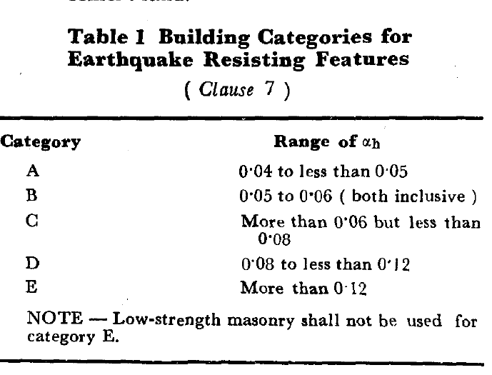

Slide 12
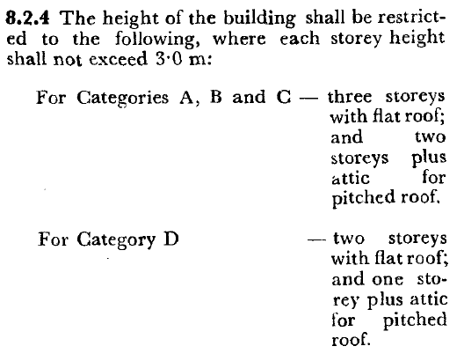

Slide 13
LOW STRENGTH MASONRY BUILDINGS
BRICK MASONRY – Earthquake performance of a masonry wall is very
sensitive to the properties of its constituents, namely masonry units and mortar.
STONE MASONRY - Low strength stone masonry buildings are weak
against earthquakes, and should be avoided in high seismic zones.

Slide 14
BRICK MASONRY
Masonry Buildings are brittle structures and one of the most vulnerable of the entire building stock under strong earthquake shaking. Ground Vibrations during earthquake cause inertia forces at locations of mass in the building. These forces travel through the roof and walls of the foundation. The main emphasis is on ensuring that theses forces reach the ground without causing major damage or collapse.

Slide 15
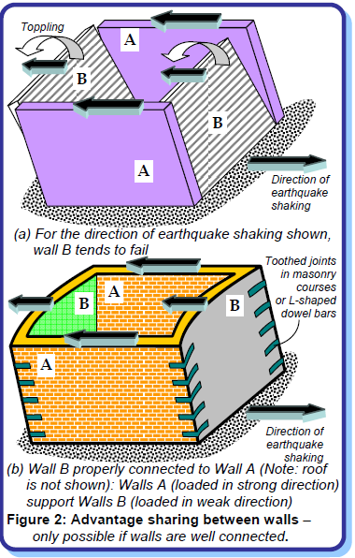

Slide 16
How to Improve behaviour of masonry walls?
Masonry walls are slender because of their small
thickness compared to their height and length. A
simple way of making these walls behave well during
earthquake shaking is by making them act together as
a box along with the roof at the top and with the
foundation at the bottom.. Firstly,
connections between the walls should be good. This
can be achieved by (a) ensuring good interlocking of
the masonry courses at the junctions, and (b)
employing horizontal bands at various levels,
particularly at the lintel level

Slide 17
STONE MASONRY
In a typical rural stone house,
there are thick stone masonry walls (thickness ranges
from 600 to 1200 mm) built using rounded stones from
riverbeds bound with mud mortar. These walls are
constructed with stones placed in a random manner,
and hence do not have the usual layers (or courses)
seen in brick walls. These uncourse walls have two
exterior vertical layers (called wythes) of large stones,
filled in between with loose stone rubble and mud
mortar.

Slide 18
How to make Stone Masonry Buildings Earthquake-Resistant?
Ensure proper wall construction.
Ensure Proper Bond in Masonry Course.
Provide horizontal reinforcing elements.
Control on overall dimensions & heights.

Slide 19
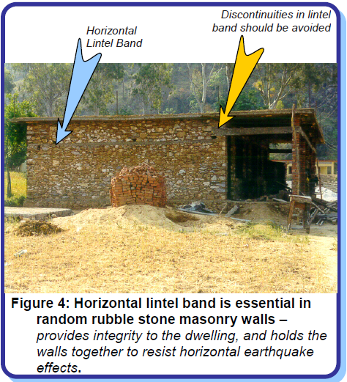

Slide 20
REFERENCES
IS 13828:1993 (Reaffirmed 1998)
www.iitk.ac.in_nicee_IITK-GSDMA_EBB_001_30May2013
www.ias.ac.in_jess_sep2003_Esb1511
www.tn.gov.in_tsunami_digitallibrary_ebooks-web_48 Earthquake_safe_construction_of_masonry_building
www.iitk.ac.in_nicee_EQTips_EQTip16

Slide 21
THANK YOU !!!

