Slide 1
What is engineering?
Engineering is the application of scientific, economic, social, and practical knowledge in order to invent, design, build, maintain, research, and improve structures, machines, devices, systems, materials, and processes.

Slide 2
Meaning
The term Engineering is derived from the Latin ingenium, meaning "cleverness" and ingeniare, meaning "to contrive, devise".

Slide 3
HISTORY
Engineering has existed since ancient times as humans devised fundamental inventions such as the wedge, lever, wheel, and pulley. Each of these inventions is essentially consistent with the modern definition of engineering.
The term engineering itself has a much more recent etymology, deriving from the word engineer, which itself dates back to 1300, when an engine'er (literally, one who operates an engine) originally referred to "a constructor of military engines." In this context, now obsolete, an "engine" referred to a military machine, i.e., a mechanical contraption used in war (for example, a catapult). Notable examples of the obsolete usage which have survived to the present day are military engineering corps, e.g., the U.S. Army Corps of Engineers.

Slide 4
What is civil engineering?
The design and construction of public and private works, such as infrastructure (airports, roads, railways, water supply and treatment etc.), bridges, dams, and buildings.

Slide 5
History of civil engineering?
Engineering has been an aspect of life since the beginnings of human existence. The earliest practice of civil engineering may have commenced between 4000 and 2000 BC in Ancient Egypt and Mesopotamia (Ancient Iraq) when humans started to abandon a nomadic existence, creating a need for the construction of shelter. During this time, transportation became increasingly important leading to the development of the wheel and sailing.

Slide 6
What is structural engineering?
Structural engineering is concerned with the structural design and structural analysis of buildings, bridges, towers, flyovers (overpasses), tunnels, off shore structures like oil and gas fields in the sea, aerostructure and other structures.

Slide 7
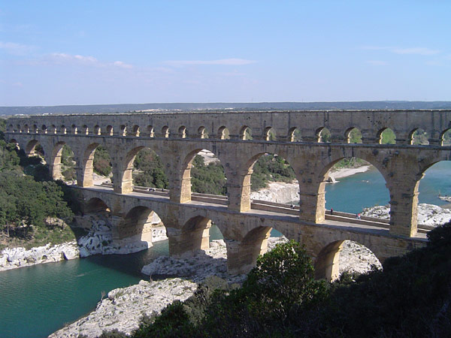
History of structural engg.
Structural engineering dates back to 2700 B.C.E. when the step pyramid for Pharaoh Djoser was built by Imhotep, the first engineer in history known by name. Pyramids were the most common major structures built by ancient civilizations because the structural form of a pyramid is inherently stable and can be almost infinitely scaled (as opposed to most other structural forms, which cannot be linearly increased in size in proportion to increased loads)

Slide 8
What is building?
A building or (Edifice), is a man-made structure with a roof and walls standing more or less permanently in one place, such as a house or factory. Buildings come in a variety of shapes, sizes and functions, and have been adapted throughout history for a wide number of factors, from building materials available, to weather conditions, to land prices, ground conditions, specific uses and aesthetic reasons. To better understand the term building compare the list of nonbuilding structures.

Slide 9
What is design?
Design is the creation of a plan or convention for the construction of an object or a system (as in architectural blueprints, engineering drawings, business processes, circuit diagrams and sewing patterns). Design has different connotations in different fields (see design disciplines below). In some cases the direct construction of an object (as in pottery, engineering, management, cowboy coding and graphic design) is also considered to be design.

