Slide 1
ASSIGNMENT NO-1
SUBJECT- F.E.M
SUBMITTED TO:- PROF. H. S. Rai
SUBMITTED BY:- Vishwa mohini Rai
ROLL NO:- 1524525

Slide 2
WHAT IS ENGINEERING?
Engineering is the application of scientific, econ0mic, social & practical knowledge in order to invent, design, build, maintain, research & improve structures. Engineering combines the fields of science and maths to solve the problems. There are different types of engineering:- civil engineering, mechanical engineering, electrical engineering, computer science engineering, chemical engineering and many more.

Slide 3
What is civil engineering?
Civil engineering is professional engineering that deals with the design and construction of public & private works and maintenance of physical and naturally built environment such as infrastructure (like airports, roads, railways, canals, water supply and treatment etc), dams, bridges, buildings. It is one of the oldest branch of engineering. It is all about helping the people and shaping the world.

Slide 4
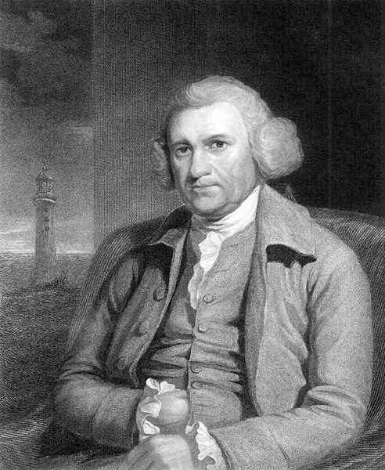
And those persons who study about
civil engineering are called civil
engineers. Civil engineer design,
construct, supervise, operate and
maintain large construction projects
and systems including roads,
buildings, tunnels, dams, bridges etc.
JOHN SMEATON, the “father of
civil engineering” who Constructed
the Eddystone Lighthouse.

Slide 5
What is structural engineering?
Structural engineering is the field of the engineering which deals with the analysis and design of structures that supports or resist the loads. The structural engineering is most commonly involved in the design of buildings. It involves design, construction and inspection of load bearing structures such as large commercial buildings, bridges and industrial infrastructures.

Slide 6
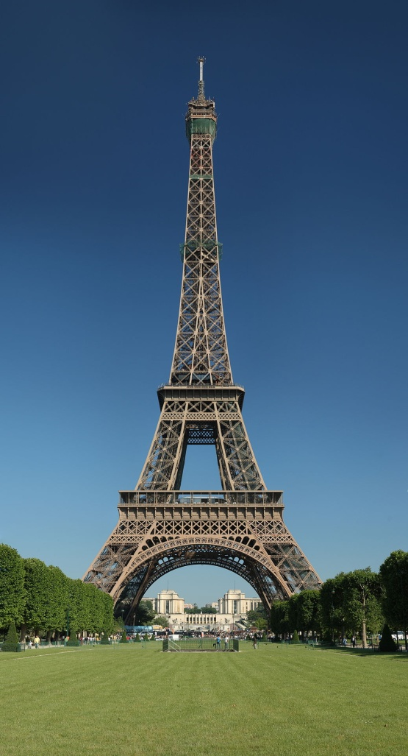
Structural engineers are responsible for
the engineering design and analysis. They
may design the individual structural
elements of a structure, for example the
beams, columns, floors etc. for example,
The EIFFEL TOWER,PARIS is a historical
Achievement of structural engineering.

Slide 7
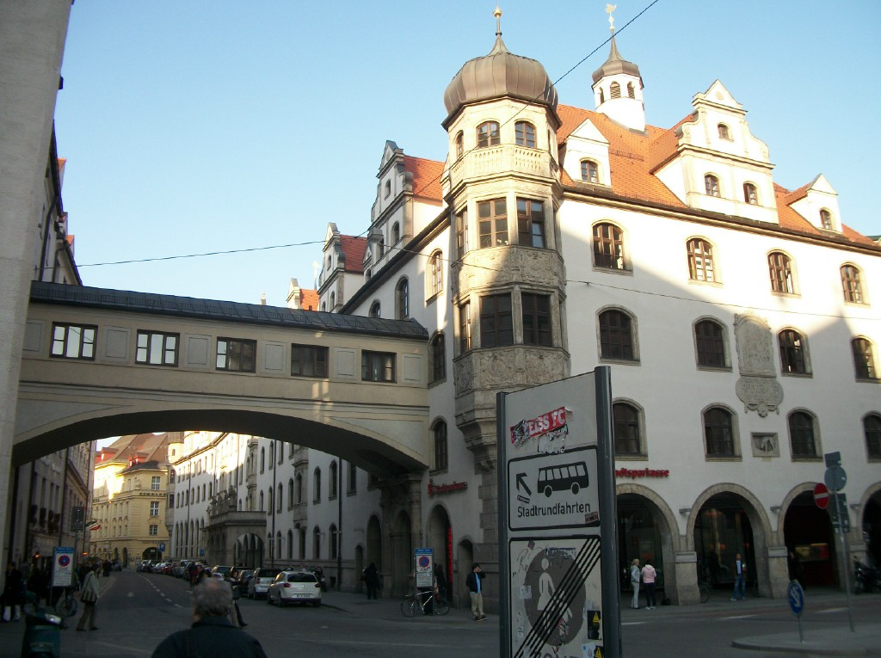
What is building?
Building is a man-made structure which is having roof and walls standing more or less permanently in one place such as a house or factory.

Slide 8
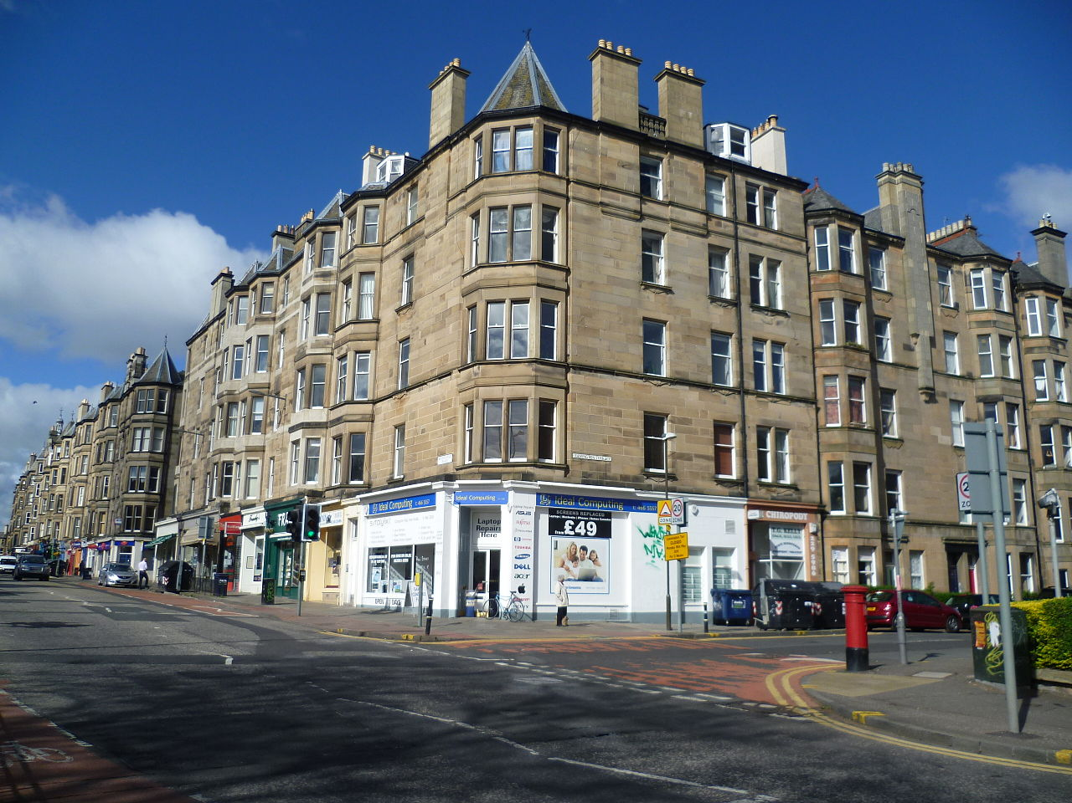
Building come in a variety of shapes, sizes and functions and have been adapted throughout the history for a wide number of factors, from building materials available to weather conditions, to land prices, ground conditions. The buildings can be residential, multistorey, industrial etc.

Slide 9
What is analysis?
It is the process of determining what needs to be done before how it should be done. In order to accomplish this the developer refers the existing systems and documents. So, simply it is an art of discovery.

Slide 10
What do you mean by design?
Design is the creation of a plan or convention for the construction of an object or a system as in architectural blueprints, engineering drawings. It defines the specifications, plans, parameters, costs, activities, processes and how & what to do within legal, political, social, environmental, safety and economic constraints in achieving that objective.

