Slide 1
SIX MONTH
INDUSTRIAL TRAINING AT
AIR FORCE STATION
(TECHNICAL & RESIDENTIAL AREA)
SIRSA(HARYANA)
SUBMITTED BY:
LAKSHAY BANSAL
UNIV. R.NO 100370101146

Slide 2
Company profile
Shiv Shankar Enterprises (Building & Roads) was established on 2004.
Contractar : Shri.Pawan Goyal.
Ongoing projects:
Construction of flats in residential area of air force
Construction of cockpit builiding in technical zone.
Construction of delhi byepass.
Construction of flyover.

Slide 3
Project overview
Area of ground floor: 25123mt²
Cost of building project: 40 crores
Start of project :18 NOV 2013
Completion of project:2 years
Designed for G+1 storey

Slide 4
Introduction to site
Design of the building made by: Testing And Consultancy CDLU.
Designed for: Air Force Residents.
Contractar : Sh.Pawan Goyal
Company : Shiv Shankar Enterprises

Slide 5
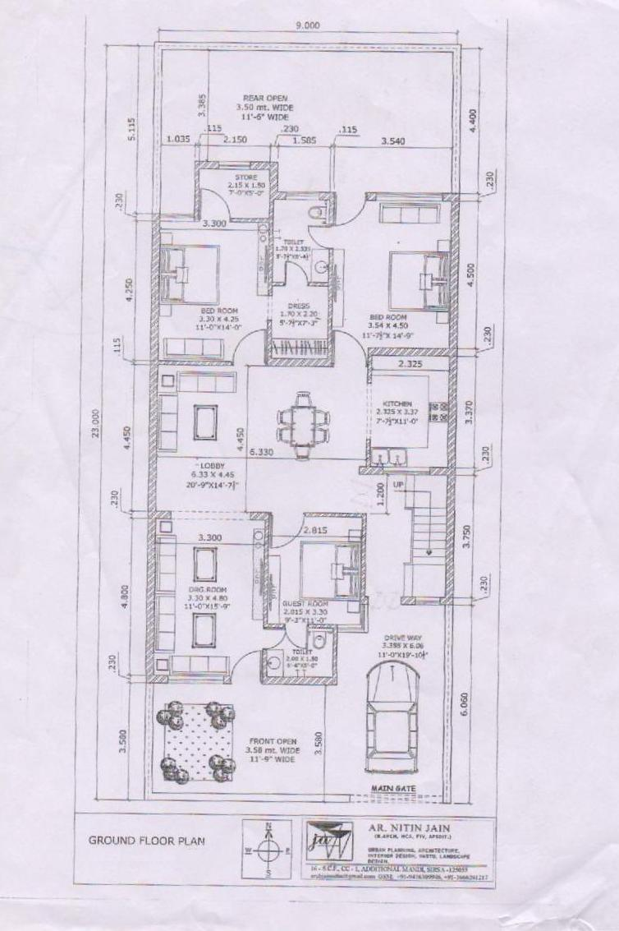
LAYOUT OF GROUND FLOOR

Slide 6
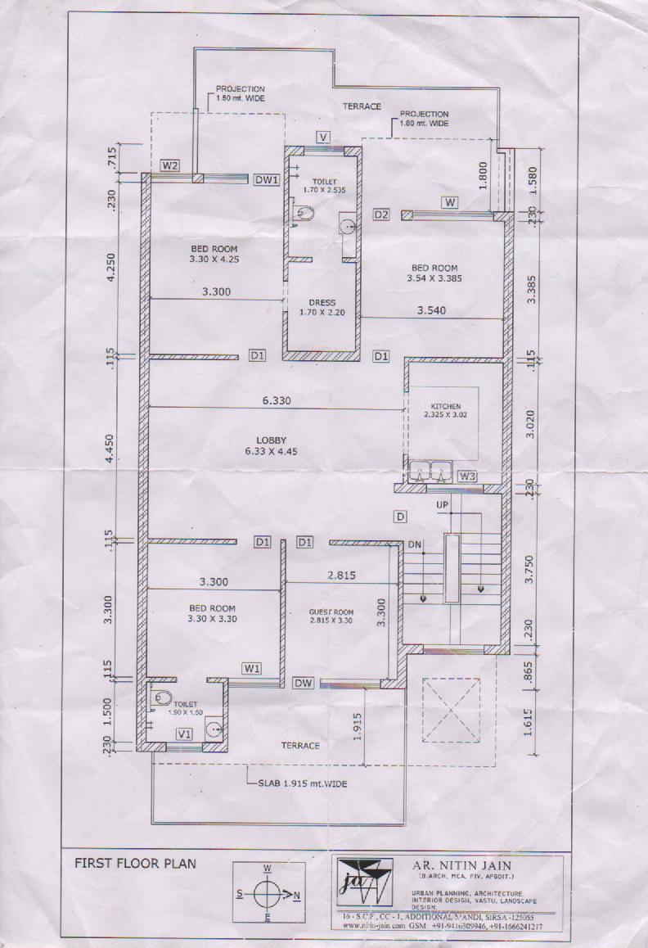
LAYOUT OF FIRST FLOOR

Slide 7
2.p.c.c. (plain cement concrete)
Thickness of pcc : 6’’
Pcc layer was compacted by using rammer.
Pcc composition: 1:4:8 (1 part cement, 4 part fine aggregates, 8 part coarse aggregates).

Slide 8
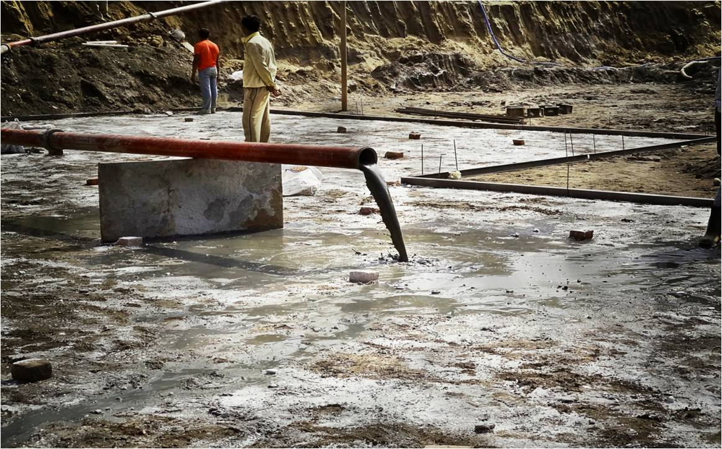
PCC

Slide 9
2. p.c.c.

Slide 10
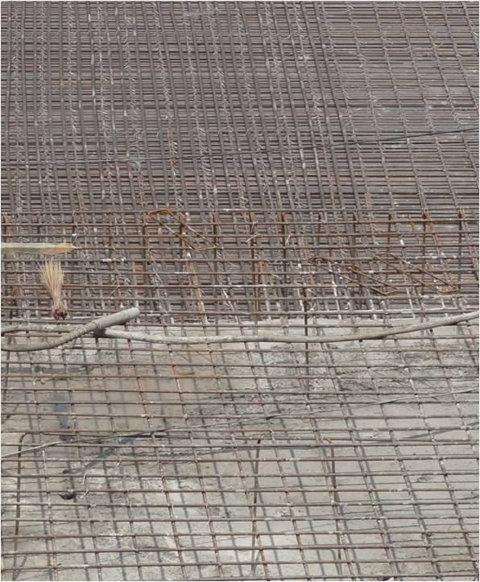
Reinforcement of RAFT FOUNDATION

Slide 11
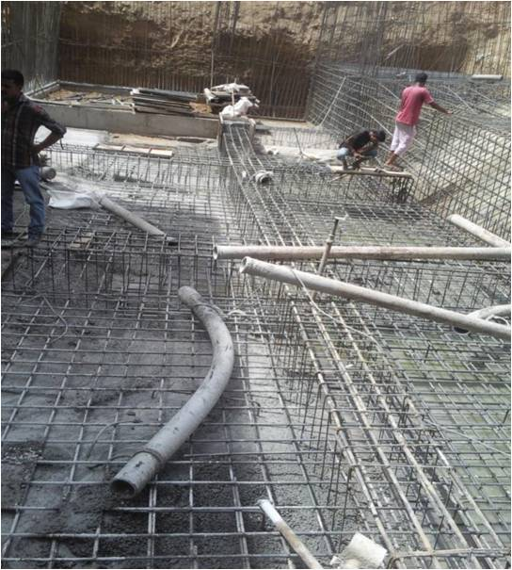
Concreting of raft foundation

Slide 12
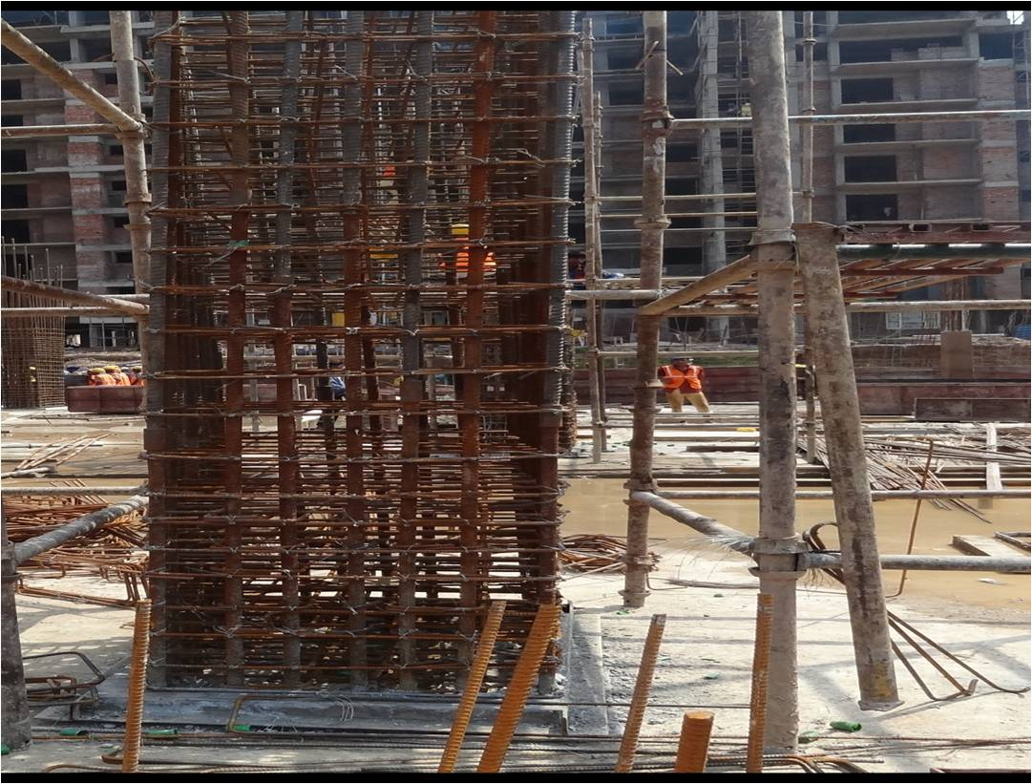
COLUMN STARTER

Slide 13
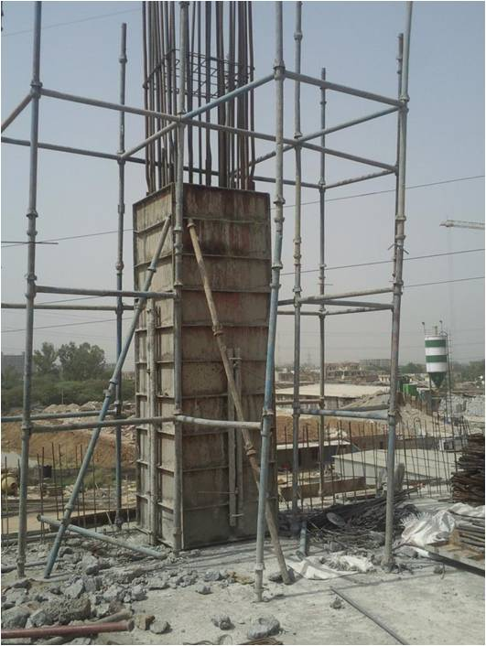
column

Slide 14
6. columns

Slide 15
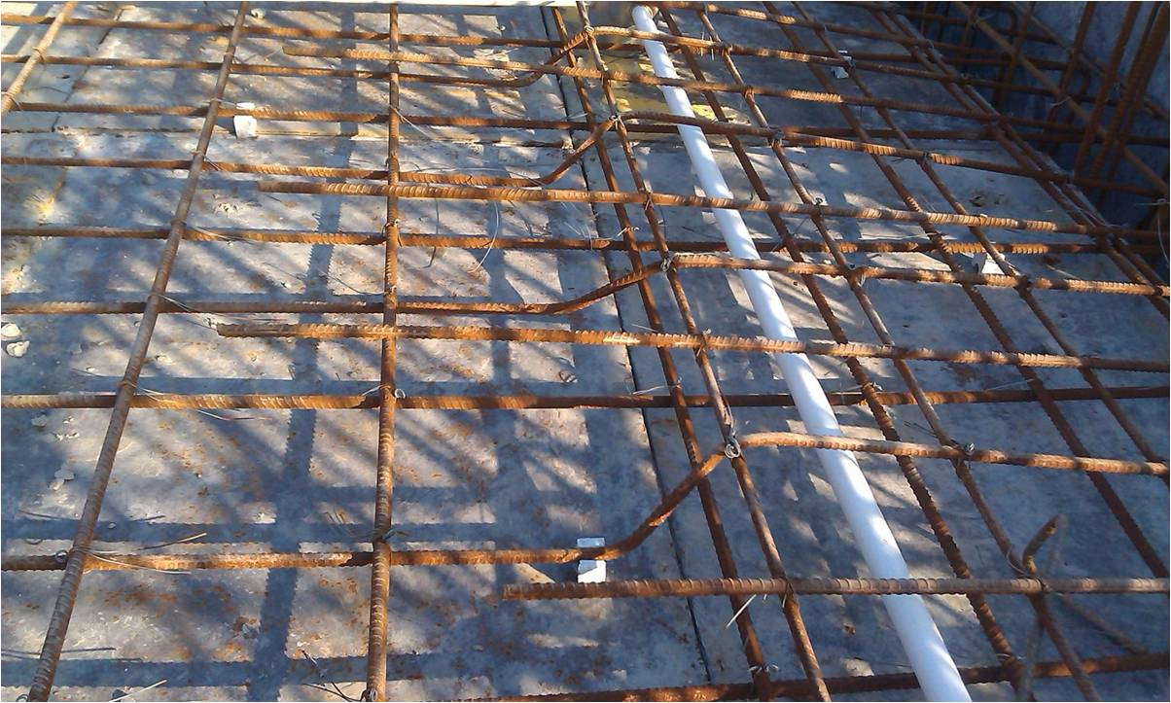
Crank in slab

Slide 16
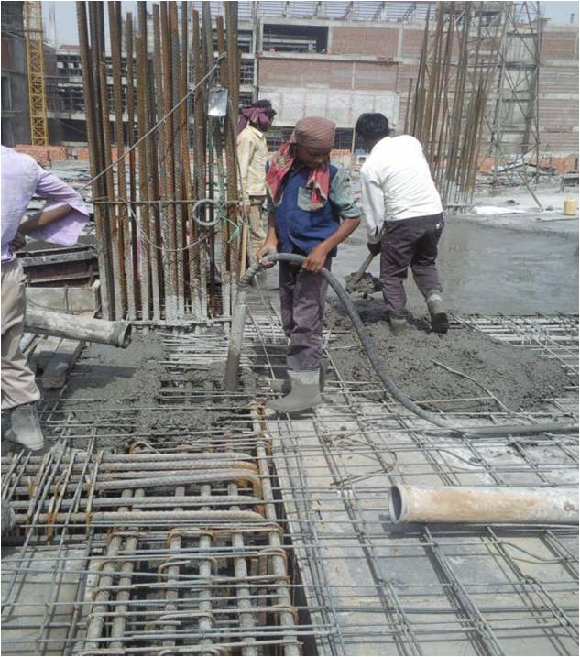
Casting of beam and slab

Slide 17
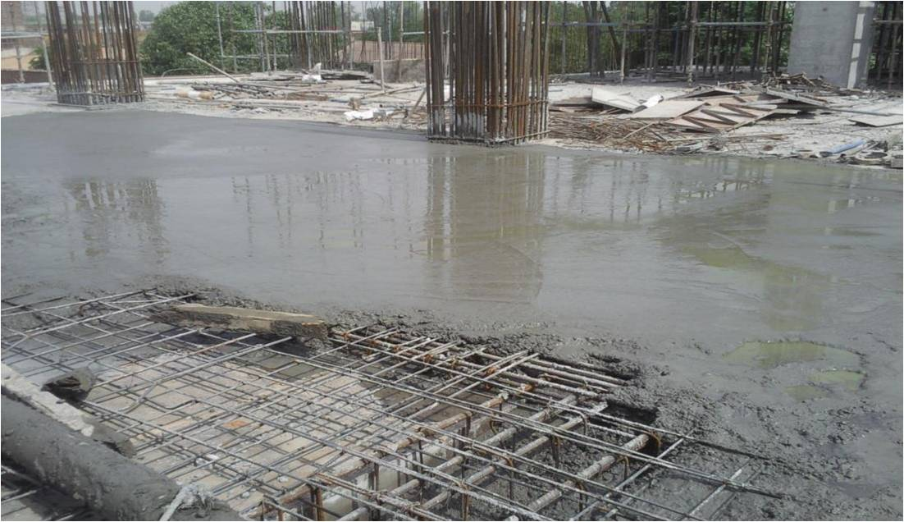
Concreting of slab

Slide 18
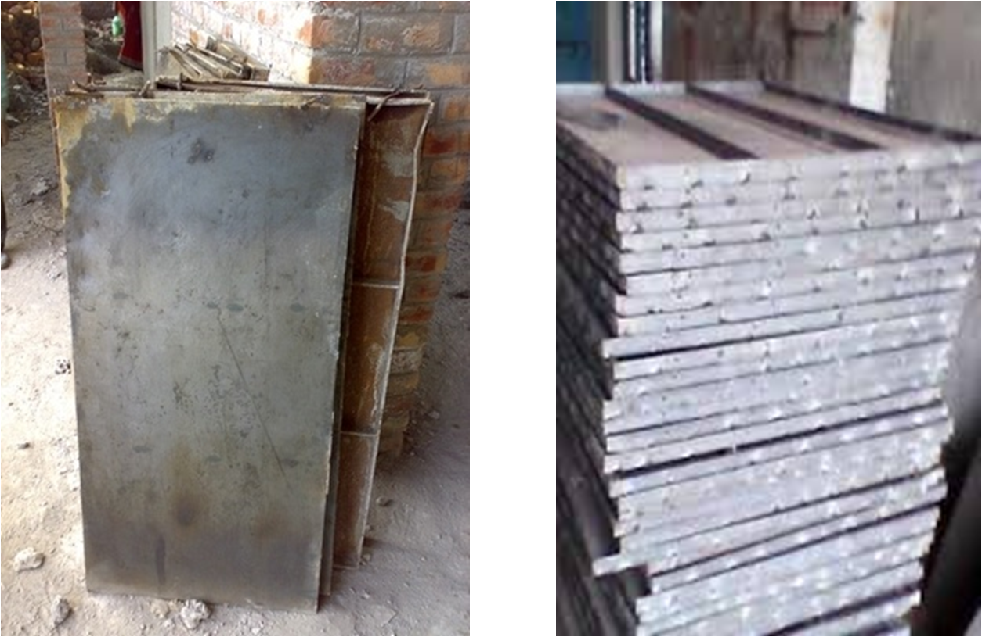
Shuttering plates

Slide 19
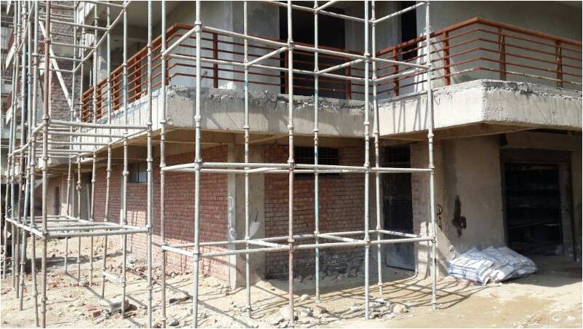
scaffolding

Slide 20
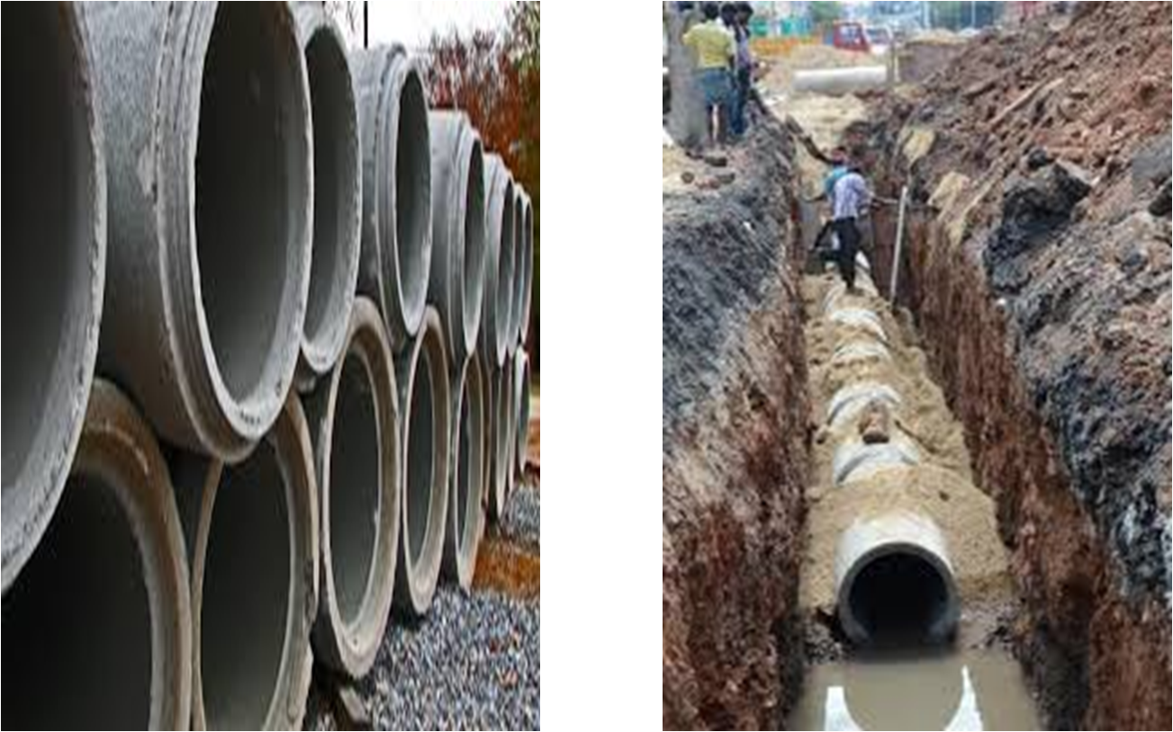
SEWER PIPES AND LAYING

Slide 21
THANKS

