Slide 1
WELCOME
PRESENTATION
ON
SEWERAGE
(FINAL YEAR)
PRESENTED BY: -
AMARVEER SINGH
MANPREET SINGH
HARMADEEP SINGH

Slide 2
Design of Sewers
The hydraulic design of sewers and drains, means finding out their sections and gradients, is generally carried out on the same lines as that of the water supply pipes.
However, there are two major differences between characteristics of flows in sewers and water supply pipes.

Slide 3
The sewage contain particles in suspension, the heavier of which may settle down at the bottom of the sewers, as and when the flow velocity reduces, resulting in the clogging of sewers.
To avoid silting of sewers, it is necessary that the sewer pipes be laid at such a gradient, as to generate self cleansing velocities at different possible discharges.
The sewer pipes carry sewage as gravity conduits, and are therefore laid at a continuous gradient in the downward direction up to the outfall point, from where it will be lifted up, treated and disposed of.

Slide 4
Laying of Sewer
The basics of laying a residential sewer is lateral in the ground.
You will need a starting elevation and an ending elevation.
After the trench is excavated, when entering an open trench, the pipe layer prepares the trench bottom by removing loose dirt and grading the trench bottom to allow for proper flow of sewage within the pipe.

Slide 5
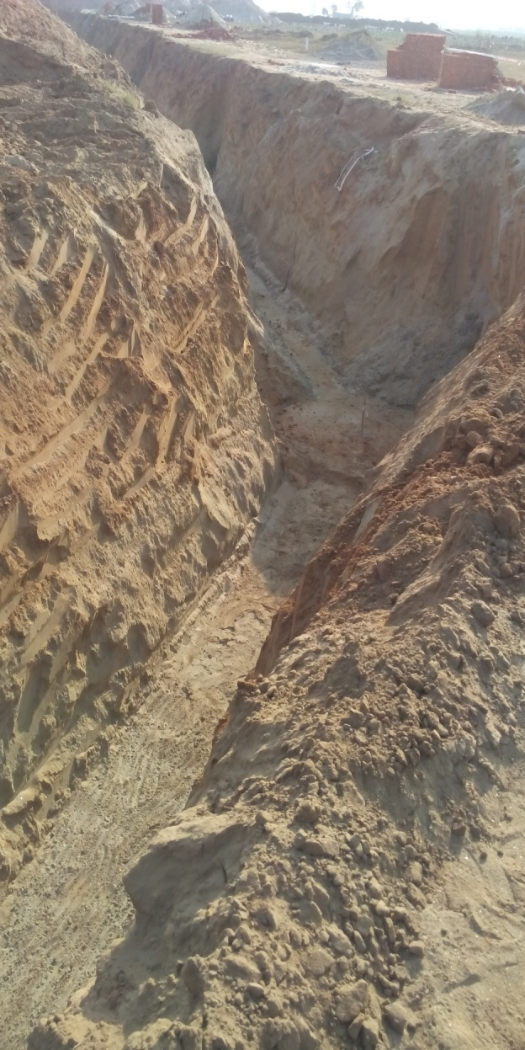
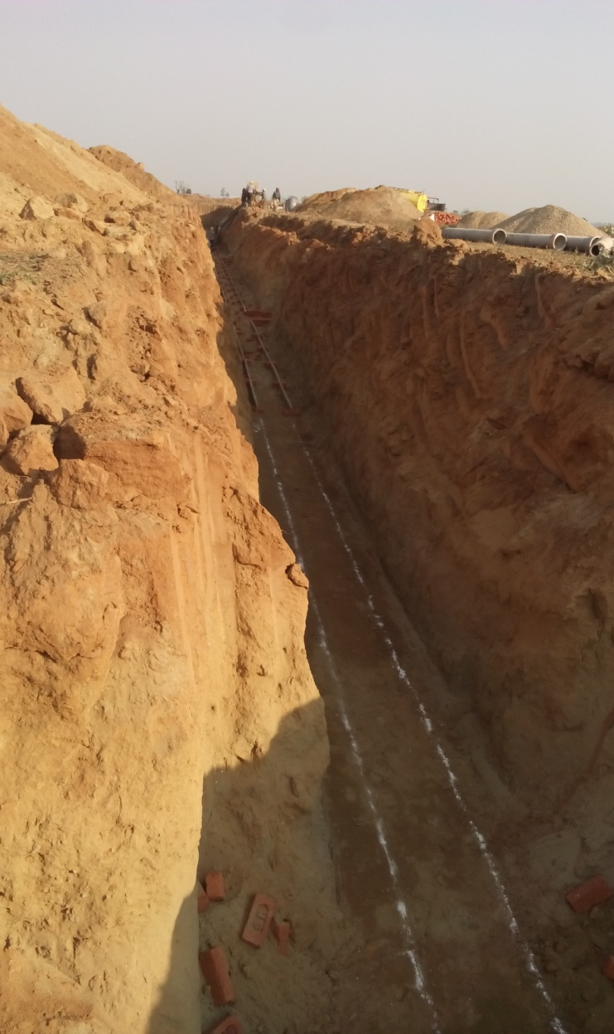
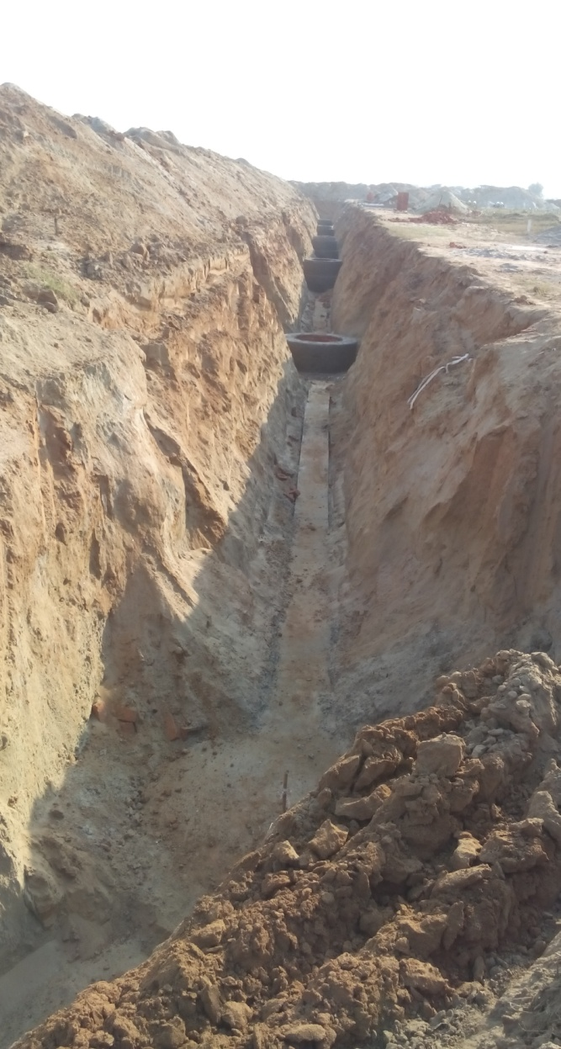

Slide 6
You need to ensure that the material beneath the pipe is solid so that the pipe does not "sag" after it is backfilled.
Typically if the "original" ground beneath the new pipe is not disturbed and graded properly, the pipe will be adequately supported.
If the original ground is over excavated, however, you will need to install compacted sand or gravel bedding beneath the pipe in order to support it.

Slide 7
Once the ground is prepared, you lay the pipe on the prepared soil.
In most cases, you should start on the low end of the run and work your way up to the connecting point.
If you use "hub" pipe, that is, pipe with an integral pipe built into the pipe, you should lay your first pipe beginning on the low end of the run with the hub on the uphill side of the pipe.

Slide 8
If you are using PVC pipe, both ends of the pipe should be primed with purple primer prior to laying it.
To connect the two ends of the pipe, you apply glue to the male and to the female ends of the pipe, being careful to not allow dirt to stick to the glued ends of the pipe.
Insert the male end into the female end and spin the pipe.
Hold the two pipes in place for ten seconds to ensure that they do not come apart.

Slide 9
Once the pipes are connected, you are ready to "bed" the pipe.
This means that you should place sand or gravel around and over the pipe - enough to just cover the top of the pipe.
Once this is complete, you compact the granular material around the pipe.
It is important to pay attention to this compaction process so that the pipe does not lift while you are compacting.

Slide 10
Once the bedding process is complete, you are ready to move on the next pipe.
It is important to note that as you install more pipe, you should be backfilling the trench behind you up to a safe level.

Slide 11
TYPES OF SEWER PIPES
STONEWARE PIPES
R.C.C. PIPES
CAST IRON PIPES
DUCTILE PIPES
SOLID WALL UPVC PIPES
SOLID WALL HDPE PIPES
GLASS FIBRE REINFORCED PLASTIC PIPES
PITCH FIBRE PIPES
DOUBLE WALL CORRUGATED POLYETHYLENE PIPES

Slide 12
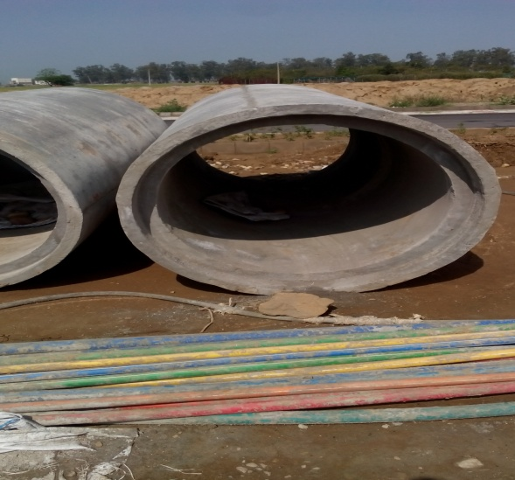
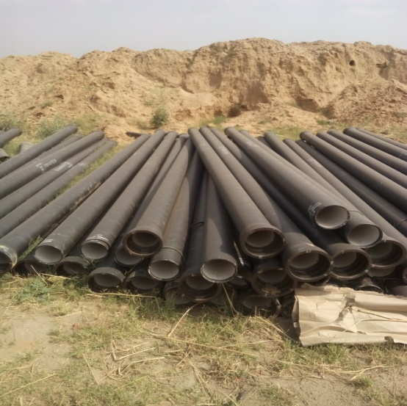

Slide 13
Testing of sewer
The testing of sewers is necessary as any leakage, improper joints, straightness or obstruction of sewers may occur during laying of sewers.
These defects may be removed or repaired after detection.
So there are various tests by which these defects may be detected. These tests are :-

Slide 14
Water Test.
Air Test.
Smoke Test.
Test For Obstruction.

Slide 15
Water Test
This test is carried out for sewer lines between two manholes.
Plugging is done by rubber plug at its lower end.
Rubber plug is connected with air blown.
The upper end of sewer is plugged with a connection to the funnel.
The sewer is filled with water and to maintain the required head, water level in the funnel is kept 2 m above the upper end.

Slide 16
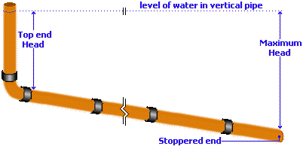

Slide 17
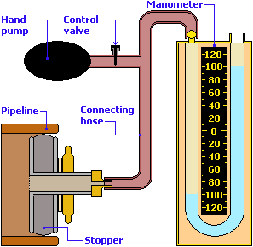
Air Test
When sufficient amount of water is not available, then air test is to be carried out.

Slide 18
Air is pumped into the pipeline, usually via a hand-pump with a control valve, until the reading on the manometer is around 125-150mm.
The set-up is then left for 5-10 minutes to allow for temperature stabilisation within the pipe before the pressure is reduced to exactly 100mm on the manometer scale.
The manometer is then monitored for a period of 5 minutes; the level of water in the manometer should not fall below the 75mm mark during this period.

Slide 19
This is deemed to be a 'pass' and the pipeline is declared satisfactory and can be backfilled.
However, if the level in the manometer does fall below the 75mm mark, then the equipment should be checked and cleaned and the pipeline examined for leaks or defects.
If any problems are identified, they should be rectified before re-testing.

Slide 20
Smoke Test
The purpose of smoke testing is to find potential points of inflow and infiltration in the sanitary sewer system that could lead to high flows during a storm.
Smoke testing forces smoke-filled air through a sanitary sewer line.

Slide 21
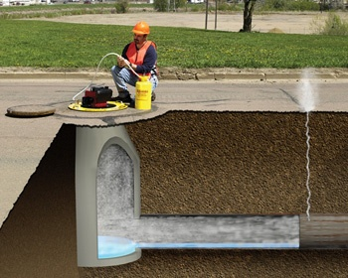
The smoke under pressure will fill the main line plus any connections and then follow the path of any leak to the ground surface, quickly revealing the source of the problem.
Only enough force to overcome atmospheric pressure is required.

Slide 22
Test For Obstruction
For straightness or obstruction of pipe, this test can be used. There are many methods for obstruction or straightness :
1. To check the obstruction of sewer pipe, a ball of suitable diameter is rolled down from upstream side. The diameter of ball should be less then the diameter sewer. If there is no obstruction, the ball can be taken out at downstream side.

Slide 23
2. The straightness can also be checked by placing a lamp at one end and a mirror at the other end.
If the full circle of light is visible at other end, then the sewer is straight and there is no obstruction.
If there is any obstruction within the sewer line, it can also be traced out.

Slide 24
Sewer Appurtenances
Sewer appurtenances are the various accessories on the sewerage system and are necessary for the efficient operation of the system.
They include man holes, lamp holes, street inlets, catch basins, inverted siphons, and so on.

Slide 25
Man-holes: Man holes are the openings of either circular or rectangular in shape constructed on the alignment of a sewer line to enable a person to enter the sewer for inspection, cleaning and flushing.
They serve as ventilators for sewers, by the provisions of perforated man-hole covers.
Also they facilitate the laying of sewer lines in convenient length.
Man-holes are provided at all junctions of two or more sewers, whenever diameter of sewer changes, whenever direction of sewer line changes and when sewers of different elevations join together.

Slide 26
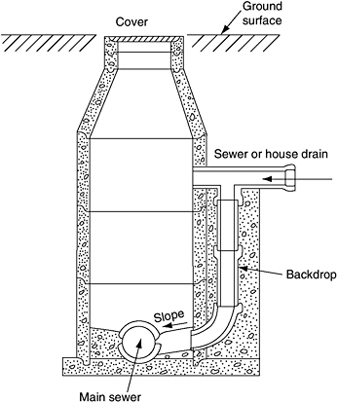

Slide 27
Special Man-holes
Junction chambers: Man-hole constructed at the intersection of two large sewers.
Drop man-hole: When the difference in elevation of the invert levels of the incoming and outgoing sewers of the man-hole is more than 60 cm, the interception is made by dropping the incoming sewer vertically outside and then it is jointed to the man-hole chamber.

Slide 28
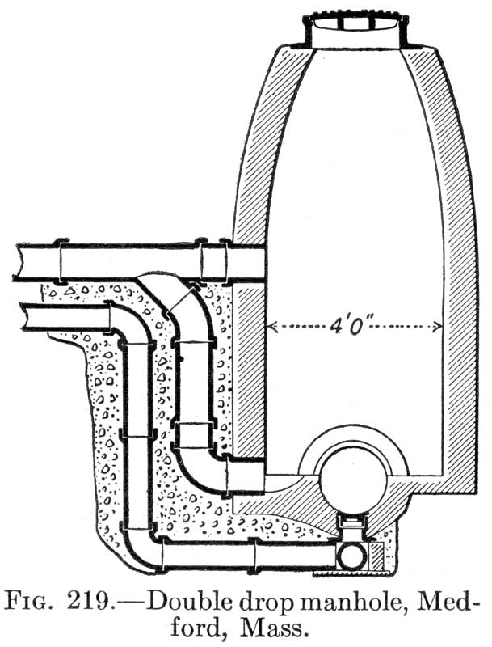

Slide 29
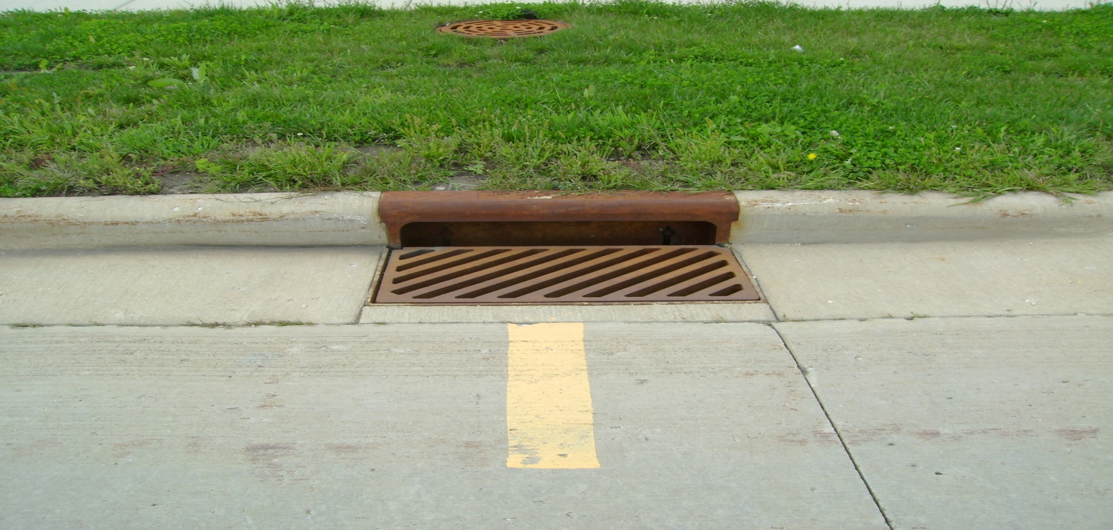
Street inlets: Street inlets are the openings through which storm water is admitted and conveyed to the storm sewer or combined sewer. The inlets are located by the sides of pavement with maximum spacing of 30 m.

Slide 30
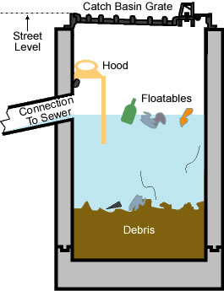
Catch Basins: Catch basins are small settling chambers of diameter 60 - 90 cm and 60 - 75 cm deep, which are constructed below the street inlets. They interrupt the velocity of storm water entering through the inlets and allow grit, sand, debris and so on to settle in the basin, instead of allowing them to enter into the sewers.

Slide 31
Thank u all…

