Slide 1
PRESENTATION
INDUSTRIAL TRAINING
UNDER
SOLUTIONS INC (PROJECT MANAGEMNT COMPANY)
BY: GURLEEN KAUR(100370180014, 100154)
TARANVIR KAUR(1183688, 100196)

Slide 2
ABOUT SOLUTIONS INC
SOLUTIONS INC.
Is synonymous to a school of multi disciplinary professionals with a proven track record and time tested expertise in the arena of project management. The Group specializes in managing building construction projects like Hotels, Residential ,Group housings, hospitals, commercial towers, shopping malls, for various real estate’s & corporate organization.
The company has Group professionals who have the Track record in delivering projects on time, to budget and the desired quality.
Basic Mantras:
Integrity
Honesty & Transparency
Better communication & documentation
Commitment to deliver the time & the TQM

Slide 3
ADVANTAGES OF PROJECT MANAGEMENT
COST SAVING
DESIGN REVIEWS
VALUE ENGINEERING
PROCUREMENTS
CLAIM ANALYSIS
TIME SAVING
EFFICIENT & REALISTIC PLANNING
STRICT TRACKING
SCHEDULE ANALYSIS
PROGRAMME REPORTS
REGULAR MEETINGS
BETTER QUALITY
CONTROL SAMPLES
QUALITY MANAGEMENT
FORMATS
REGULAR INSPECTION

Slide 4
SCOPE OF PROJECT MANAGEMENT SERVICS
PRE CONSTRUCTION FACE
Assistance in appointment of architect and consultants
Design Management
Procurement Management
Planning Management
Commercial Management
CONSTRUCTION FACE
Appointment of contractor
Planning Management
Commercial Management
Site Management
Quality control
Safety Management
Co ordination with client, Architect and other Consultant
POST CONSTRUCTION FACE
Package closure technical & commercial
Final cost Report
Preparation of Handing over document includes as built drawings
Operation & Maintenance Manuals

Slide 5
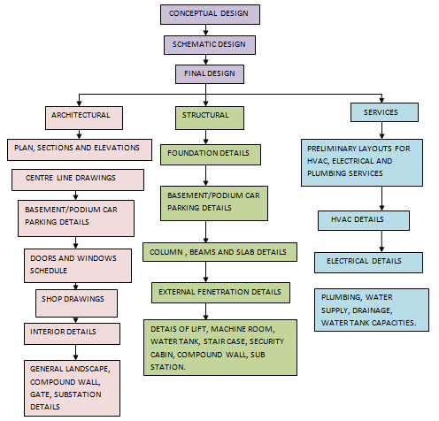
DESIGN MANAGEMENT

Slide 6
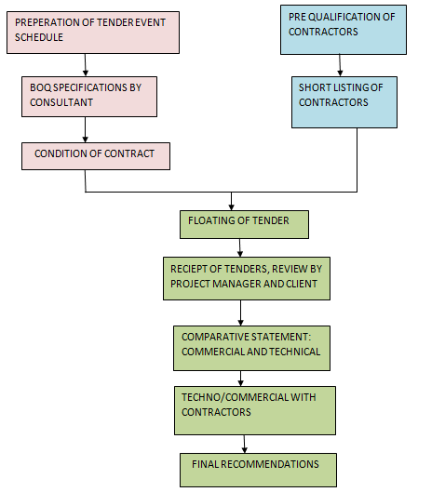
PROCUREMENT MANAGEMENT

Slide 7
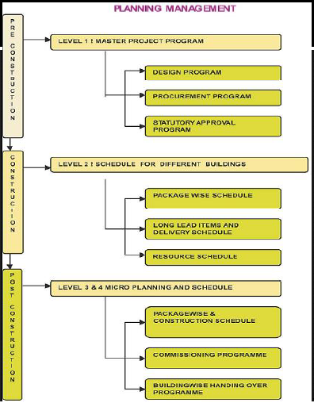
PLANNING MANAGEMENT

Slide 8
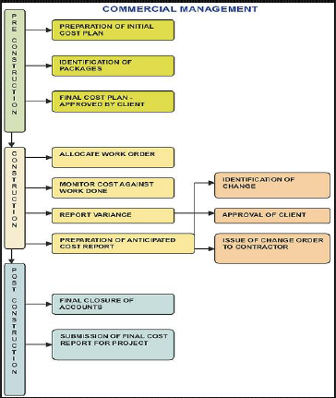
COMMERCIAL MANAGEMNT

Slide 9
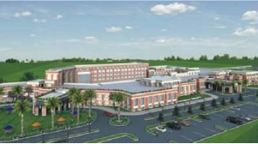
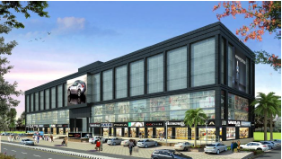
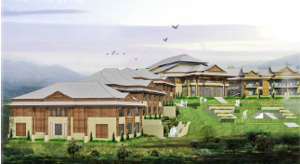
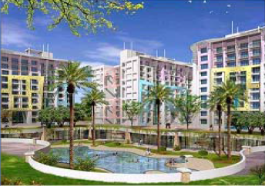
CLUB NIRVANA, LUDHIANA
GS COMMERCIAL COMPLEX, LUDHIANA
PINNACLE RESORT, GULMARG
NARAYAN INFINITY, JAIPUR

Slide 10
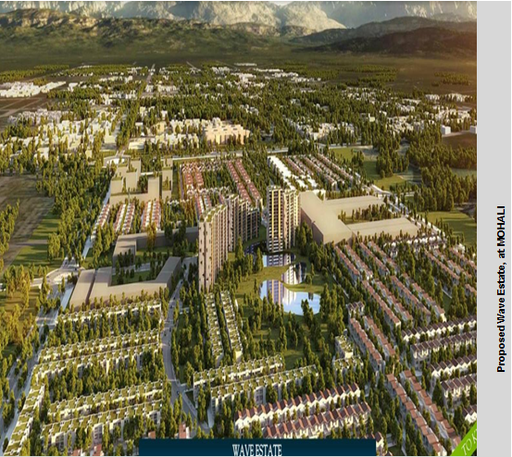
ABOUT PROJECT (WAVES ESTATE)
WAVE Estate is spread over area of about 250 Acres across entire Sector 85 and a part of Sector 99 of Mohali and comprises of Residential High Rise towers, Plots, Villas and Commercial Buildings respectively, proposed in the project

Slide 11
ABOUT INDEPNDENT FLOORS
NAME OF THE AREA
NAME OF CONTRACTOR
CLIENT
PMC
STRUCTURAL CONSULTANT
ARCHITECT
ORIGINAL CONTRACT VALUE
TOTAL AREA
TOTAL REINFORCEMENT
CONCRETE REQUIREMENT
TOTAL MANPOWER
INDEPENDENT FLOORS(250 SQ.YD.)
Surya contractors
M/S Country colonisers Pvt. Ltd.
SOLUTIONS INC
M/S MIENHARDT
STUDIO DRA
11.29 Cr
7250 sq. yd
450 metric tonnes
5500 cubic meter
100-120 per month

Slide 12
AREA STATEMENT MATRIX
S.NO. | NAME OF POCKET | TOTAL NO. OF PLOTS WITH PLOT NO. | NO. OF FLOORS | NO. OF INDEPENDENT FLOORS | AREA OF ONE INDEPENDENT FLOOR in Sq ft. | TOTAL AREA OF ALL FLOORS in sq ft.
1 | POCKET A | 9 nos. (192-183) | 3 | 27 | 2250 | 67500
2 | POCKET B | 10 nos. (182-173) | 3 | 30 | 2250 | 67500
3 | POCKET C | 10 nos. (172-162) | 3 | 30 | 2250 | 67500
 | TOTAL | 29 nos. | 3 | 87 | 2250 | 67500

Slide 13
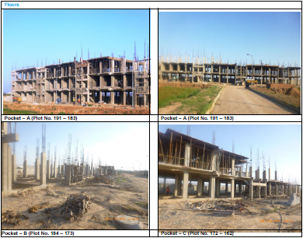
SITE PHOTOGRAPHS

Slide 14
ABOUT GROUP HOUSING-2
NAME OF THE AREA
NAME OF CONTRACTOR
CLIENT
PMC
STRUCTURAL CONSULTANT
ARCHITECT
ORIGINAL CONTRACT VALUE
TOTAL AREA
TOTAL REINFORCEMENT
CONCRETE REQUIREMENT
TOTAL MANPOWER
Group Housing-2
Shapoorji Pallonji
M/S Country colonisers Pvt. Ltd.
SOLUTIONS INC
M/S MIENHARDT
STUDIO DRA
205.5 Cr
12 acre
10270 metric tonnes
80700 cubic meter
370-380 per month

Slide 15
AREA STATEMENT MATRIX
TOWER | BUILDING LEVELS | NO OF APARTMENTS
BUILDING 1 PART A |  | 125
TOWER A | G+18 | 48
TOWER B | G+17 | 45
TOWER C | G+16 | 32
PART B |  | 108
TOWER E | G+15 | 39
TOWER F | G+14 | 36
TOWER G | G+13 | 33
BUILDING 2 |  | 235
TOWER H | G+15 | 30
TOWER I | G+15 | 42
TOWER J | G+16 | 45
TOWER K | G+17 | 48
TOWER L | G+18 | 70

Slide 16
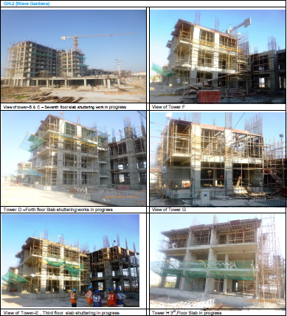
SITE PHOTOGRAPHS

Slide 17
ABOUT VILLAS (250 SQ. YDS.)
NAME OF THE AREA
NAME OF CONTRACTOR
CLIENT
PMC
STRUCTURAL CONSULTANT
ARCHITECT
TOTAL AREA
TOTAL REINFORCEMENT
CONCRETE REQUIREMENT
TOTAL MANPOWER
Villas (250 sq. yd.)
M/S RS INFRA
M/S Country colonisers Pvt. Ltd.
SOLUTIONS INC
M/S MIENHARDT
STUDIO DRA
250 SQ. YD.
36 metric tonnes
320 cubic meter
30-35 per month

Slide 18
AREA STATEMNT MATRIX
S.NO. | PLOT NOS. | NO. OF FLOORS | AREA OF ONE FLOOR IN SQ. FT. | TOTAL AREA OF ALL FLOORS in sq ft.
1 | 278 | 3 | 2250 | 67500
2 | 288 | 3 | 2250 | 67500
TOTAL | 2 | 3 | 2250 | 67500

Slide 19
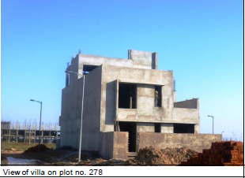
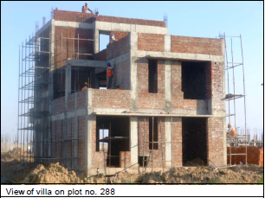
SITE PHOTOGRAPHS

Slide 20
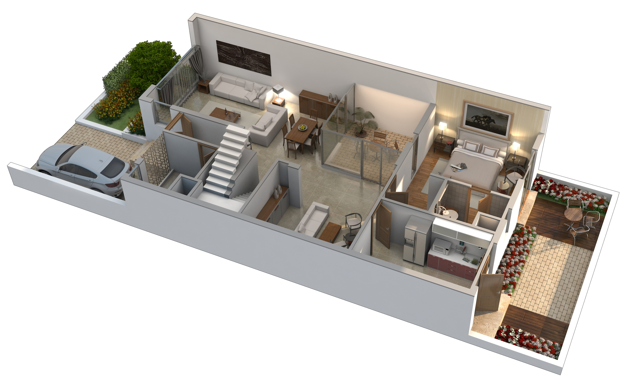

Slide 21
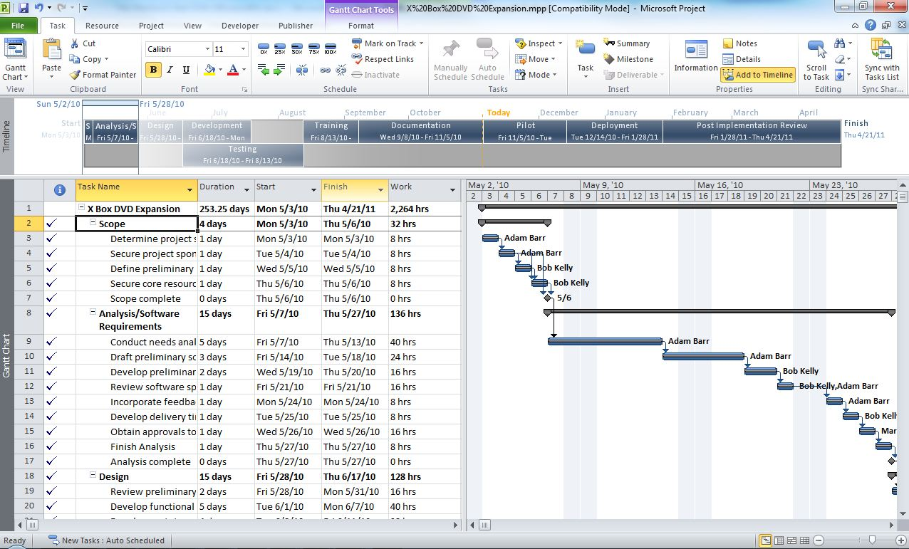
ABOUT MICROSOFT PROJECT
MICROSOFT PROJECT is a project management software that contains a set of tools to help managers plan, schedule and control progress.

Slide 22
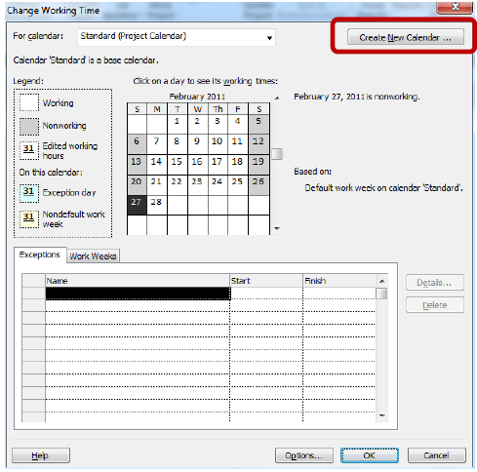
ASSIGN A PROJECT CALENDAR
CALENDARS are used to set project an resource working times to accurately reflect resource availability information.

Slide 23
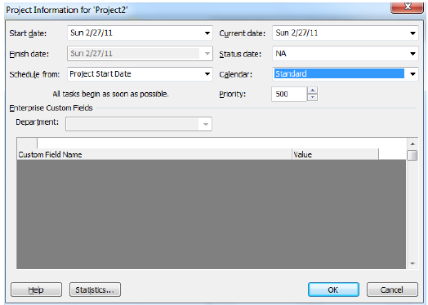
ASSIGN THE CALENDAR TO PROJECT
After defining the calendar, we have to assign it to the project.

Slide 24
TASK AND ITS RELATIONSHIP
TTASK MODE
FINISH TO START (FS)
MANUAL SCHEDULE MODE
START TO START (SS)
FINISH TO FINISH (FF)
AUTO SCHEDULE MODE
START TO FINISH (SF)

Slide 25
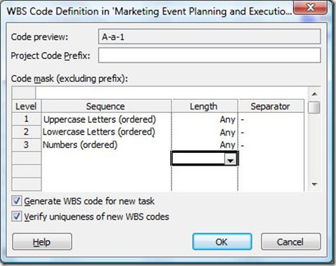
WORK BREAKDOWN STRUCTURE
A WBS charts displays and defines the product, to be developed and produced. It relates the elements of work to be accomplished to each product.

Slide 26
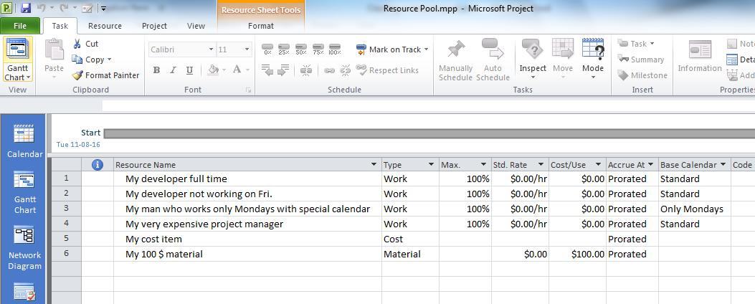
RESOURCES
RERSOURCES
WORK
MATERIAL
COST

Slide 27
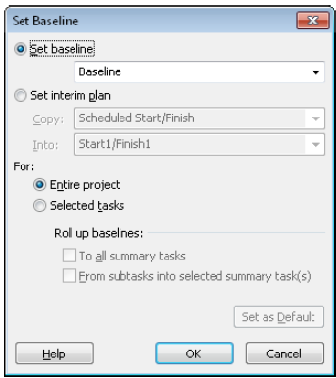
BASELINE
Baseline is a common project management term. It refers to a set of data about your project that represents its state before the work actually began. This brings you to a different set of Project features, which can help you track your progress and compare this progress to your original plan.

Slide 28
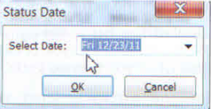
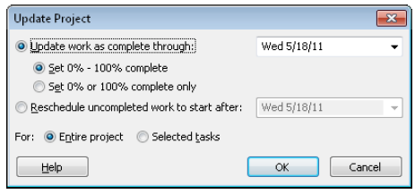
UPDATE PROJECT
Update is the second major phase of project management. It gives the variance between what you thought would happen an what really happened.

Slide 29
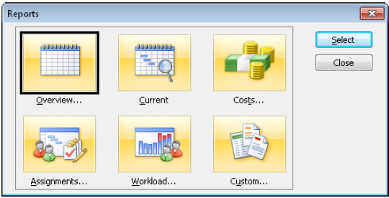
PROJECT REPORTS
These reports compile the most commonly
used sets of information needed to manage a project, coordinate resources, control
costs, analyze potential problems, and communicate progress.

Slide 30
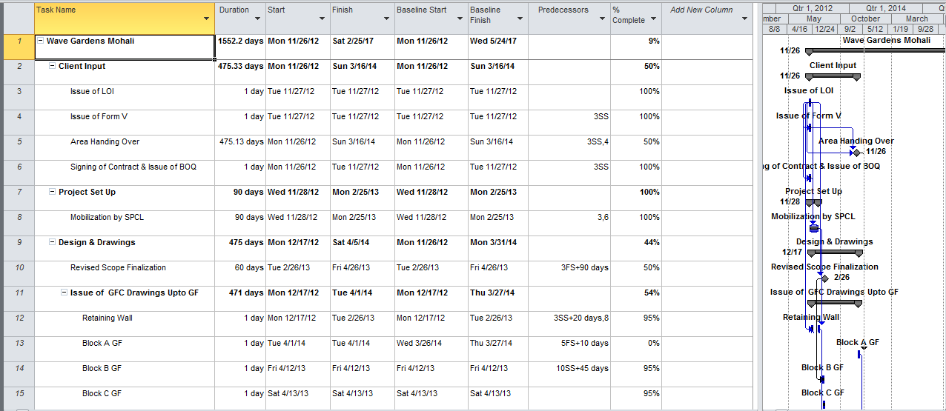

Slide 31
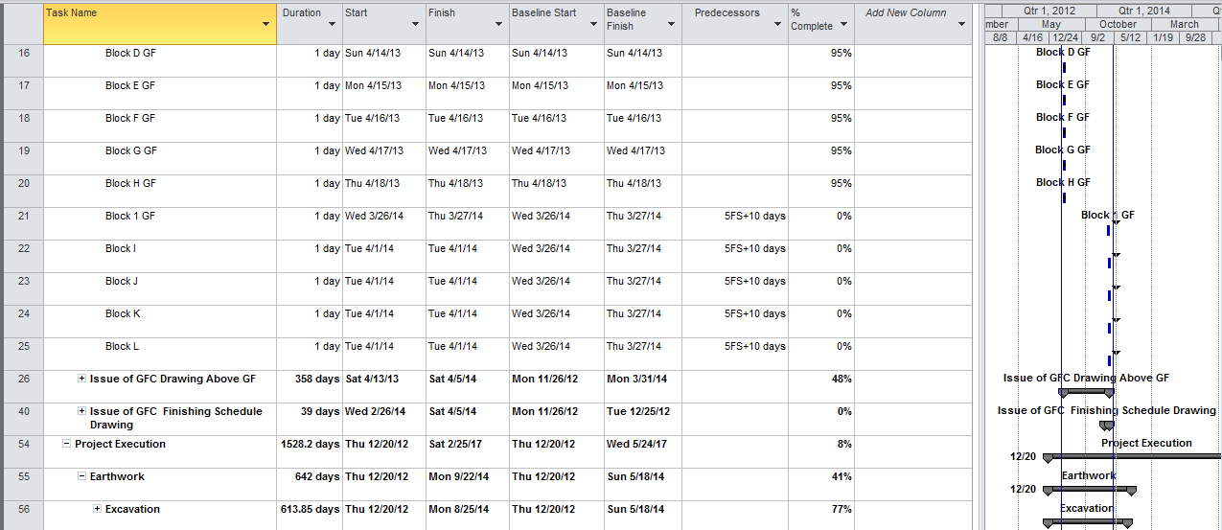

Slide 32
THANK YOU

