Slide 1
PRESENTATION ON
CONSTRUCTION OF RESIDENTIAL FLATS G+2
AT OMAXE CASSIA
NEW CHANDIGARH
BY : RAHUL KUMAR ALAGH
ROLL NO. 100370101242
D4 CIVIL ENGINEERING
GNDEC, LUDHIANA

Slide 2
PROJECT DETAILS
NAME OF PROJECT : CONSTRUCTION OF RESIDENTIAL FLATS G+2 ( 300 SQ. YARDS )
TYPE OF THE STRUCTURE : RCC SEMI-STRUCTURE TYPE
CONTRACTOR : JAGDAMBAY CONTRACTORS
DEVELOPER : OMAXE LTD.
STIPULATE TIME OF WORK : 4 YEARS
STIPULATE TIME OF START : FEB 2012
PROJECT COST : 137 CRORES

Slide 3
OVERVIEW OF THE PROJECT WORK
(At the time of joining)
DATE OF JOINING # 03/01/2014
STATUS OF PROJECT (BLOCK-B )
  DEMARCATION OF THE PLOT 48X28 M USING CHALK POWDER (CHUNA) WAS
    ALREADY DONE AND EXCAVATION OF THE PLOT WAS GOING ON .
  SLAB OF ONE OF THE FLATS WAS BEING CASTED.
  BRICKWORK WAS BEING CARRIED OUT IN VARIOUS FLATS.
  COLUMNS AT FIRST FLOOR WERE BEING CONSTRUCTED.
  STAIR CASE REINFORCEMENT WAS BEING CARRIED OUT.

Slide 4
ROLES AND RESPONSIBILITIES
The Duties assigned to me are of WORK EXECUTOR AND SUPERVISOR. My duty is to monitor the work being carried out and observe the daily schedule..
My duty was to keep a check on following items and gain experience side by side:
Check on reinforcement of slab, column, beam, stair case as per drawing.
Check on cover blocks and laying of concrete and use of vibrator properly.
All execution work
Brickwork layout
Excavation
Formwork
Ratio of mortar
Levelling
Laying of concrete
Casting of slabs, beams & columns
Binding of the reinforcement bars
Curing of concrete
Repair work of the superstructure

Slide 5
VARIOUS ACTIVITIES ON SITE
EXCAVATION
P.C.C
FOOTING AND COLUMN
FORMWORK
STEEL REINFORCEMENT
CONCRETING
CURING

Slide 6
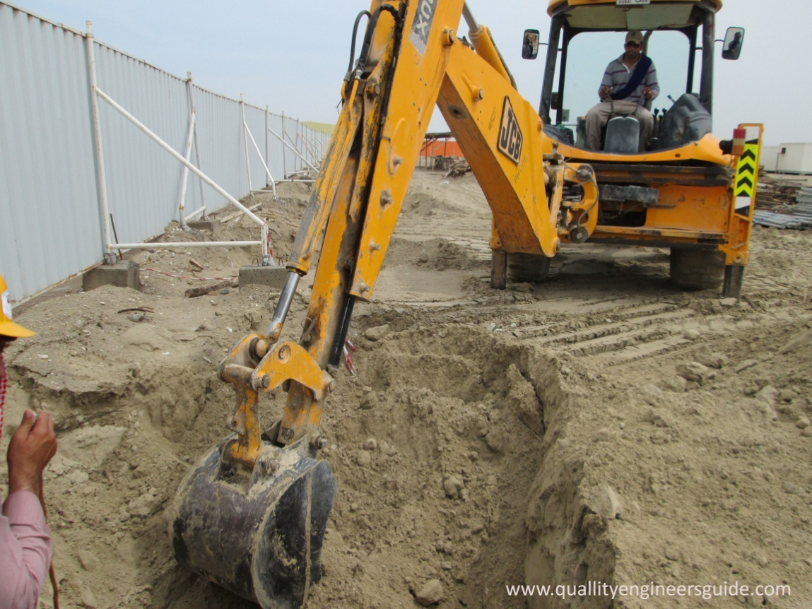
EXCAVATION
At our site the excavation is carried on 1450mm from the ground level.

Slide 7
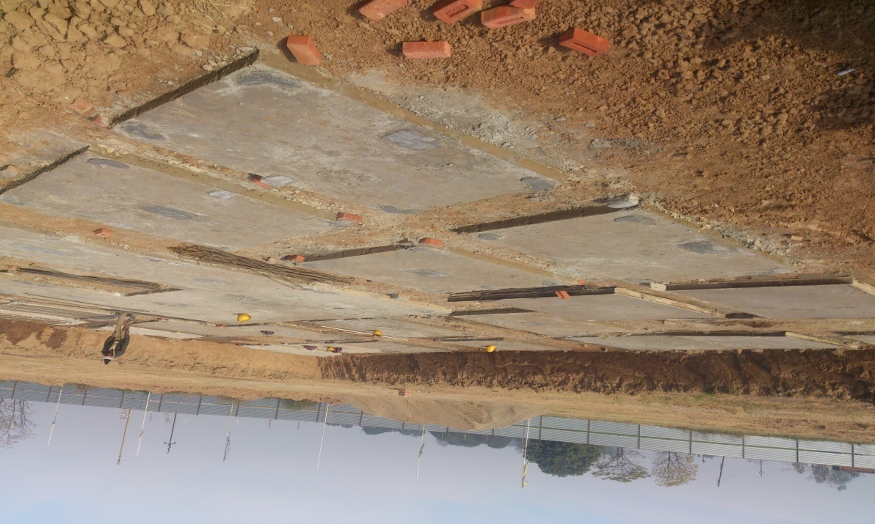
P.C.C
p.c.c
PCC is plain cement concrete.
After the excavation laying of
PCC is done. A layer of 4’’ is
Made on the soil such that it
is not mixed with the soil.
A concrete mix of 1:4:8 is
used. It provides the base for
Footing.

Slide 8
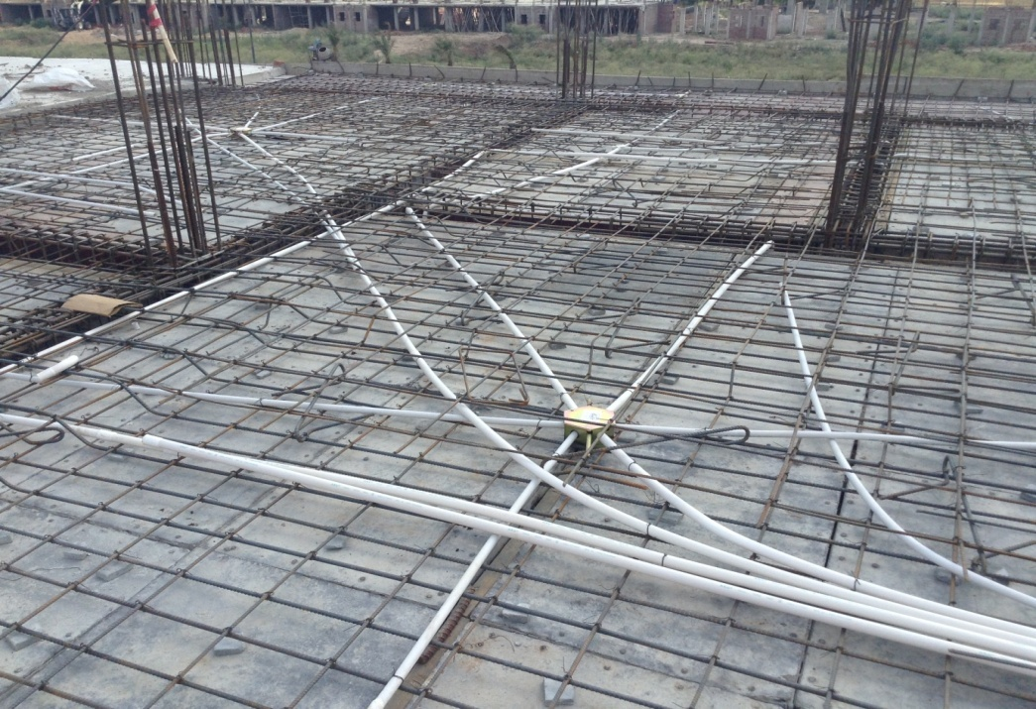
STEEL REINFORCEMENT
Reinforcement of the slab is
shown in the figure. Cover
blocks are provided so that
reinforcement does not touch
the shuttering.
Reinforcement is done as per
drawing.

Slide 9
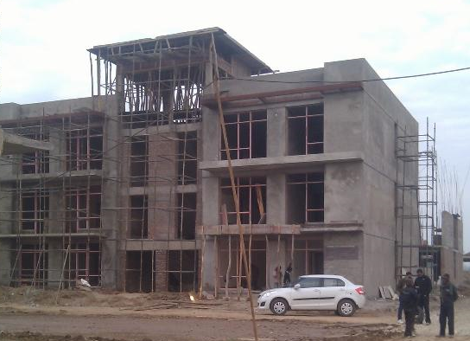
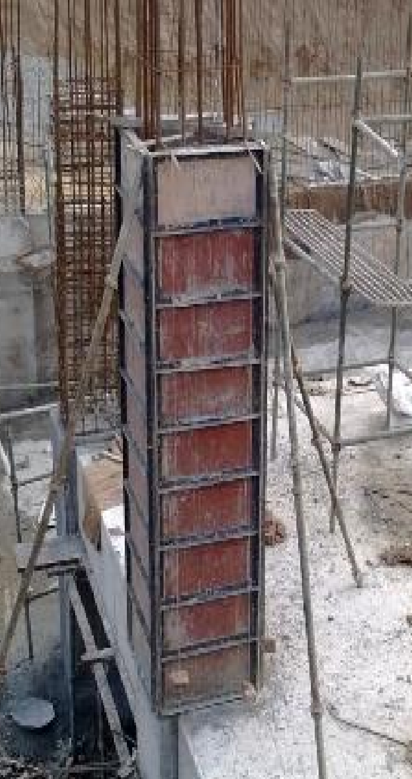
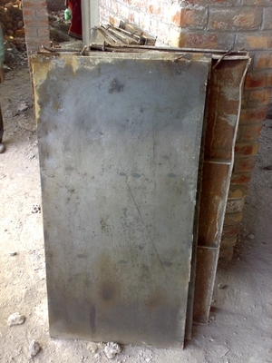
FORMWORK

Slide 10
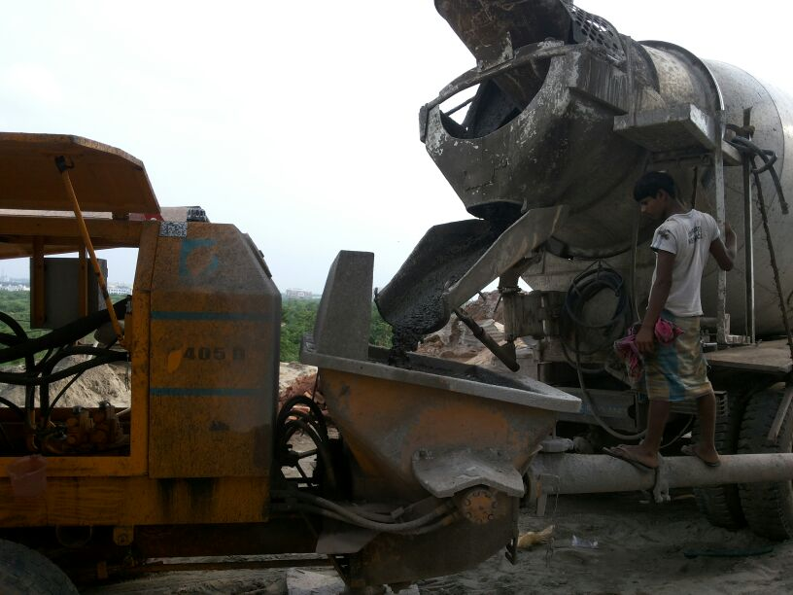
CONCRETE WORK
GRADE OF CONCRETE = M25
TYPE OF BATCHING = R. M C
BRAND OF R.M.C = ULTRA TECH
TYPE OF PLACING = WITH PUMP OR
MANNUALY
Concrete transferred using pump.

Slide 11
FIELD TESTS ON MATERIALS
I have performed tests on concrete, soil, brick, reinforcement bars and aggregates. I have performed the quality testing of materials. For eg- The compressive strength of concrete cubes and bricks.
BRICK TEST :Water absorption test, Weight of brick, Shape and Size of brick, Load bearing capacity
(Compression test)
AGGREGATE TEST: Sieve Analysis
CONCRETE TEST : Slump test ( to check out workability of the concrete ) , Cube test
( compressive value test )
STEEL TEST : Rolling margin

Slide 12
TEST ON CEMENT
When small quantity of cement is put in a glass of water it should not float on water.
If a small quantity of cement slurry is taken on a piece of glass and allowed to dry for a day, cracks should not develop after cracking.
When hand immersed into bag of cement, it should feel cool.
Lumps should not appear in a cement bag.
When cement is rubbed with fingers it should produce the smooth feeling.

Slide 13
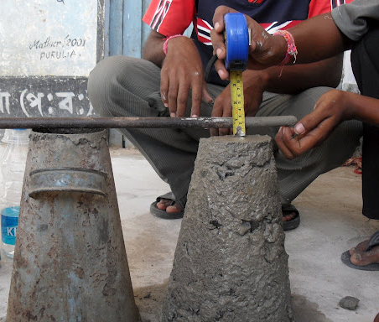
SLUMP TEST
It is used for measuring the workability of fresh concrete and to check the uniformity of concrete from batch to batch.

Slide 14
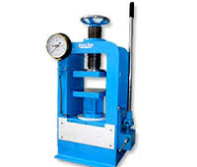
CUBE TEST
This test is done to determine the compressive strength of a given sample of concrete for 7 days and 28 days.
This same equipment is used to perform brick compression test.

Slide 15
Construction Process And
Materials Used
PCC (Plain Cement Concrete): After the process of excavation, laying of plain cement concrete that is PCC is done. A layer of 4 inches was made in such a manner that it was not mixed with the soil.
Laying of Foundation: At our site, Raft foundations are used to spread the load from a structure over a large area, normally the entire area of the structure. Normally raft foundation is used when large load is to be distributed.

Slide 16
Cement: The Bureau of Indian Standards (BIS) has classified OPC in three different grades The classification is mainly based on the compressive strength of cement-sand mortar cubes.
Three types of cement grades
(i) 33 grade
(ii) 43 grade
(iii) 53 grade
AGGREGATE: Aggregate should be hard, strong, dense, durable, clean, and free from clay or loamy admixtures or quarry refuse or vegetable matter.
Two types of aggregates:
(i)Coarse Aggregate: Aggregate which retained on
4.75mm IS Sieve, is termed as coarse aggregate.
(ii)Fine Aggregate: Aggregate which is passed through
4.75 mmIS Sieve is termed as fine aggregate.

Slide 17
Brickwork: Brickwork is masonry done with bricks and mortar and is generally used to build partition walls. In our site, all the external walls and the internal walls were made of bricks.
Strength of brick masonry depends upon the following factors:
(i) Type and strength of brick.
(ii) Mix of motor.
(iii) Size and shape of masonry construction.

Slide 18
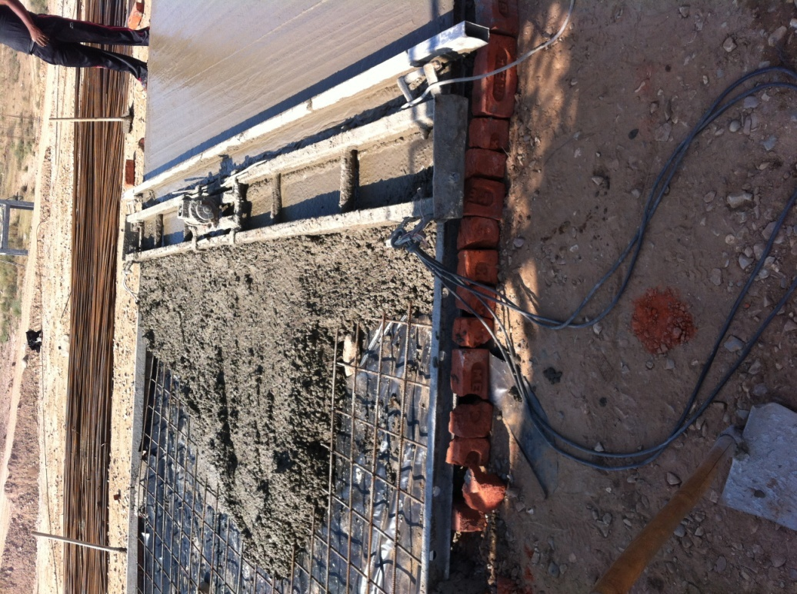
Vacuum Dewatered Concrete Flooring
In this system, concrete is poured in place & vibrated with a poker vibrator. Then a screed vibrator is run over the surface, supported on channel shuttering spaced 4.0 meters apart.

Slide 19
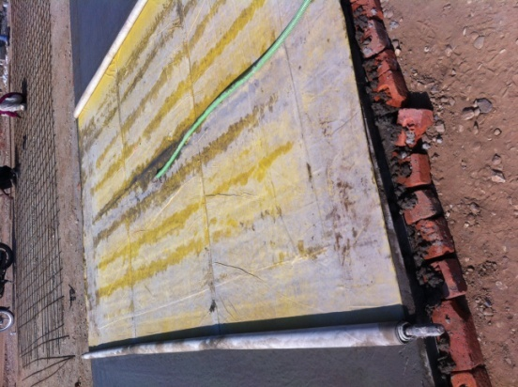
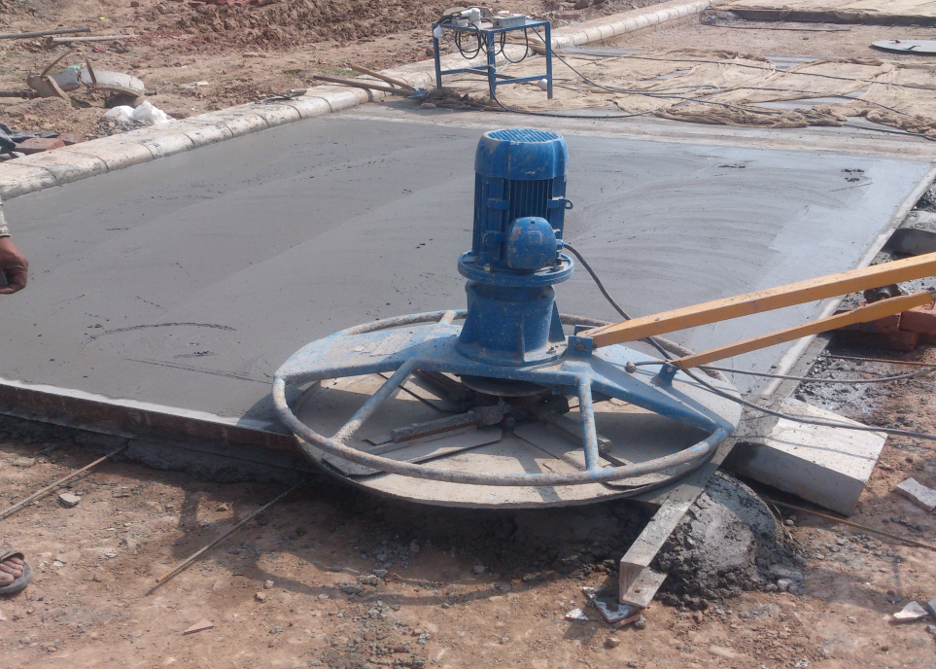
The screed vibrator is run twice to achieve optimum compaction & levelling. After this a system of lower mats & top mat is laid on the concrete layer & this is attached to a vacuum pump. This draws out the excess water.

Slide 20
BENEFITS OF VACUUM DEWATERED FLOORING
Increased Compressive Strength﻿
Increased Tensile Strength
Increased Abrasion Resistance
Minimum Shrinkage
Decreased Cement Consumption

Slide 21
MACHINARY USED AT SITE
WHEEL EXCAVATOR (JCB)
DUMP TRUCKS & TRACTORS
CONCRETE PUMP
TILTED DRUM MIXER
CUTTING , WELDING ,BAR BENDING MACHINE
GEAR BOX CRANE LIFT OR MONKEY HOIST
VIBRATOR AND NOZZEL
SCREEN VIBRATOR

Slide 22
THANK YOU

