Slide 1
Presentation on Industrial Training at ireo waterfront under s.s. construction
VARINDER SHARMA
100370101258
CIVIL ( D4 )

Slide 2

Company Profile
S.S. CONSTRUCTION CO. is an organization in the field of construction for carrying out all types of civil jobs. The company is started by its managing director Mr. S.Suri in the year 1975. And is ably supported by his son Mr. Harsh Suri (B.E.) & Mr. Pawan Kapoor Chief Engineer (M.E.S.). Our Service portfolio extends across the construction of Factories & Manufacturing Facilities, IT Campuses, Bank, Corporate Offices, Schools, Residential Complexes & Hospitals.

Slide 3
OWNERS- Mr. S. Suri , Mr. Harsh Suri and Brig. Pawan Kapoor
PROJECT MANAGER- Mr. Nand Kishore
SITE ENGINEER- Er. Arjun Sharma
FOREMAN- Mr. Nirmal Singh
ONGOING PROJECTS- Construction of Villas at IREO Waterfront
Fortis Hospital at Mall Road , Ludhiana
Construction of Mall in Gurgaon

Slide 4
PROJECT INFORMATION
PROJECT : Construction of independent villas and
Rainwater Harvesting Tank
TYPE OF STRUCTURE : 3 storey R.C.C. buildings
TOTAL COST OF PROJECT : Rs. 28-30 crores (approx.)
COMPANY UNDER WHICH : S.S. Construction Co.
TRAINEE
STIPULATE TIME OF THE : 6 years
WORK
STIPULATE DATE OF START : July - 2011

Slide 5
SEQUENCE OF WORK
SUB-STRUCTURE
SUPER-STRUCTURE
Brickwork
Reinforcements and formwork for columns
Isolated Slope Footing for columns
Construction and laying of plinth bands and beams
Casting of columns
Shuttering for beams and slab
Casting of slab
Staircase
Plastering
Step Footing for load bearing walls

Slide 6
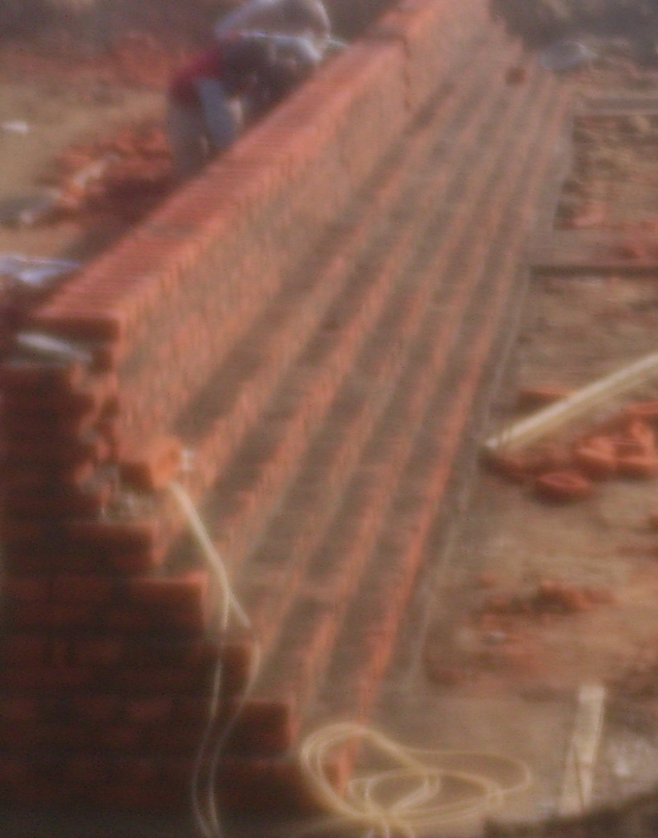
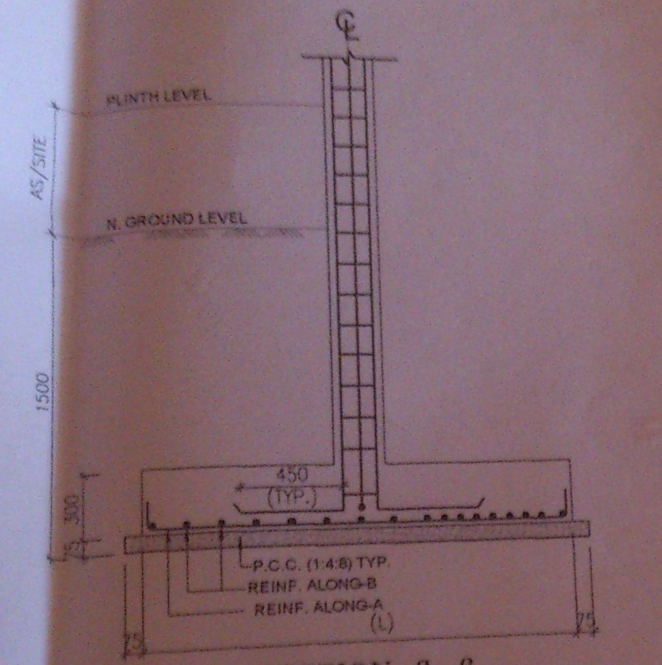
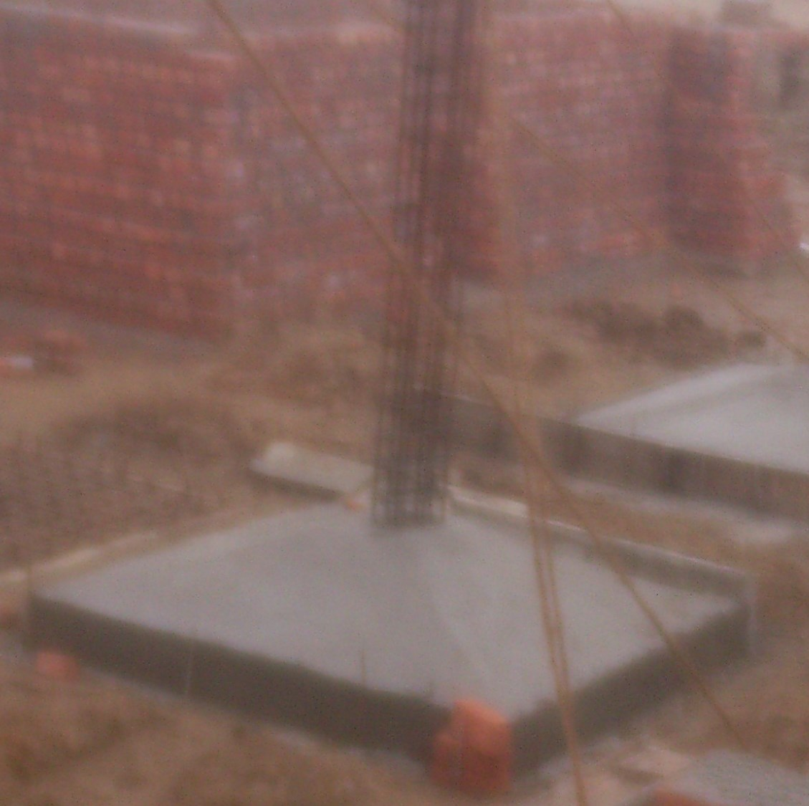
FOUNDATION
1. Step footing for load bearing walls of thickness 9” and 4^{1/2} ”.
2. Isolated slope footing for columns.

Slide 7
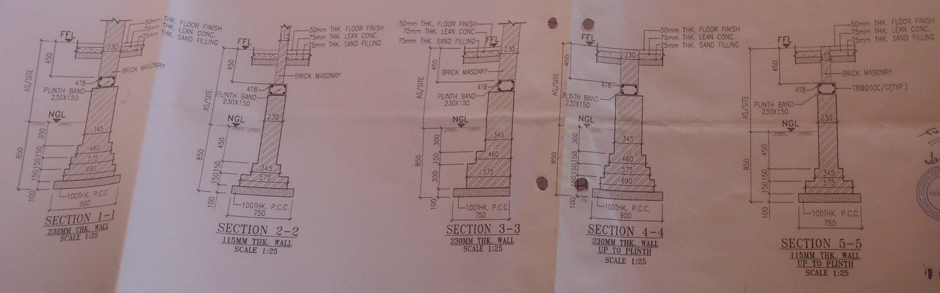

Slide 8
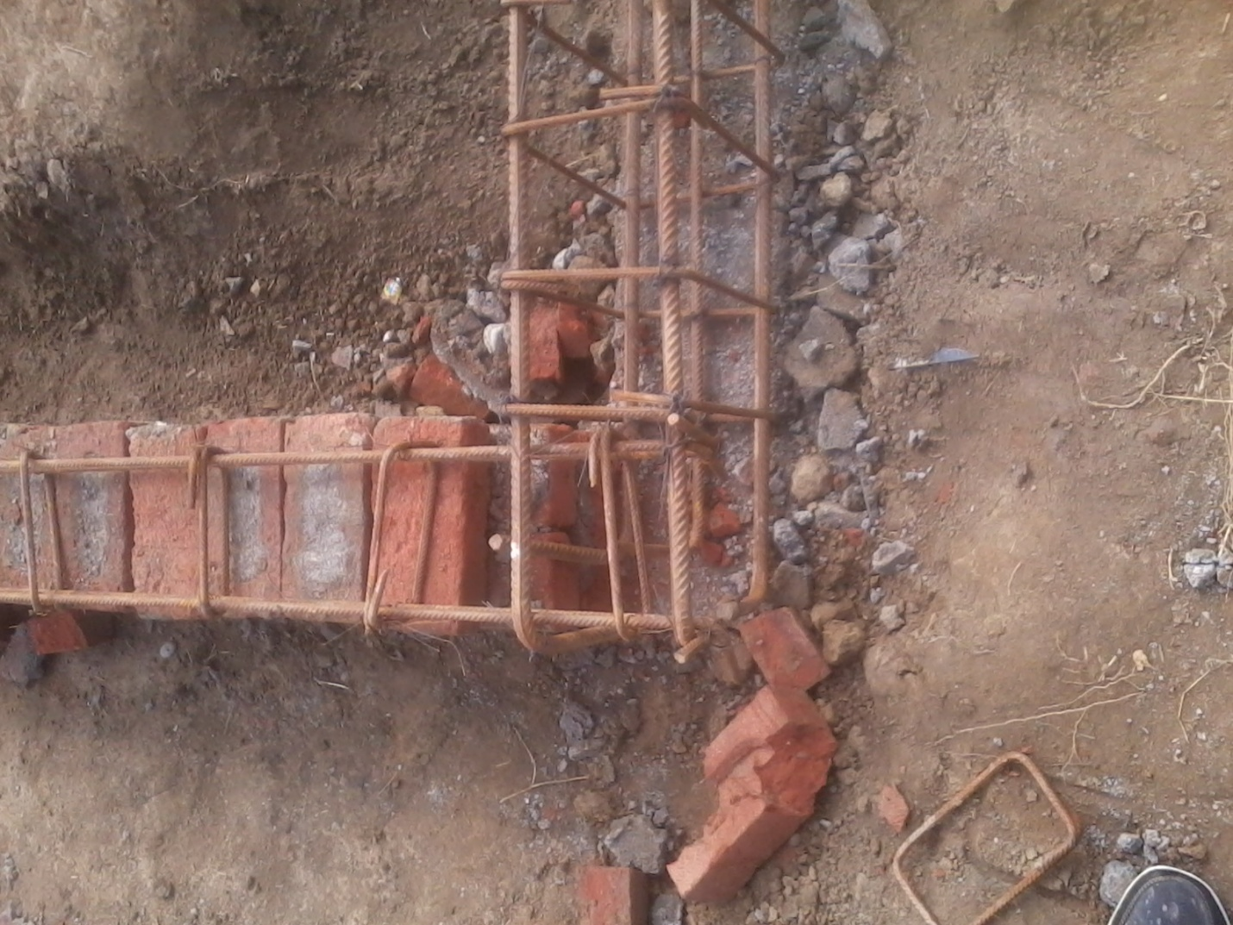
PLINTH BEAMS AND BANDS
They both are laid for 9" wall and 4.5" wall resp. The size of plinth band is 230x150mm. 4 bars of 12mm dia. and ties of 8mm @ 200mm c/c. and mix used in plinth band is of M25 and cover to reinforcement is 20 mm.
Plinth Bands are laid to make the structure earthquake resistance.

Slide 9
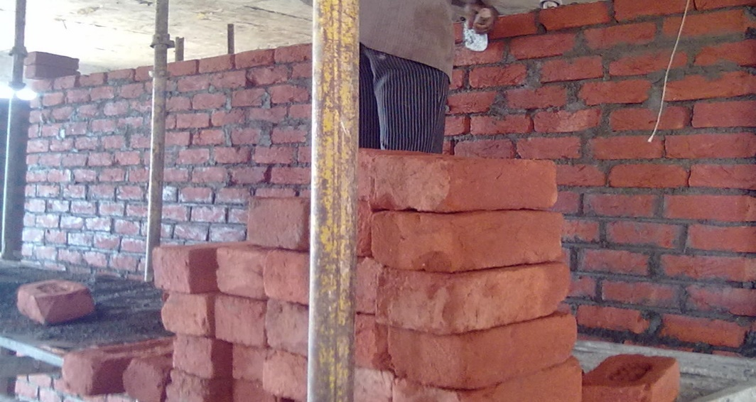
BRICKWORK
Brickwork is masonry produced by a bricklayer, using bricks and mortar. Typically, rows of bricks called courses are laid one on top of another to build up a structure such as a wall Brickwork is done by using grade .A bricks and mortar of 1:4 ( cement : sand) . Tools used are trowel , plumb bob and levelling tube.

Slide 10
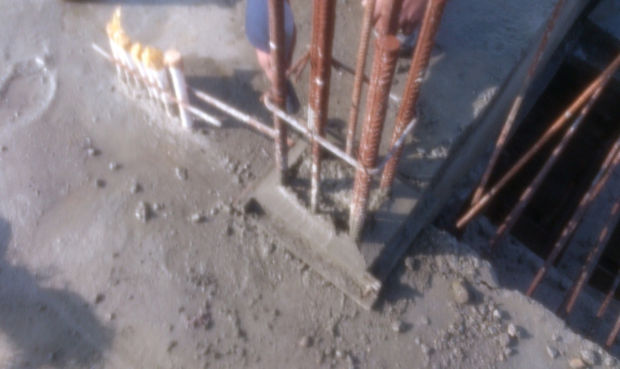
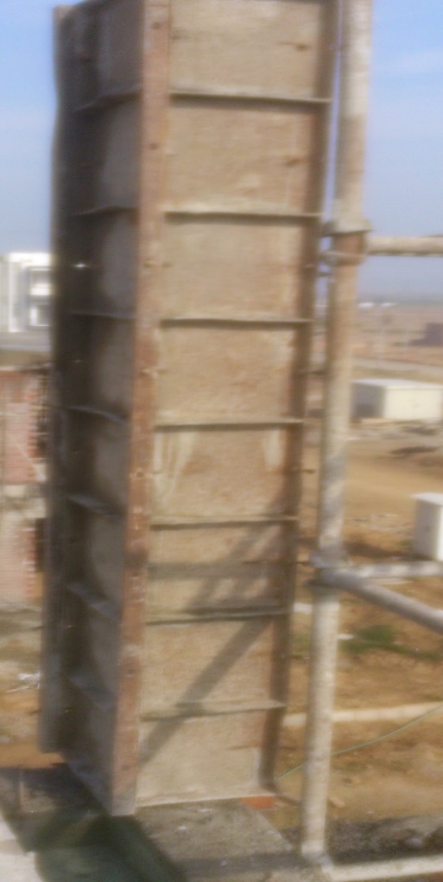
COLUMN
A column in structural engineering is a vertical member that transmits , through compression, the weight of the structure above to other elements below. Concreting of columns are done with M25 mix and cover to reinforcement was 40 mm . The dia. of bars used in columns are 16 mm, 12 mm and 25mm and ties are of 8 mm dia.
Starter is used to support the formwork for column.
Shuttering of column done for concreting with plates of size 1’x4’.

Slide 11
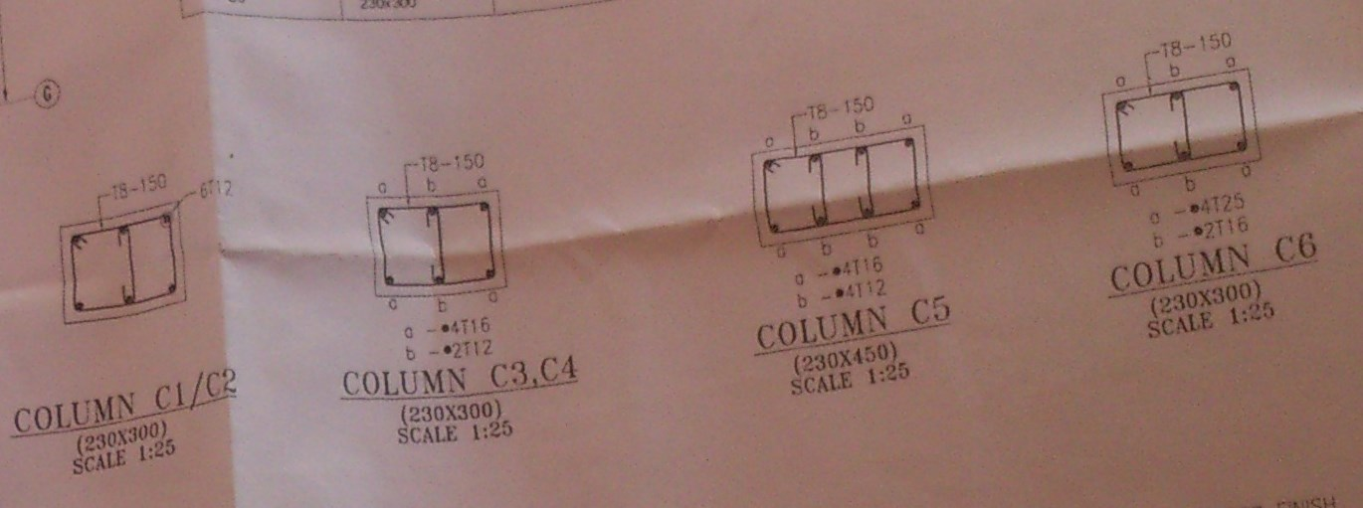

Slide 12
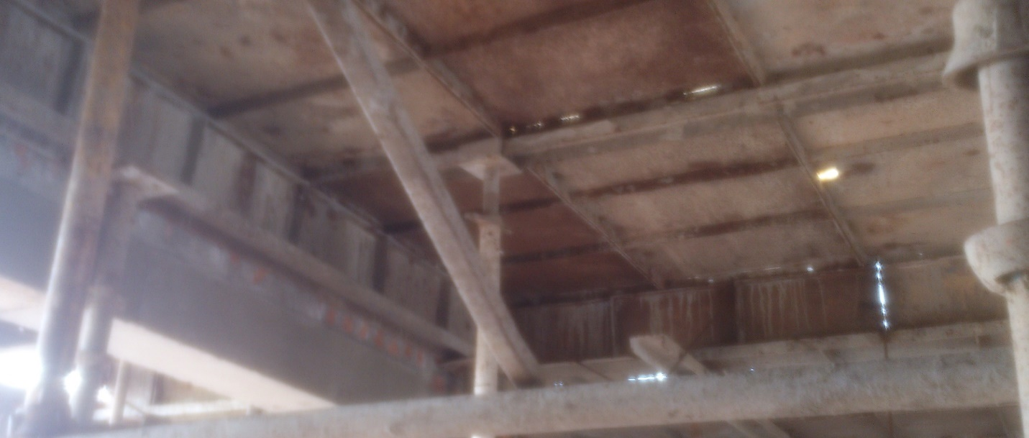
Shuttering for slab
Steel shuttering is used at site for columns, beams and slabs.The size of plates used is 2’x4’. The plates are used for concreting purpose and it is removed after 14 days.

Slide 13
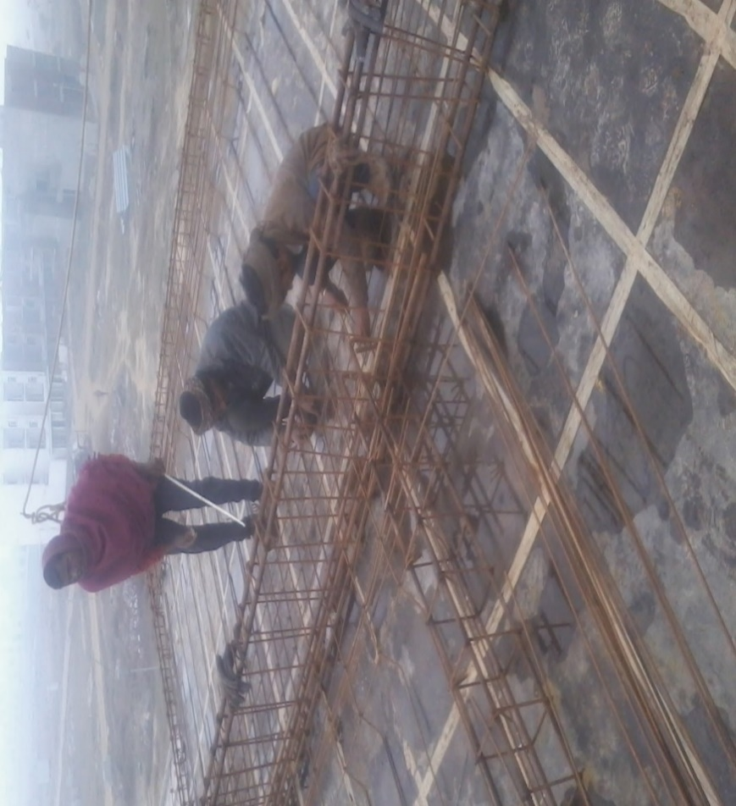
BEAM
Beam is a structural member which transfers load through bending & shear only. Beam transfers load from slab to the column & footing.
The dia. used is 8mm for ties and 12mm to 25mm for main reinforcement and clear cover was 25mm.

Slide 14
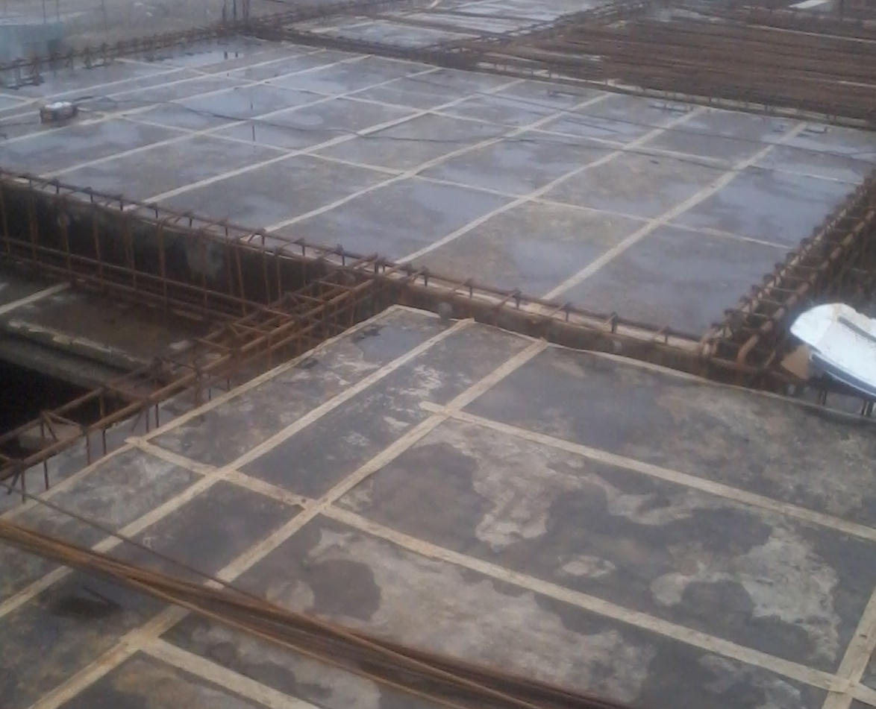
SLAB
Slab is a horizontal flat member which is supported on columns & beams, which further transfers the load to the foundation.
Slab details:-
Grade of steel Used = Fe 500
Concrete Grade Used = Design Mix
Thickness of slab = 150mm
Diameter of Bars used =10mm and 8mm
Clear cover = 20mm

Slide 15
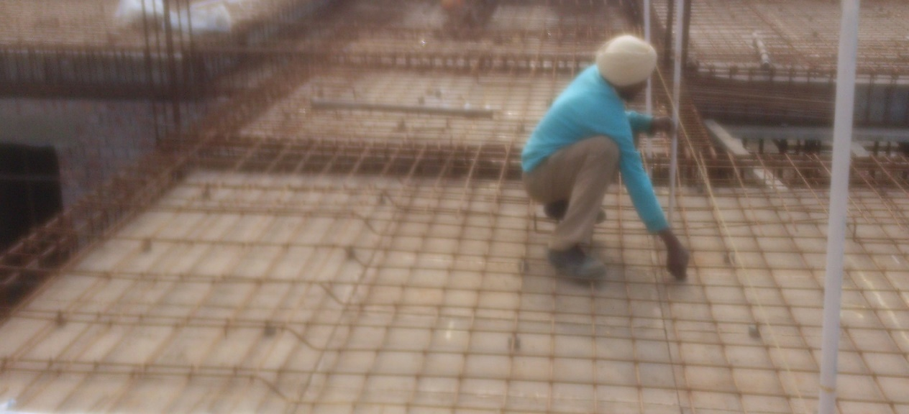
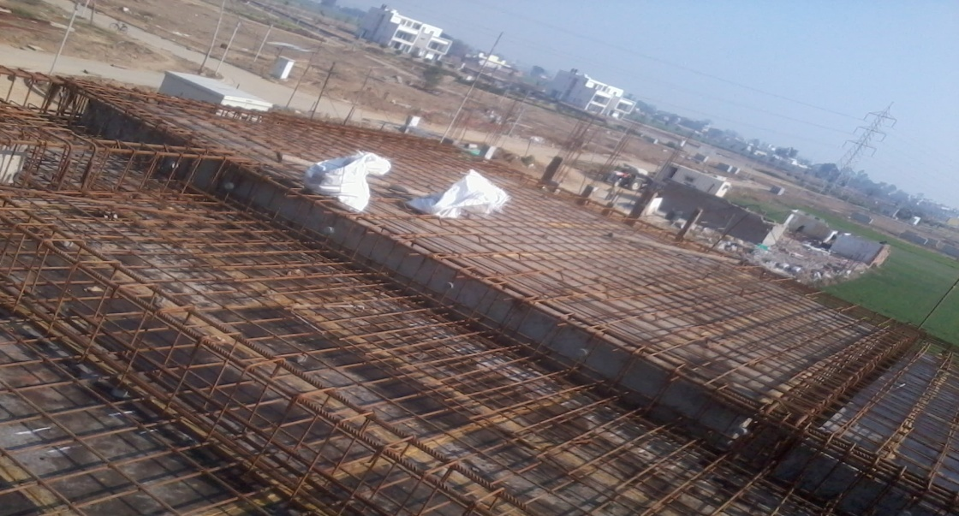
Levelling of shuttering plates-
It is done using threads by tide it with bars at desirable height (2 ft) and then using stick of marked height (2ft), level of each plate is checked.
Slab reinforcement is laid after shuttering.

Slide 16
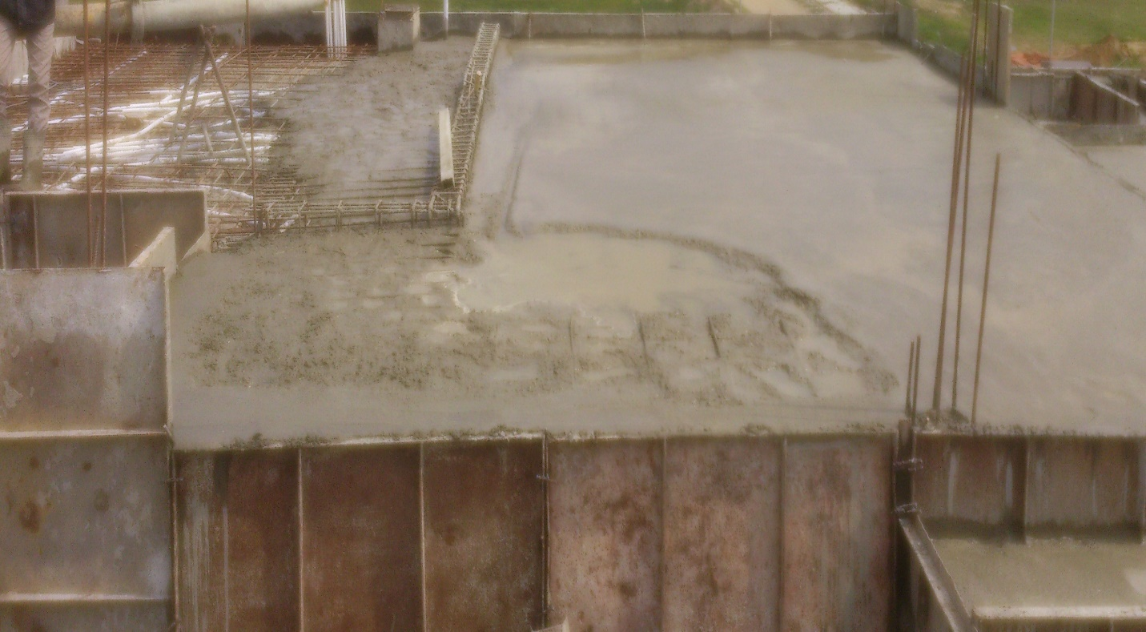
Concreting is done after reinforcement has been laid.

Slide 17
STAIRS
Staircase or simply stairs are names for a construction designed to bridge a large vertical distance by dividing it into smaller vertical distances, called steps. Stairs may be straight , round or may consist of two or more straight pieces connected at angles.
The step is composed of the tread and riser.
The type of stairs used at the site are Fold Back stairs.
Details of Staircase:-
Grade of Steel Used = Fe 500
Concrete Grade Used = M 25
Diameter of Bars Used = 12mm, 10mm and 8mm
Tread = 300mm ; Riser = 150mm and Width of stairs = 1100mm

Slide 18
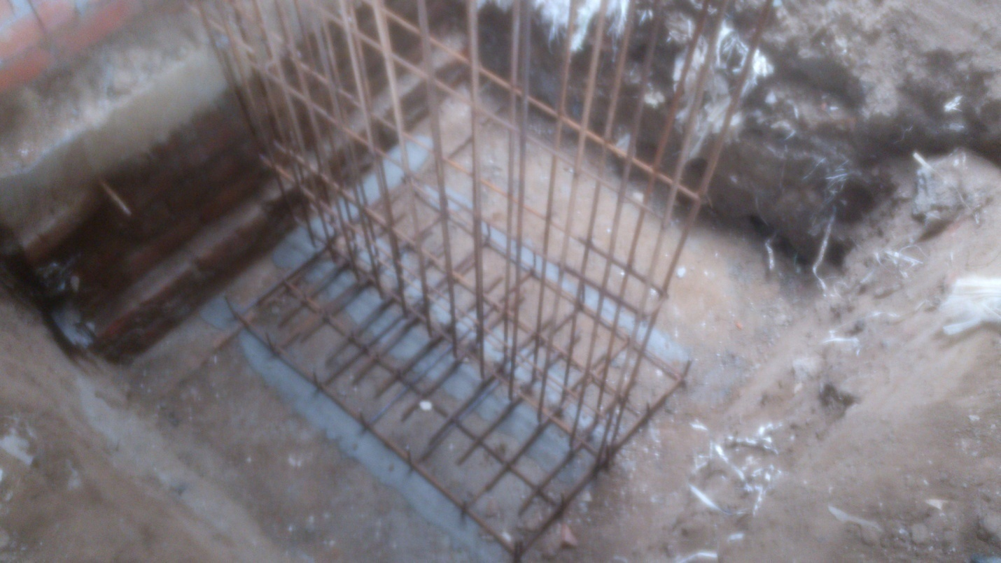
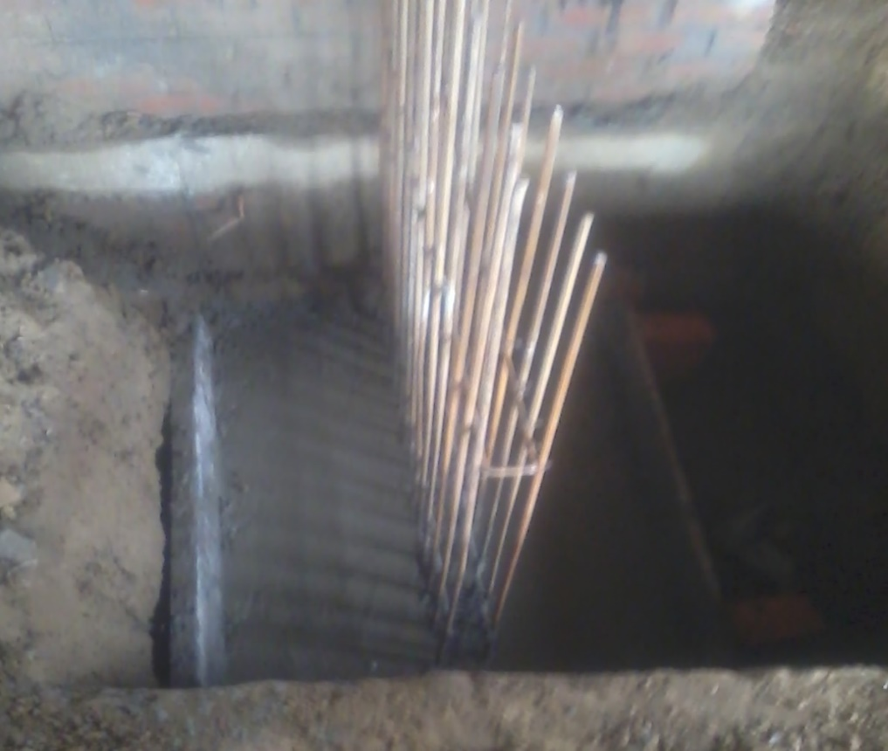
Step wise construction:-
First by marking from drawing, PCC of ratio 1:2:4 is laid.
Concreting is done in the base of thickness 200mm.

Slide 19
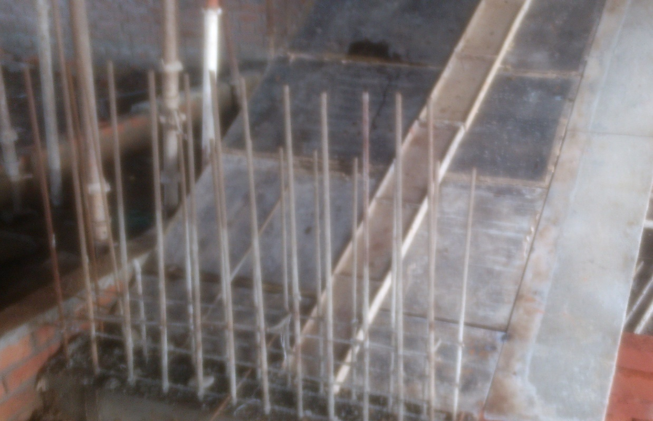
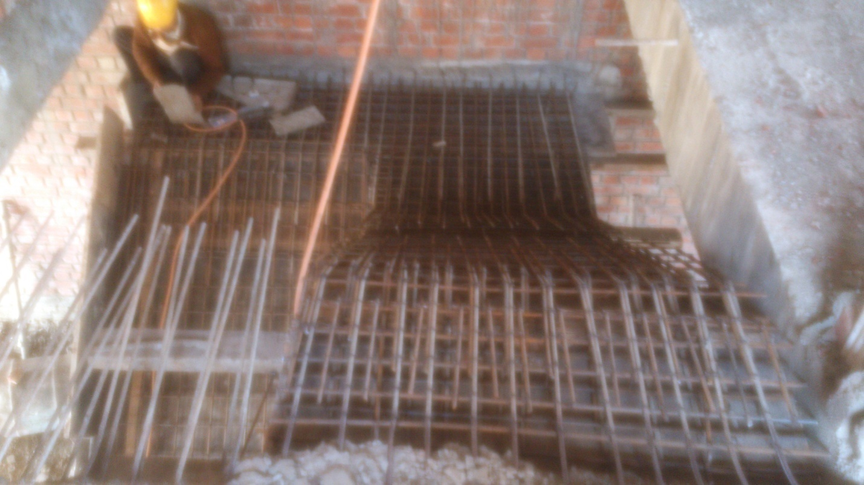
Shuttering of stair case with plates .
Stair reinforcement is laid. Bars used are of diameters 8mm @ 200mm c/c and 12mm @ 125mm c/c in horizontal and vertical direction resp.

Slide 20
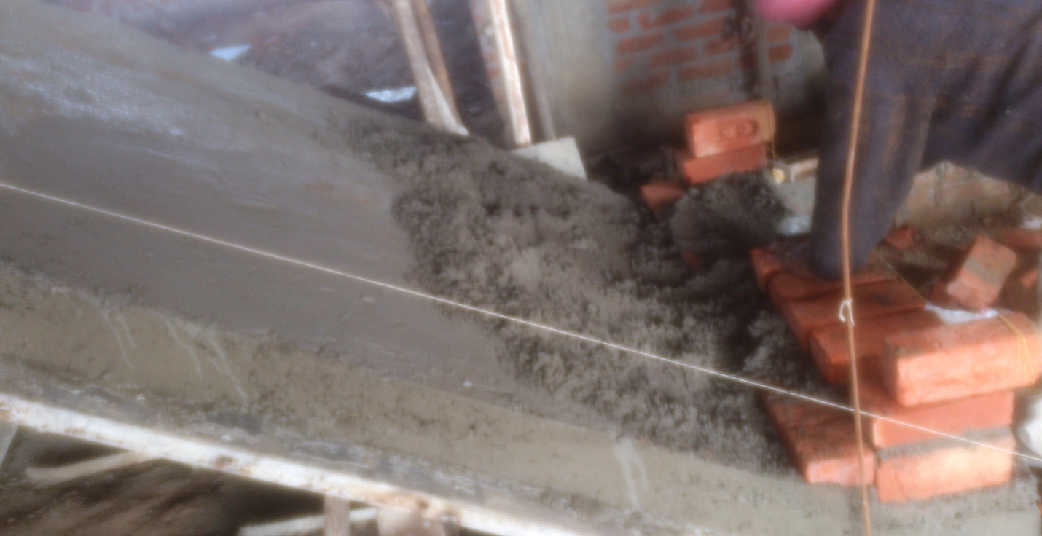
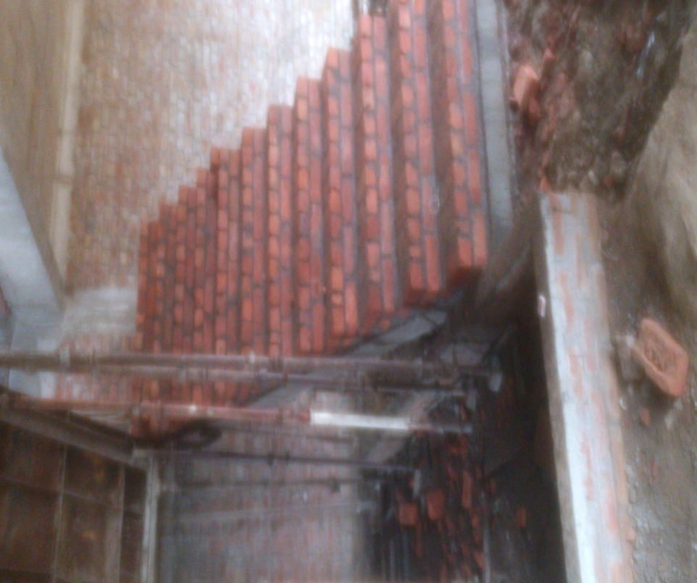
The thickness of concrete layer is 150mm. Brickwork is done using mortar of ratio 1:4 (cement: sand).
Here, the brickwork is completed.

Slide 21
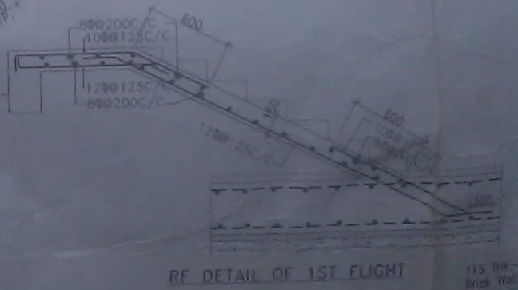

Slide 22
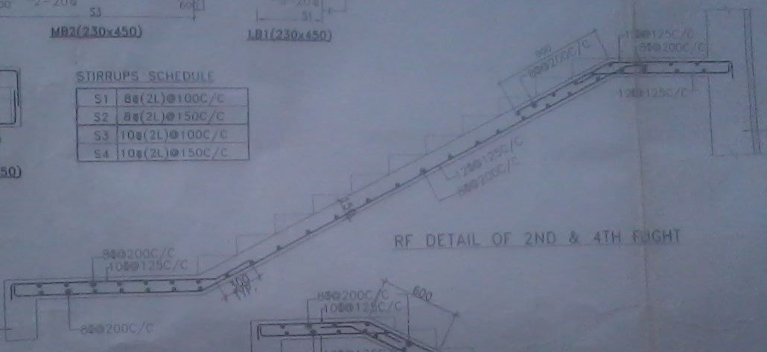

Slide 23
PLASTERING
Plastering is the process of covering rough surfaces of walls , columns , ceilings and other building components with thin coat of plastic mortars to form a smooth durable surface . The coating of plastic material is termed as plaster . Plastering on external exposed surfaces is known as rendering.
Tools used for plastering:- Gauging trowel , float , floating rule , plumb bob , spirit level , set square , straight edges brushes etc.
At the site, cement mortar is used for plastering work in 1:4 (cement: sand ) . The thickness of mortar at outer surface was 20 mm and at inner surface was 8 mm.

Slide 24
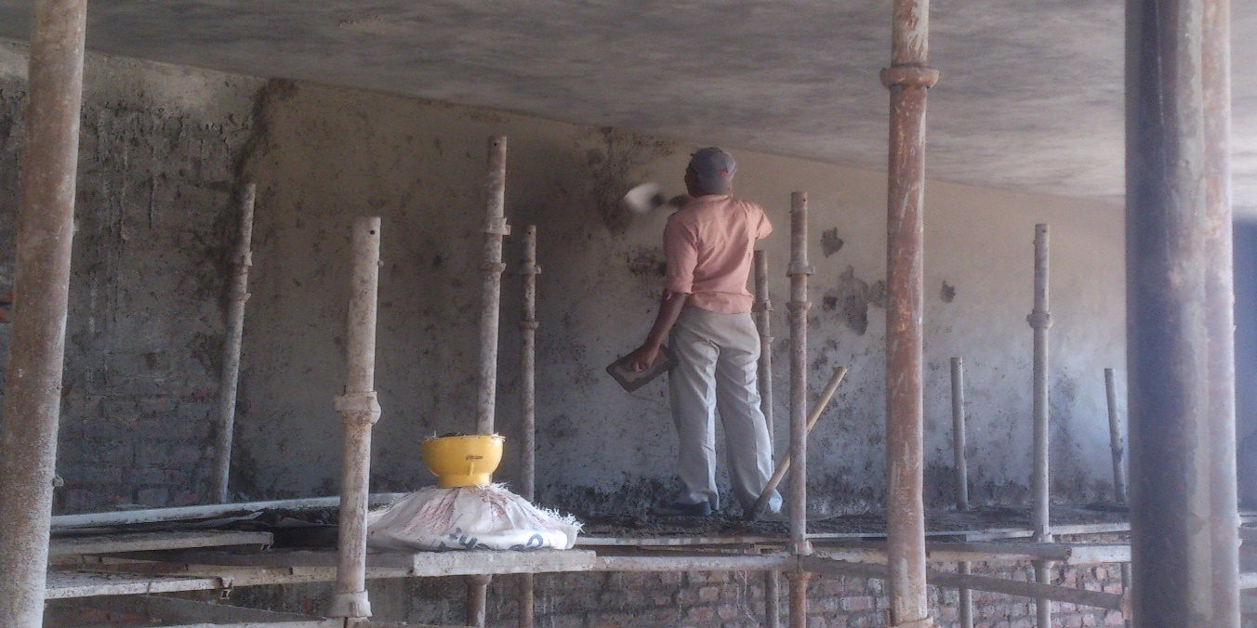
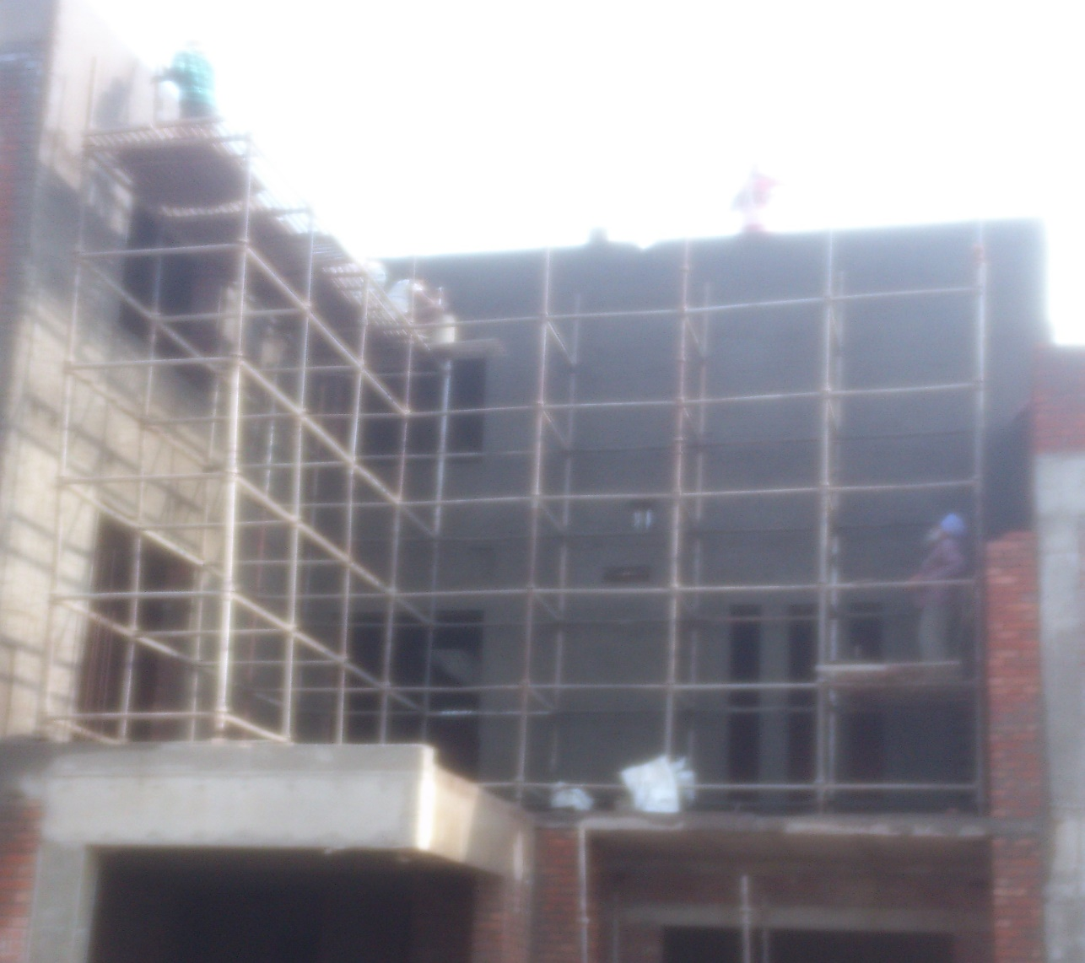
Plastering at inner surface.
Plastering at outer surface.

Slide 25
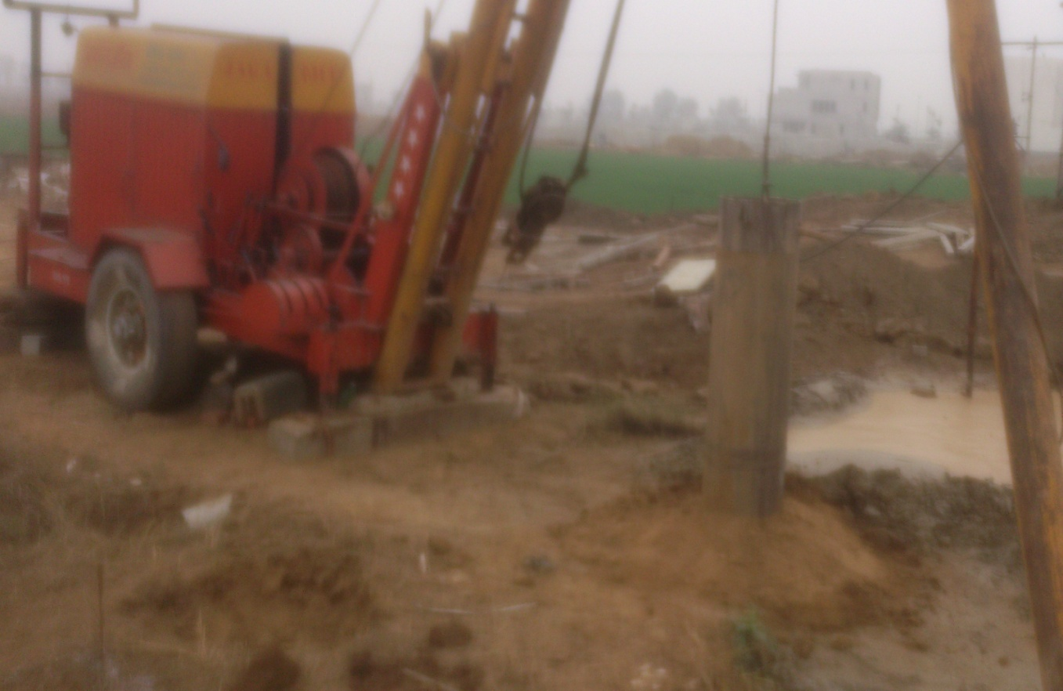
Rain Water Harvesting Tank
Rainwater harvesting tank is used for the accumulation and deposition of rainwater for reuse. Uses include water for gardening, livestock, irrigation etc. The harvested water can be used as drinking water as well as for storage and other purpose.
Step wise construction-
Holes are bored with the help of boring machine to lay PVC pipes.

Slide 26
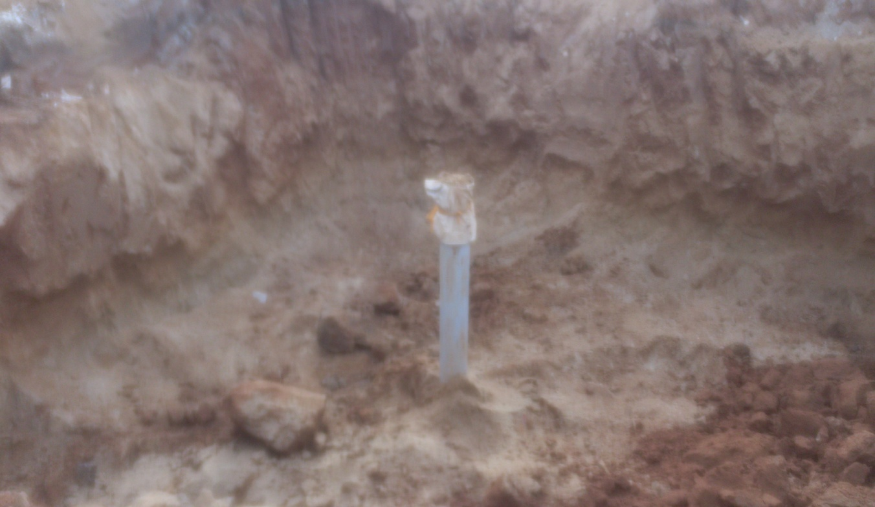
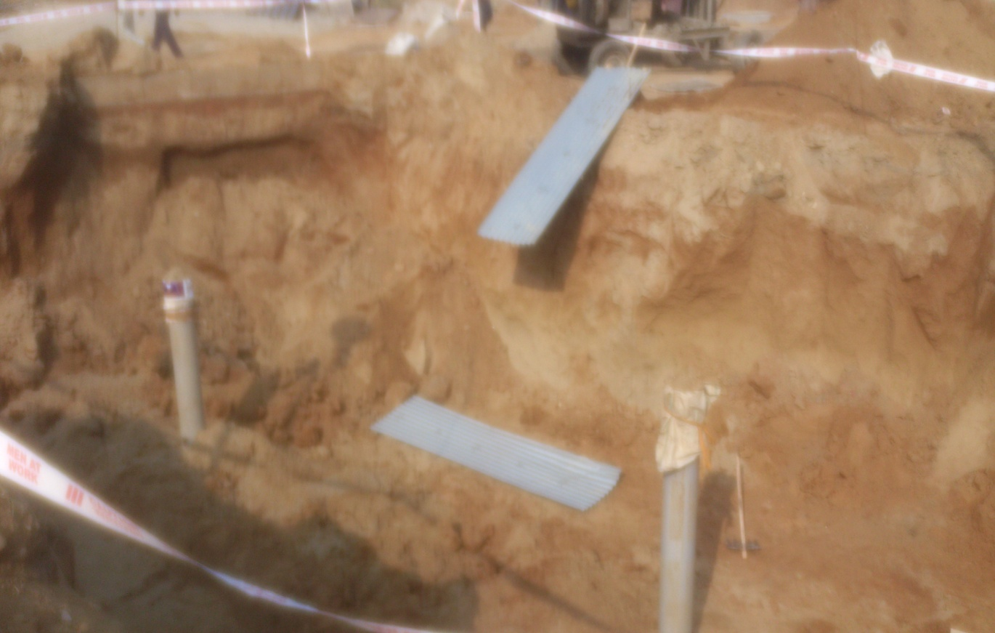
250mm dia. OD uPVC pipes are laid to allow water to enter.

Slide 27
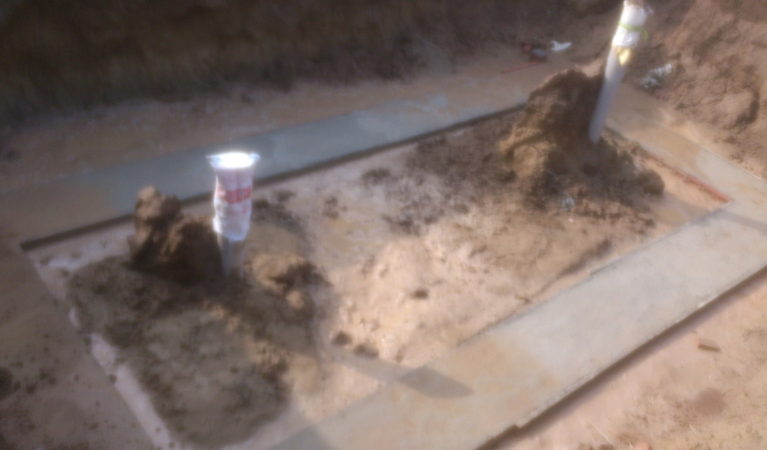
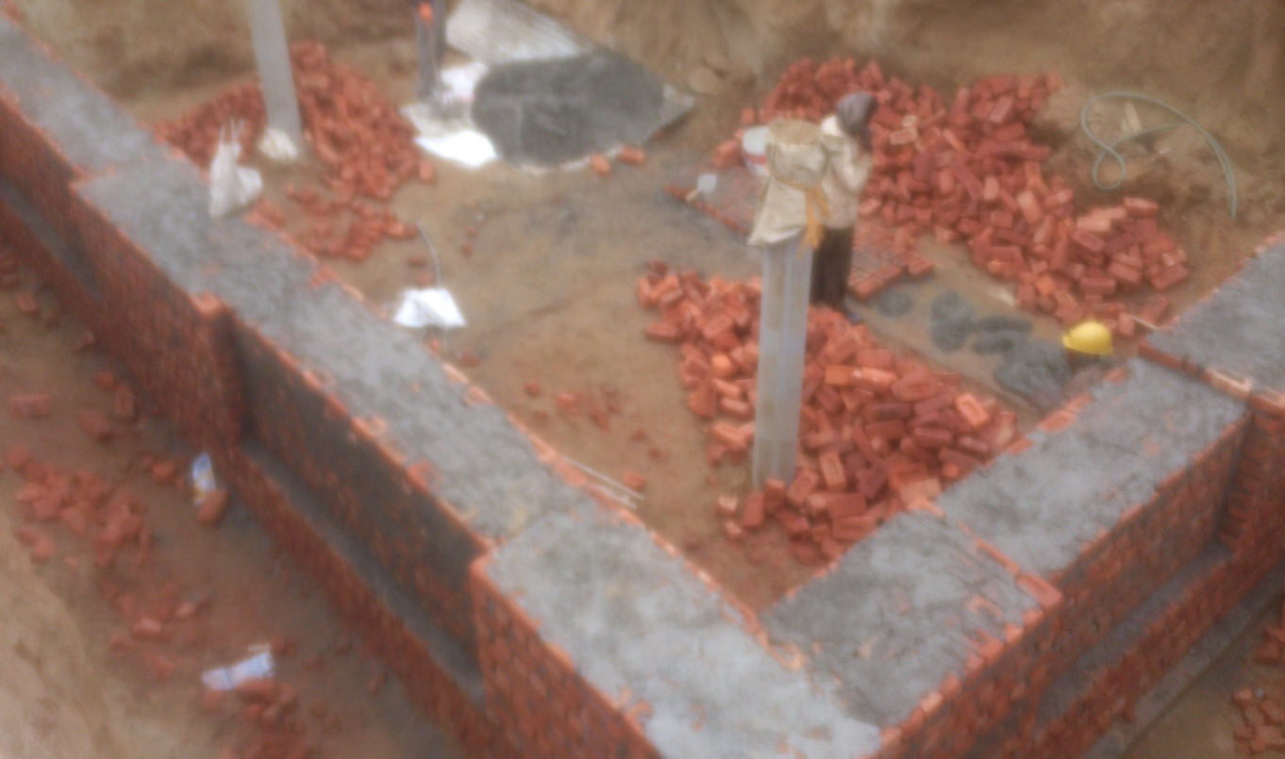
PCC laid is of mix 1:4:8 and its thickness is 100mm.
Brickwork (class 7.5) done for the structure with 1:4 cement mortar (cement:sand).

Slide 28
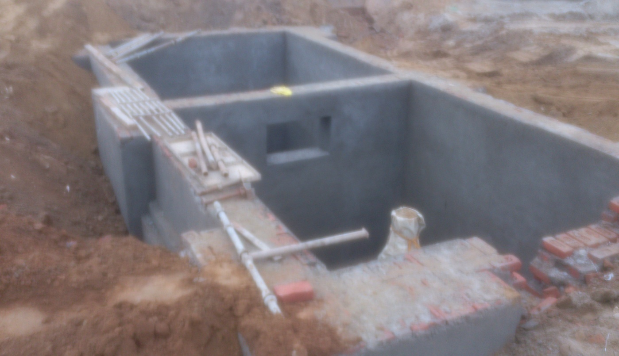
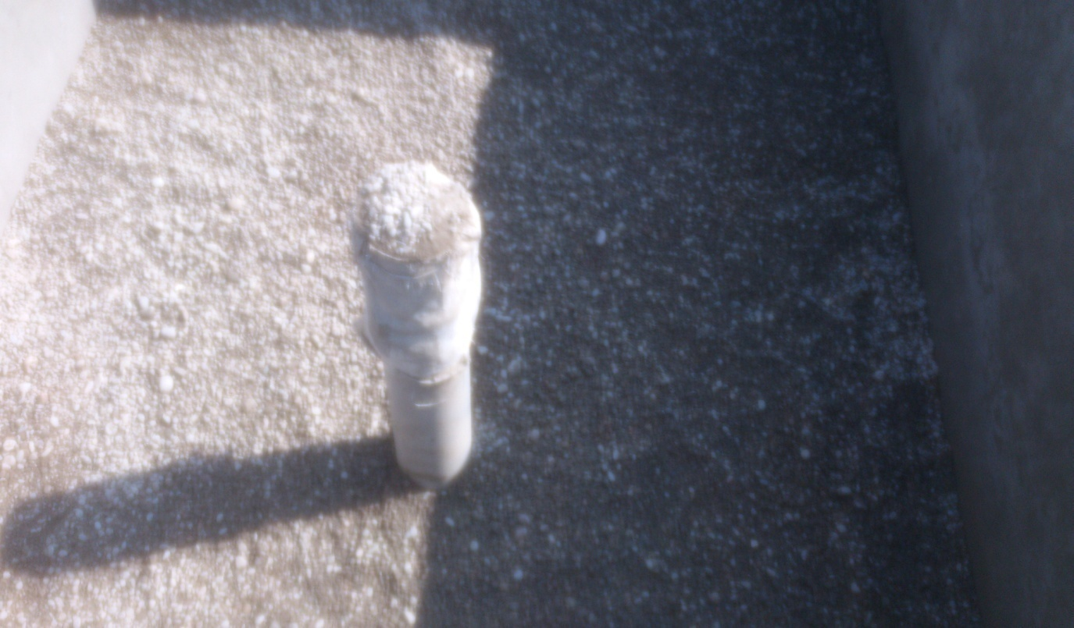
Water Proof Plastering of 15mm thickness done after the brickwork (1:3) inside and outside . The depth of tank is 3m.
Boulders (40-65mm), gravel (10-20mm) and coarse sand (1.5-2mm) are spread resp. from bottom in layers for filtration process.

Slide 29
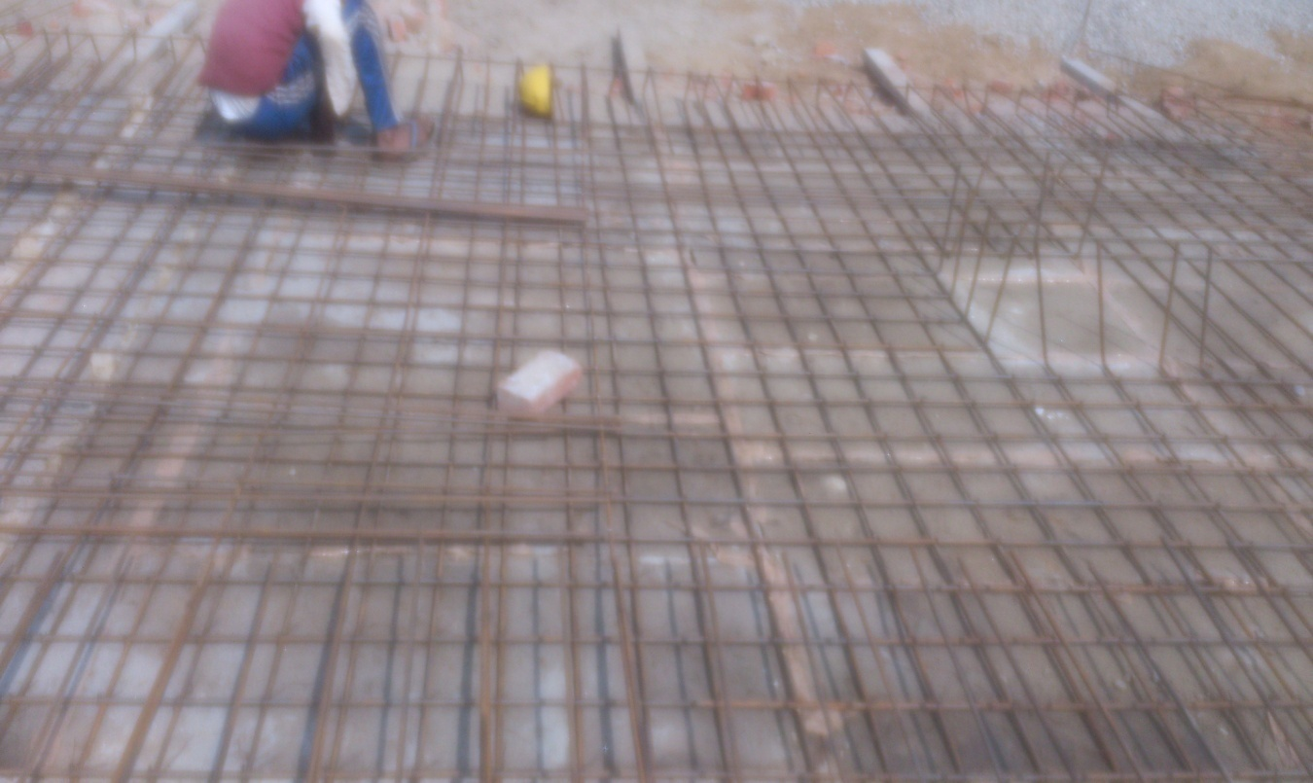
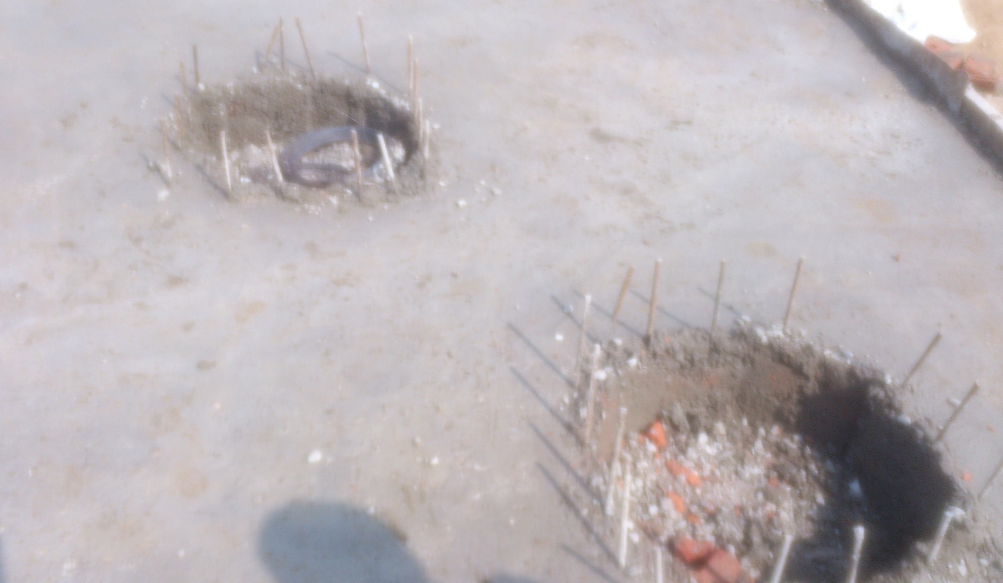
Reinforcements laid for the cover of grade FE 415.
Clear cover for reinforcement is 25mm from bottom of slab.
Top slab after concreting of grade M25.
560mm dia. SFRC removable manhole cover is used.

Slide 30
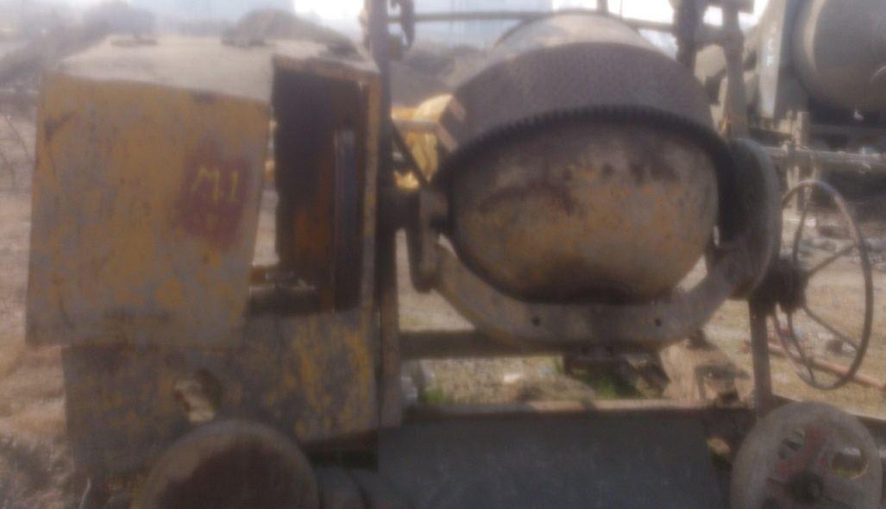
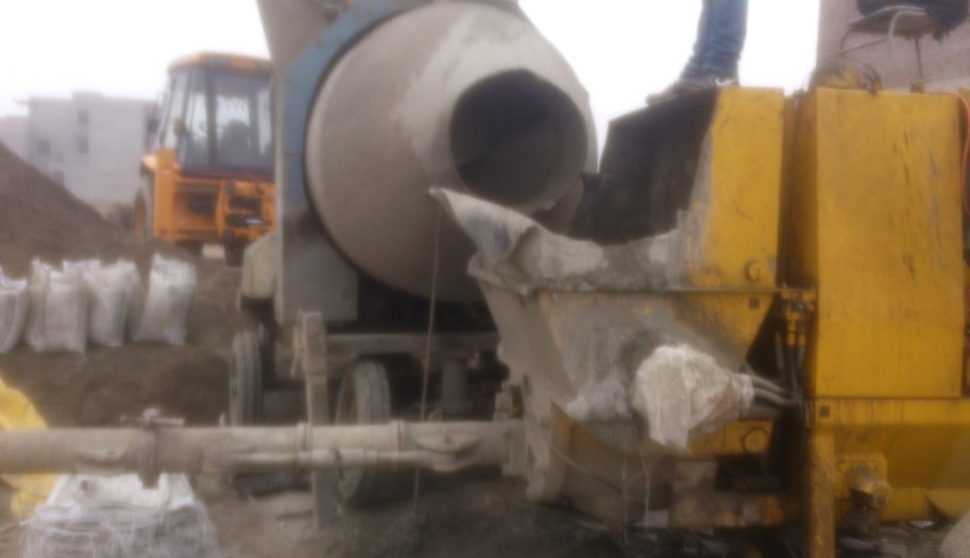
CONCRETING OPERATION
Materials - Cement, sand and aggregates are the materials used for concreting operation.
2. Batching - In order to ensure uniformity in the quality of concrete, it is necessary that all materials that go into its production are measured accurately.
In casting of slab at site, design mix was used. At one time, 200kg. Of cement, 400kg. Sand and 360 kg. each of 10mm and 20mm aggregates are taken.
3. Mixing – The process of rolling, folding and spreading of particles is known as mixing of concrete.
Tilting Drum Mixer
Non-Tilting Drum Mixer

Slide 31
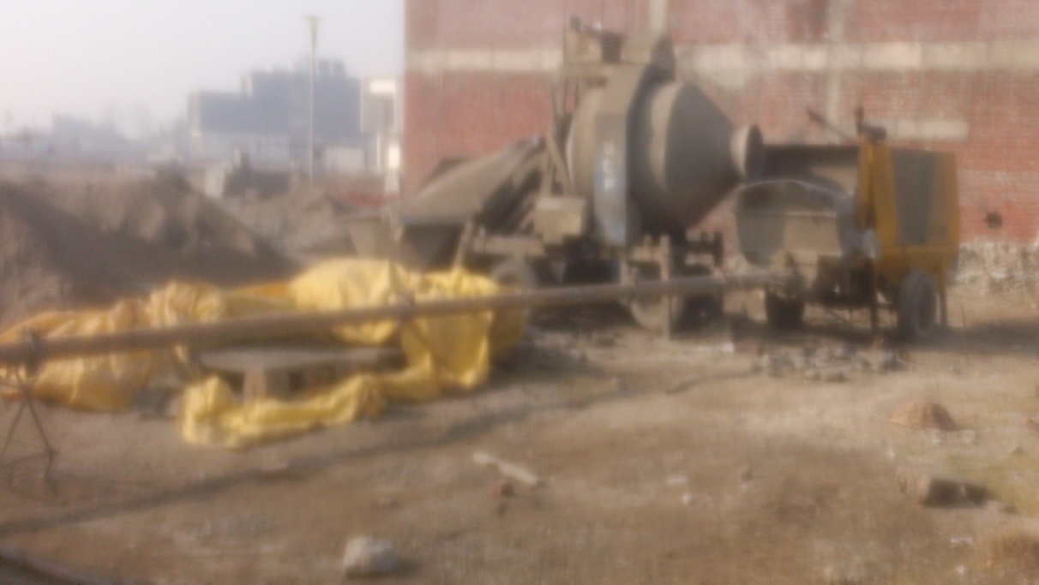
4. Transportation:- The concrete as it comes out of the mixture or as it is ready to use on the platform, is to be transported and placed on the formwork.
Pumping with pressure is used to transport the concrete with the help of pipes.
Placing:- Concrete should be placed and compacted immediately after mixing. Placing and compaction are the most critical field activities.
6. Compaction - Compaction of concrete should proceed immediately after placing. The function of compaction of concrete is to expel the air bubbles in the mass and make it impermeable enough to attain desired strength.

Slide 32
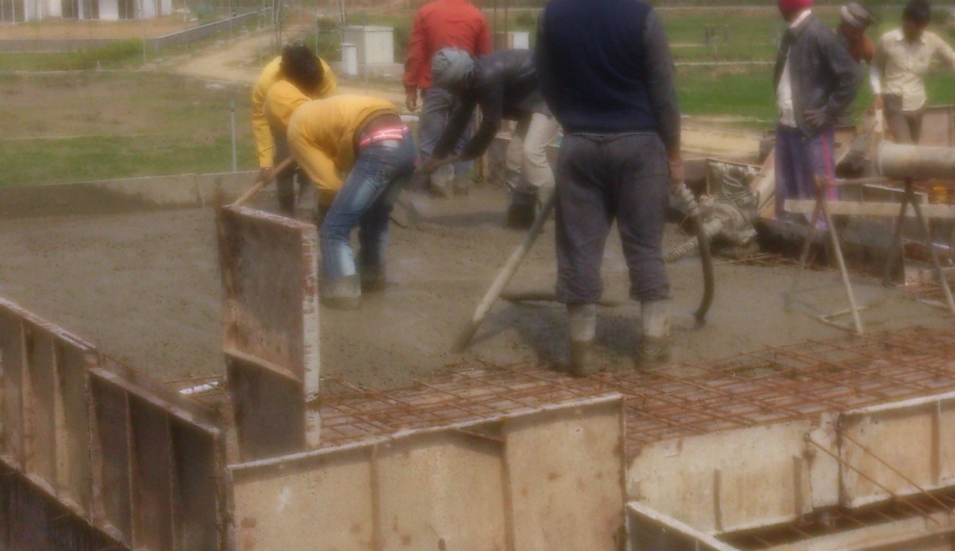
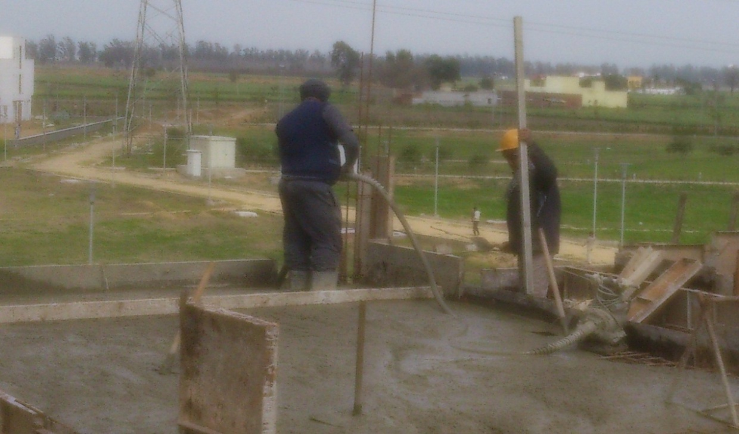
Placing of concrete
Needle vibrator was used at the site.
7. Curing - The concrete surfaces are kept wet for certain period after placing of concrete so as to promote the hardening of cement . It consists of a control of temperature and of the moisture from and into the concrete.

Slide 33
DUTIES ASSIGNED
As a trainee on the site, my duties at the site were as follows:-
1. Our main work was the quality testing of various building materials such as bricks, concrete and soil.
2. To help the site engineers & site incharge in performing different tasks at the site.
3. Supervision of work.
4. To learn & perform the layout operations of the different structural components with the help of drawings.
5. To know about the constructional techniques of the components of structure.

Slide 34
TESTS ON MATERIALS
At the site, we have carried out field tests on following materials:-
1. Concrete
2. Bricks
3. Soil
Test on concrete (Compressive Strength Test) :- This test is done to determine the compressive strength of a given sample of concrete for 7 days and 28 days and at our site we have done this test everyday whenever concreting of column , footing and slab is done.
Moulds are generally of the size 150mm x 150mm x 150 mm with nuts and bolts arrangements, 600 mm long rod of diameter trowel, iron pad are required.
The concrete should attain minimum 75% of total strength after 7 days. The mould is neatly oiled from inside. Required quantity is taken out of mixture in the iron pan. The mould is filled in 3 layers with concrete and each layer is tamped 25 times by 600 mm with long rod of diameter 16mm. Top surface is finished with the help of trowel at a time. After 24 hrs., cubes are taken out of moulds and kept in water for 7 and 28 days for curing.
Out of six cubes, 3 are tested after 7 days and remaining after 28 days.

Slide 35
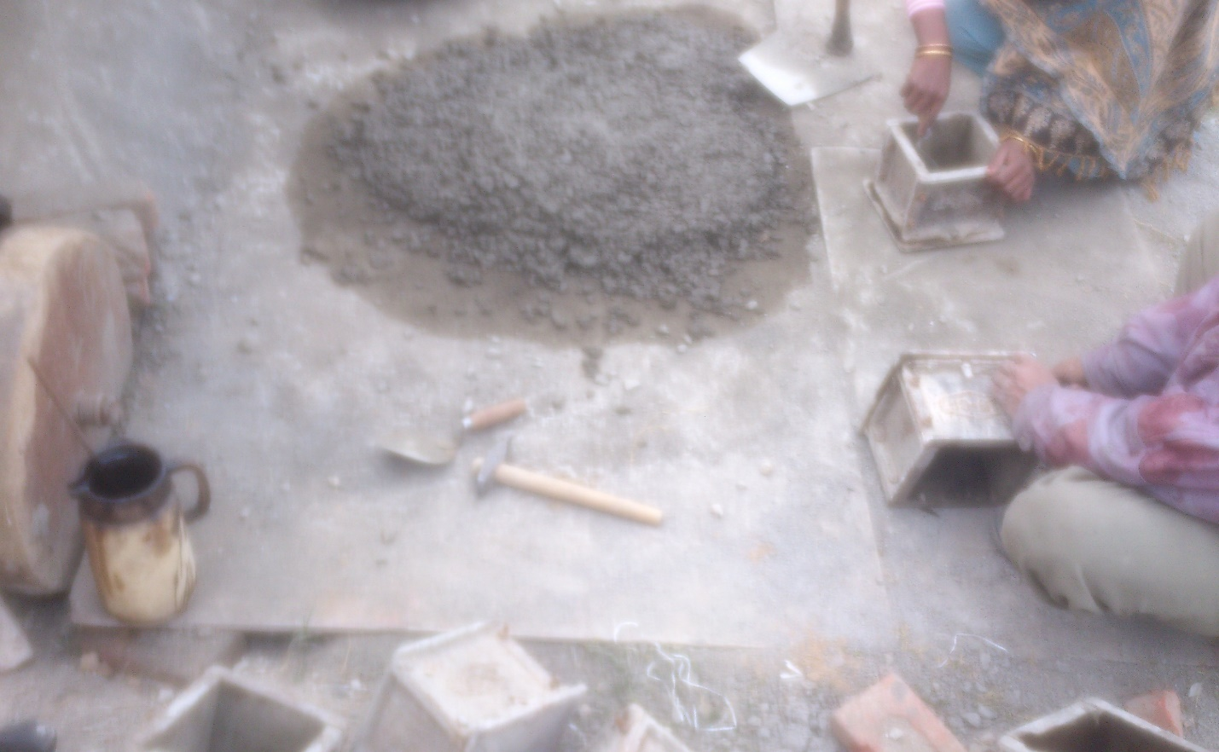
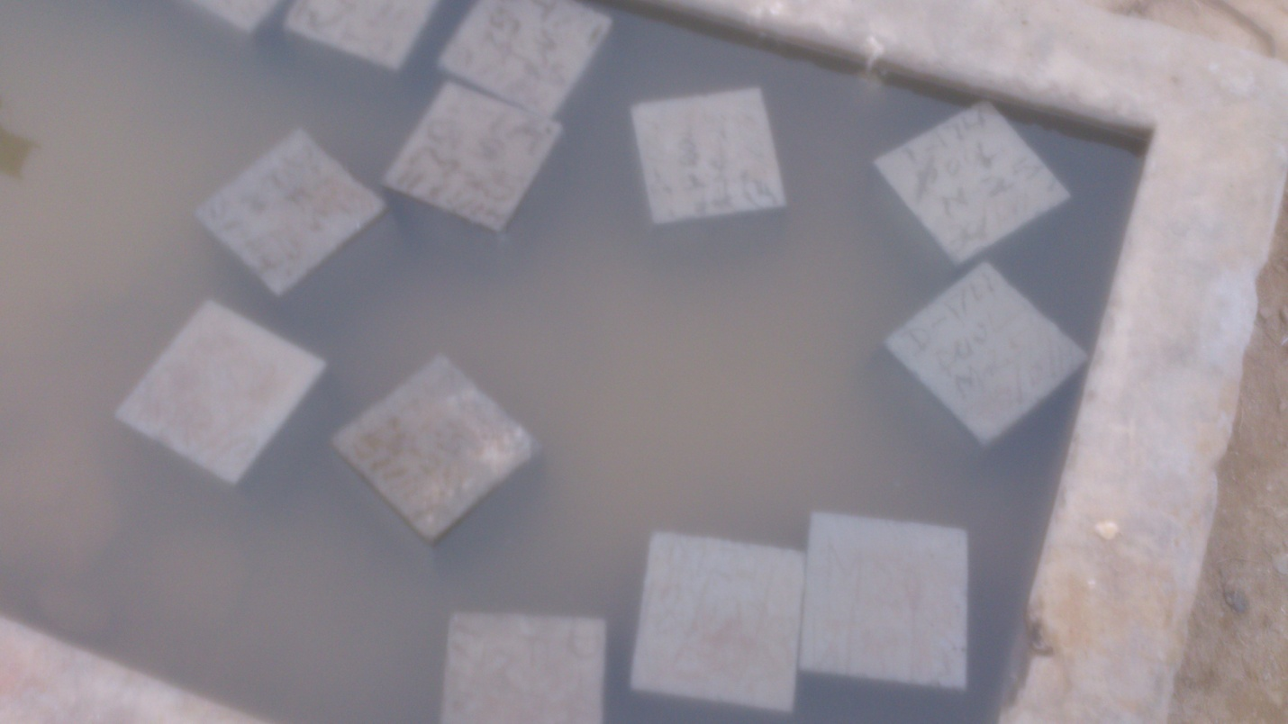
Preparation of cubes for testing.
Curing of cubes for 7 days & 28 days testing.

Slide 36
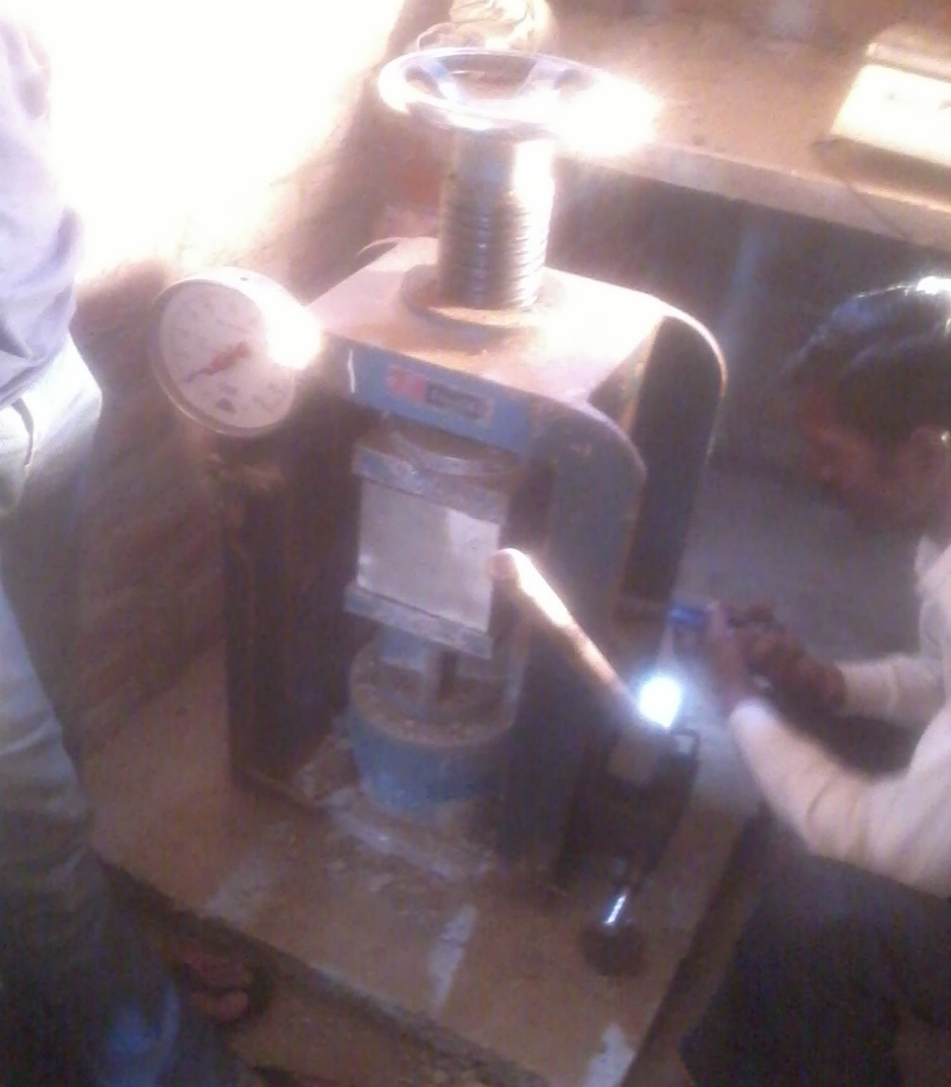
S.NO. | VILLA TYPE | DATE OF CASTING | LOAD (N) | COMPRESSIVE STRENGTH(N/mm²)
1. | D-145 | 01/03/2014 | 570000 | 25.33 (28 DAYS)
2. | D-145 | 01/03/2014 | 600000 | 26.60 (28 DAYS)
3. | D-145 | 01/03/2014 | 520000 | 23.11 (28 DAYS)
4. | TS-152 | 13/03/2014 | 290000 | 12.88 (7 DAYS)
5. | TS-152 | 13/03/2014 | 330000 | 14.66 (7 DAYS)
6. | TS-152 | 13/03/2014 | 350000 | 15.50 (7 DAYS)
Compressive Strength Testing Machine
Result of cubes test
TS stands for terrace slab Size of Cube = 150x150x150 mm

Slide 37
Test on Soil (Standard Procter Test):- To access the amount of compaction and water content required in the field, compaction tests are done on the same soil in the laboratory. The test provides the relationship between the water content and dry density. The water content at which maximum dry density is attained is known as optimum moisture content.
Equipments required for test:-
1. Mould of 100 mm dia., 127.3mm height and 1000 cc capacity.
2. Hammer of 2.6 kg weight and free fall of 310mm.
3. Coller of 60 mm height.
4. A sieve of size 4.75 mm.
Bulk Density = Mass of soil/ Volume of mould (gm/cc)
Dry Density = Bulk Density/ (1+ Water Content)

Slide 38
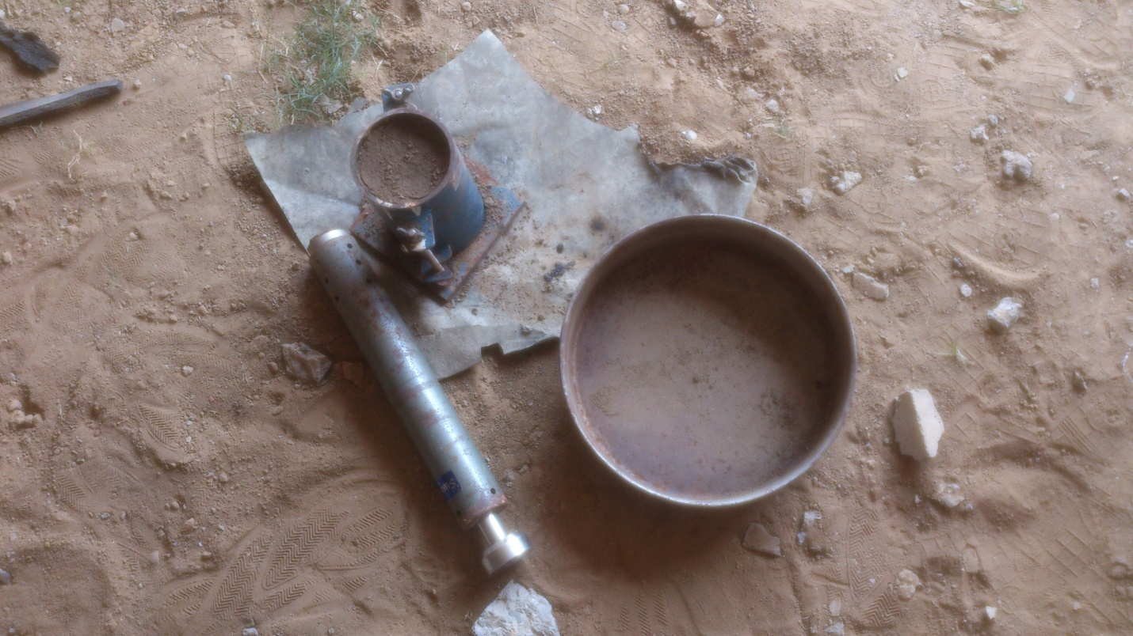
Apparatus for the test

Slide 39
Result of Standard Procter Test
S.NO. | PARTICULARS | UNIT | 1 | 2 | 3 | 4 | 5
1. | Volume of mould | c.c. | 1000 | 1000 | 1000 | 1000 | 1000
2. | Mass of mould | gm. | 5072 | 5072 | 5072 | 5072 | 5072
3. | Water content | % | 2 | 4 | 6 | 8 | 10
4. | Mass of mould &compacted soil | gm. | 7583 | 7732 | 7988 | 8180 | 7894
5. | Mass of compacted soil | gm. | 2511 | 2660 | 2916 | 3108 | 2822
6. | Bulk density of soil | gm/cc | 2.511 | 2.660 | 2.916 | 3.108 | 2.822
7. | Dry density of soil | gm/cc | 2.462 | 2.558 | 2.750 | 2.870 | 2.560

Slide 40
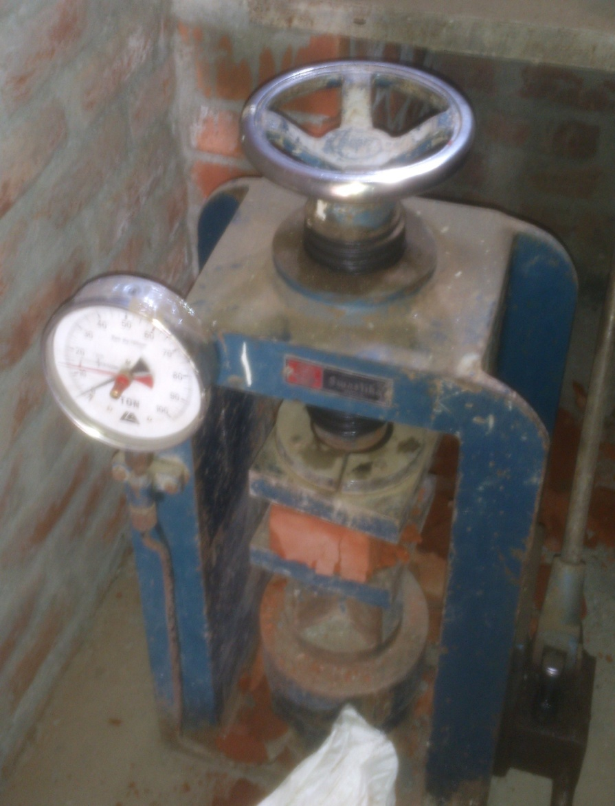
Test on bricks (Crushing Strength of Bricks):- The crushing strength of brick is found out by placing it in a compression testing machine. It is pressed till it breaks. As per as BIS: 1077-1957, the minimum crushing or compressive strength of bricks is 3.50 N/mm². The bricks with crushing strength between 7 to 14 N/mm² are graded as A and those above 14 N/mm² are graded as AA.
Equipment required for testing:-
1. Compression strength machine
2. Weighing machine
3. Measuring tape
4. Bricks
Compression test of bricks

Slide 41
Result of Bricks Test
S.NO. | WT. OF BRICK (Kg) | AREA OF BRICK (mm²) | LOAD APPLIED (N) | COMPRESSIVE STRENGTH (N/mm²)
1. | 3.464 | 19600 | 250000 | 12.75
2. | 3.65 | 19600 | 180000 | 9.18
3. | 3.54 | 19600 | 160000 | 8.16
Crushing strength (N/mm²) = Failure load on brick / Area of brick
Area of Brick = 175x112 mm

Slide 42
BIBLIOGRAPHY
1. Photos from construction site.
2. Theoretical part from books.
3. Drawings from construction company.

Slide 43
Thank you

