Slide 1
PRESENTATION OF SIX MONTH INDUSTRIAL TRAINING

Slide 2
OVERVIEW OF PROJECT
PROJECT :- Construction of
Meritorious school building
CLIENT :- Punjab State Agricultural & Marketing Board
CONSTRUCTION :- Parkash Chand Goyal &
COMPANY Company
ESTIMATE COST :- 22 Crores
DURATION :- 8 Months
AREA :- 6 Acres

Slide 3
VARIOUS ACTIVITIES PERFORMED AT SITE:-
LAYOUT
EXCAVATION
PCC
STEEL REINFORCEMENT
SHUTTERING
CONCRETING (M25)
CURING
BRICK WORK
PLASTERING

Slide 4
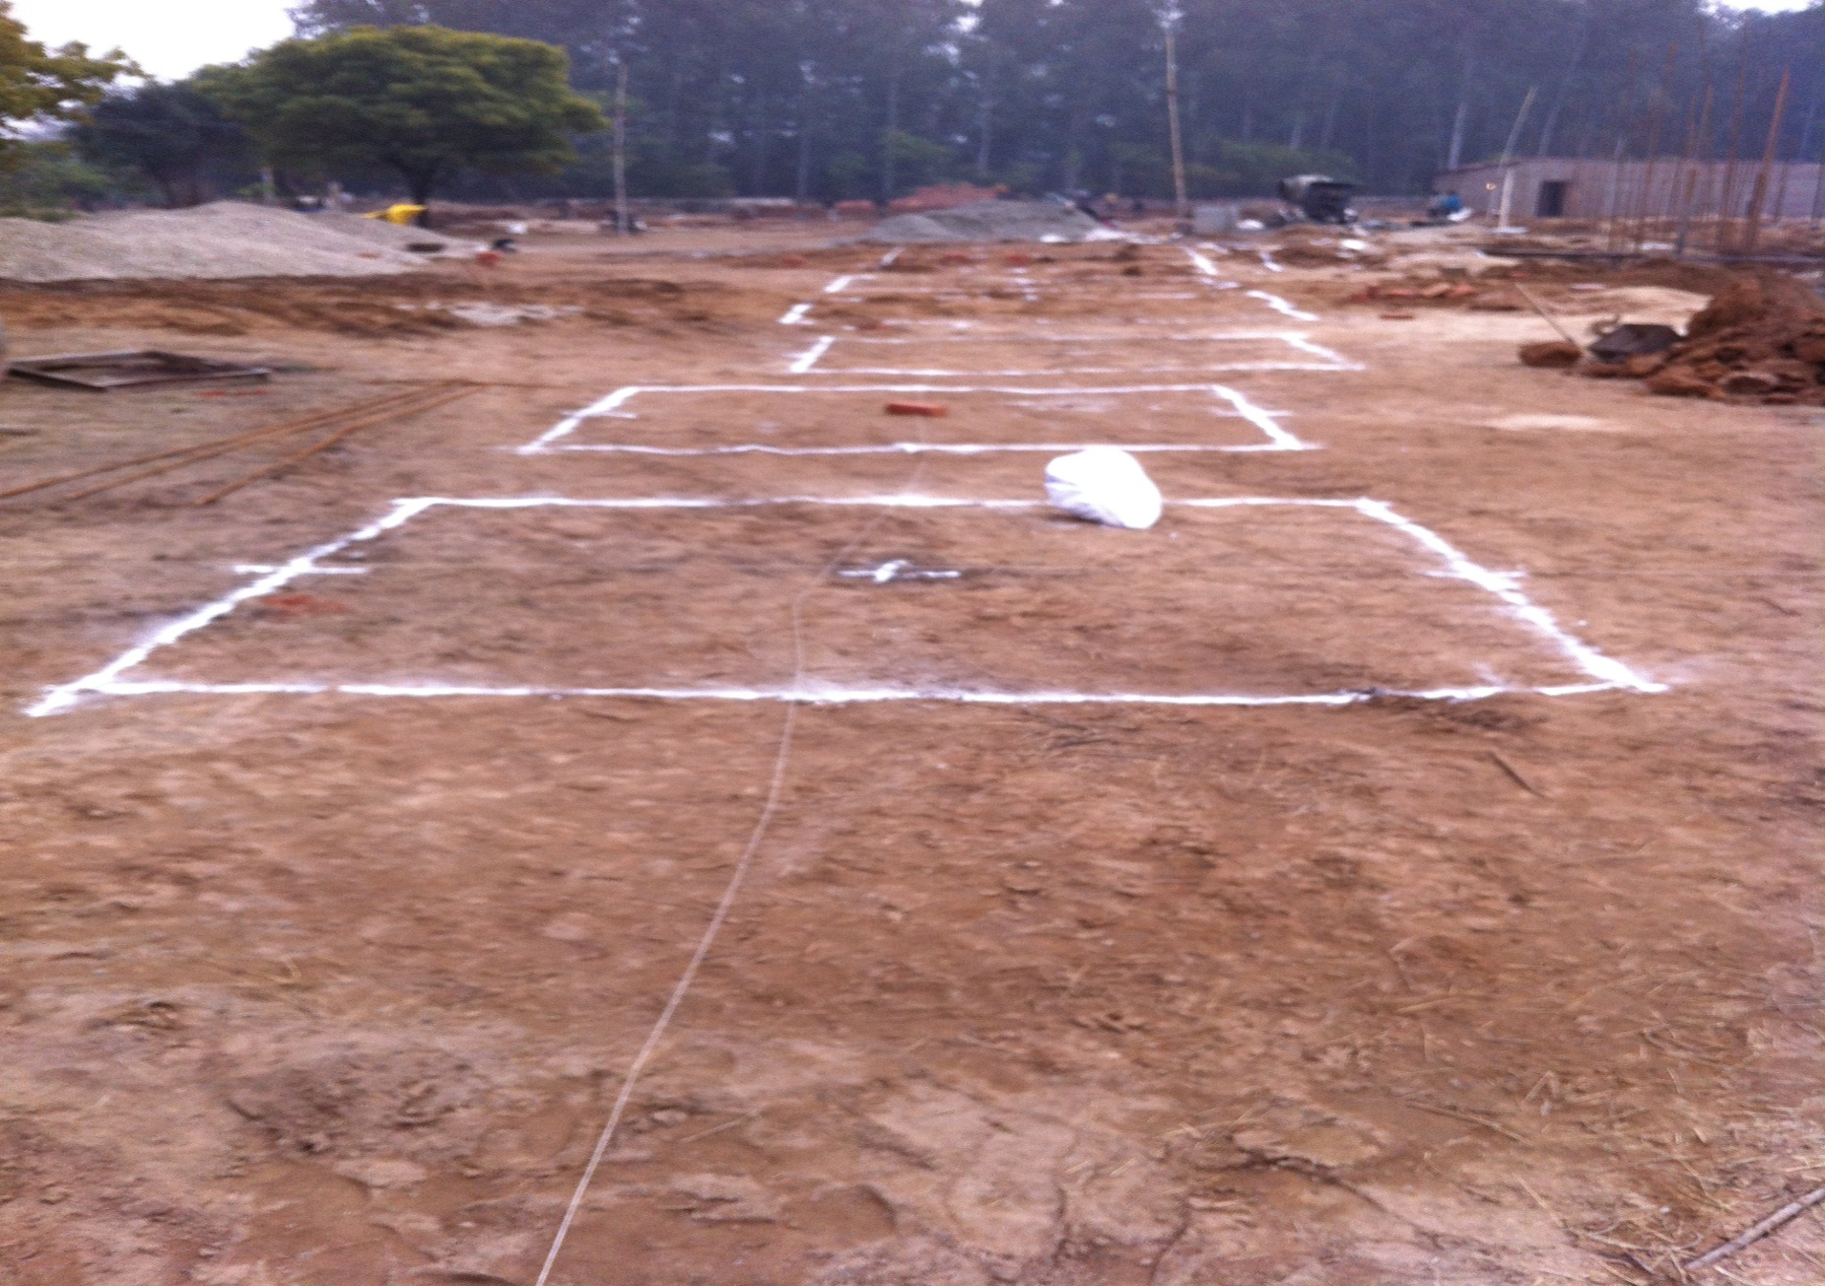
LAYOUT

Slide 5
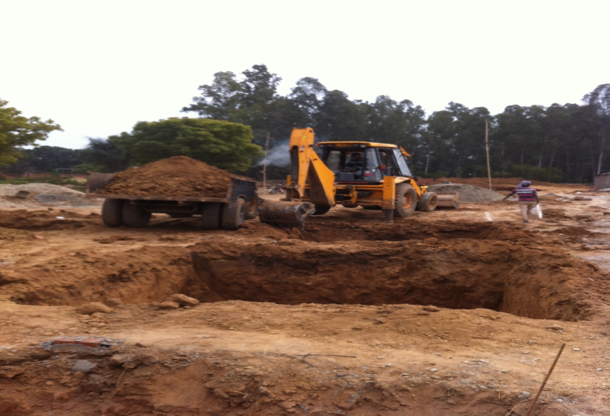
EXCAVATION

Slide 6
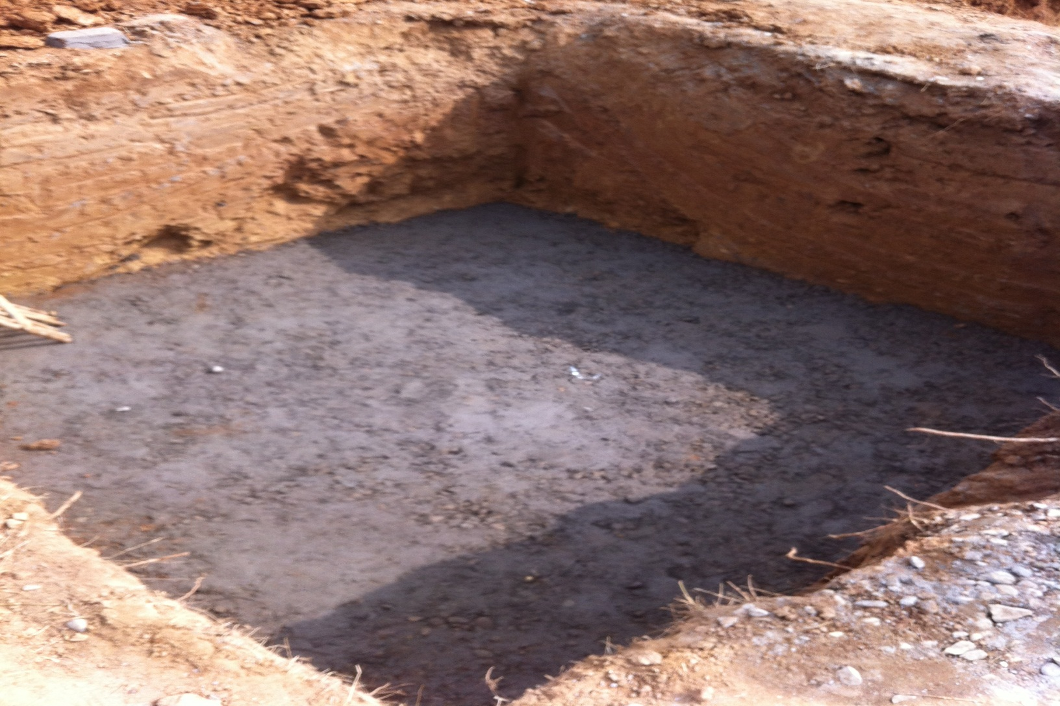
LAYING OF PCC (1:4:8)

Slide 7
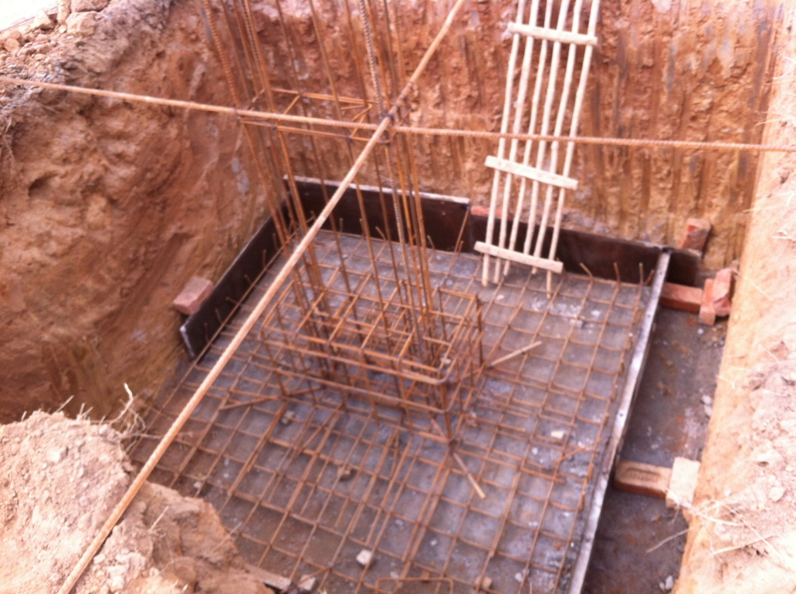
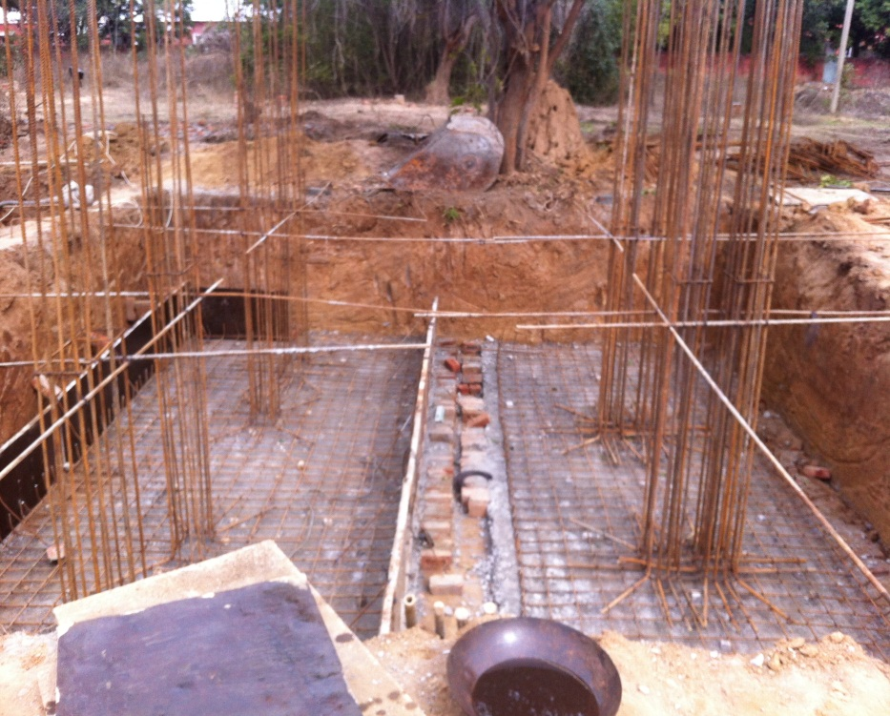
STEEL REINFORCEMENT

Slide 8
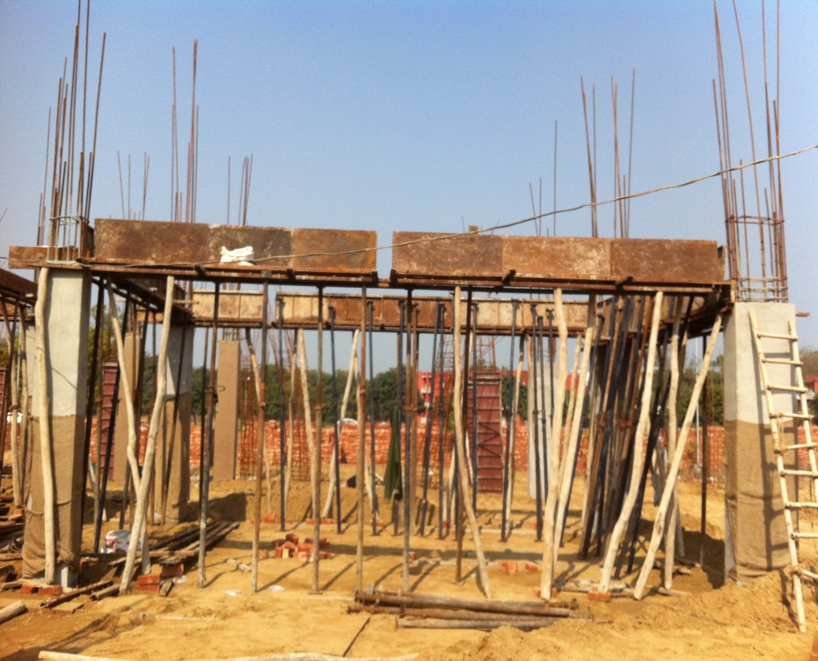
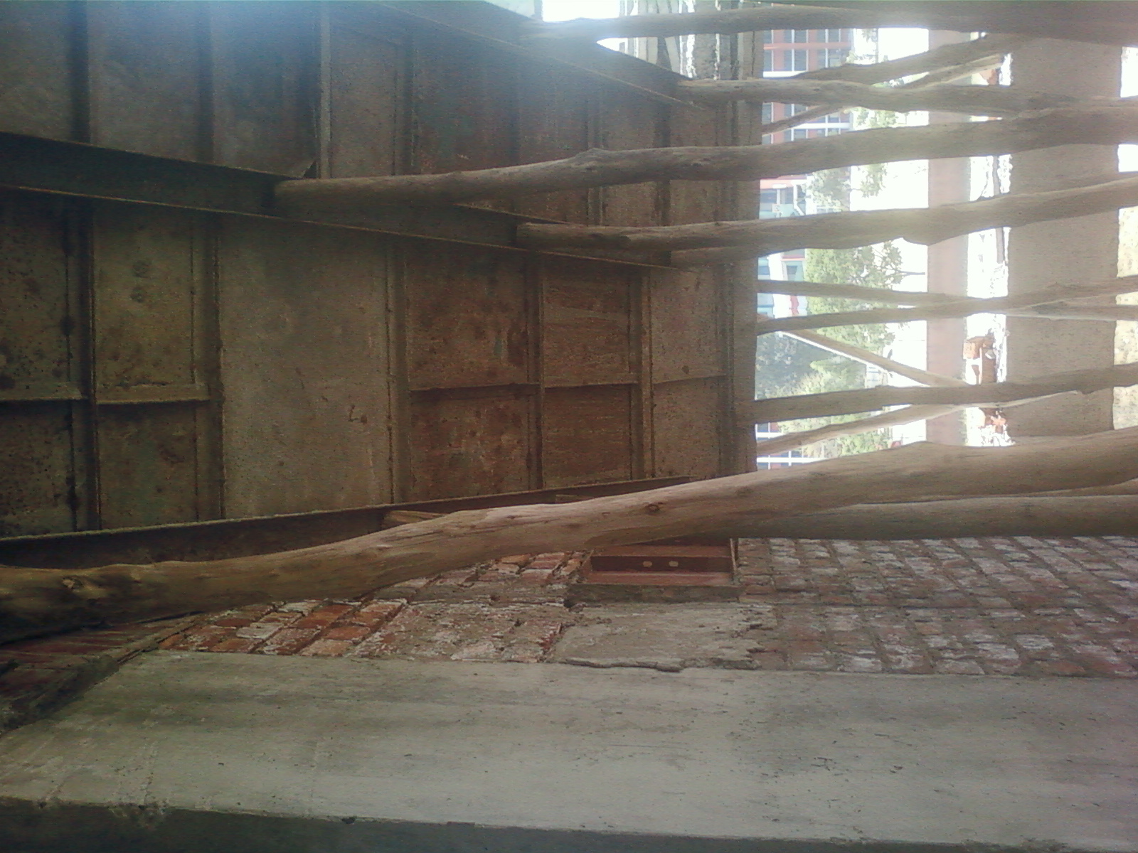
SHUTTERING

Slide 9
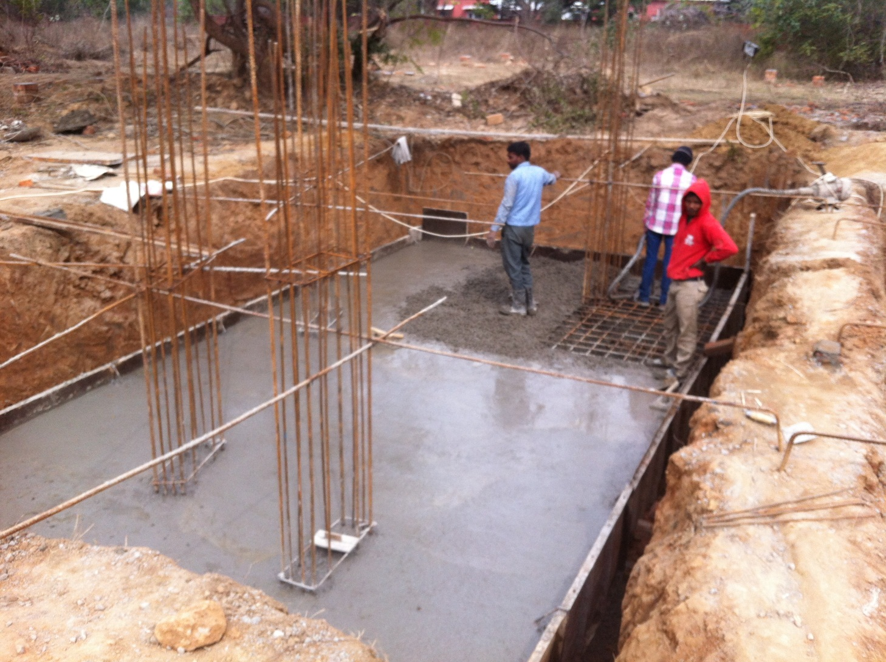
CONCRETING

Slide 10
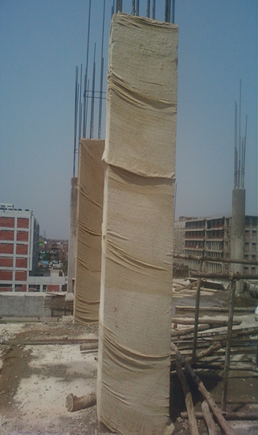
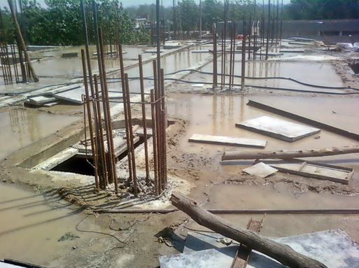
CURING

Slide 11
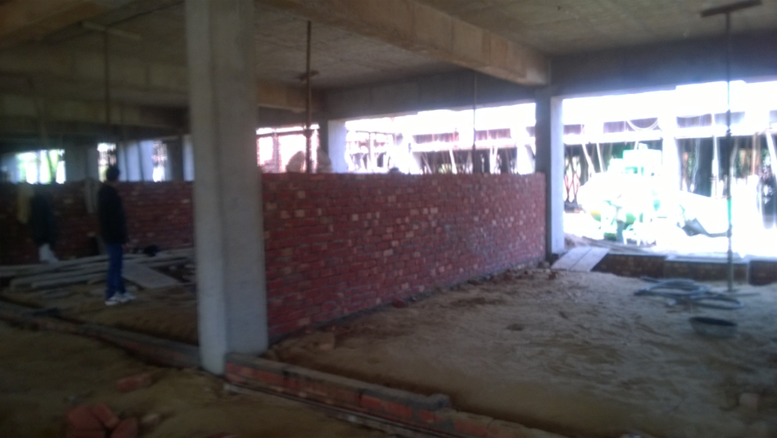
BRICKWORK

Slide 12
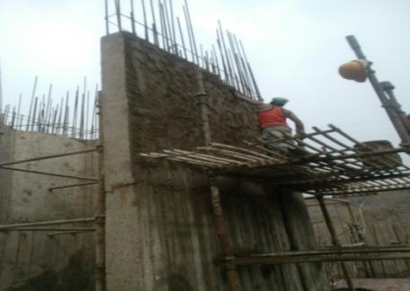
PLASTERING

Slide 13
VARIOUS TESTS PERFORMED AT SITE
FINE AGGREGATES:-
Silt Content
CONCRETE TESTS:-
Cube Test
Slump Test

Slide 14
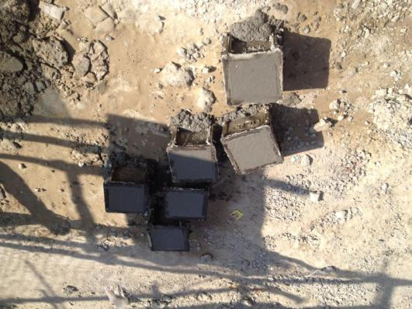
CONCRETE TESTS
Cube Test

Slide 15
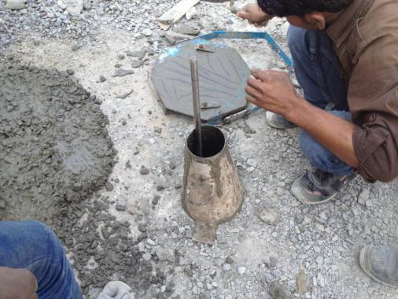
Slump Test

Slide 16
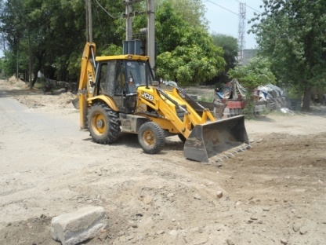
VARIOUS EQUIPMENTS USED
Back Hoe

Slide 17
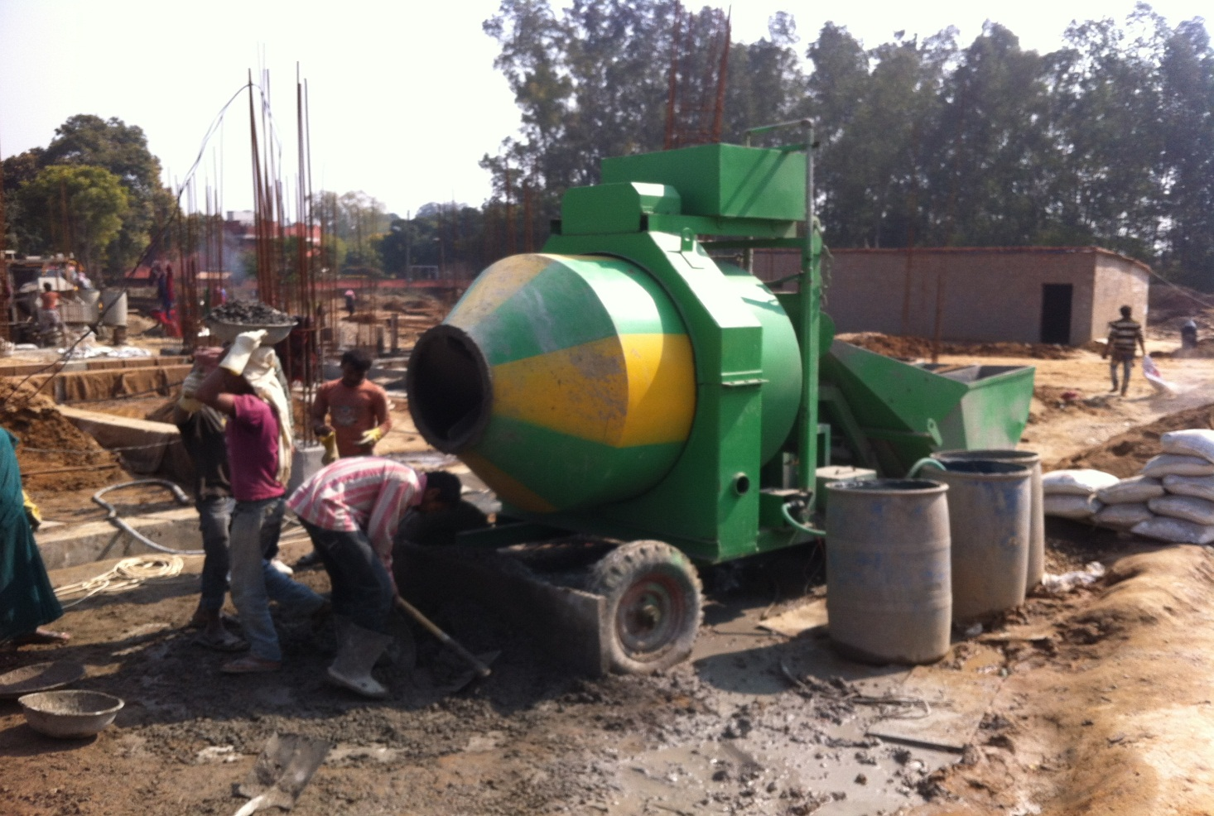
Drum Mixture

Slide 18
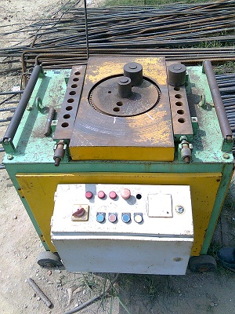
Bar Bending Machine

Slide 19
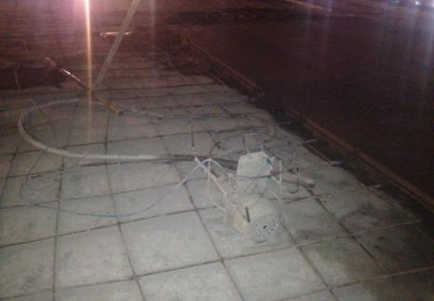
Needle Vibrator

Slide 20
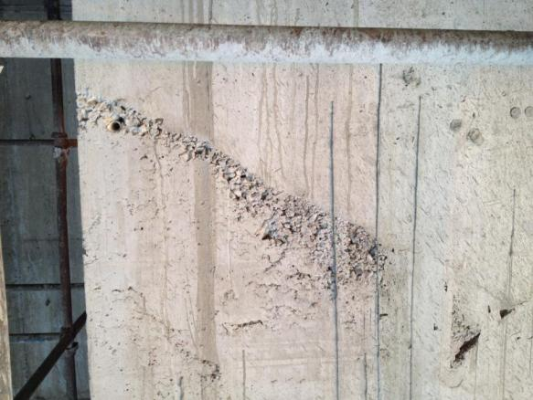
VARIOUS DEFECTS
Honey Combing

Slide 21
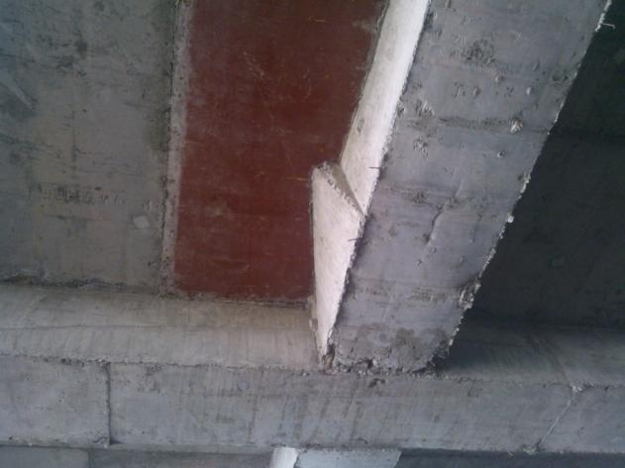
Bulging of Beams

Slide 22
THANK YOU

