Slide 1
Six Months Industrial Training
At Indoor Stadium Complex, Pakhowal Road Ludhiana
By- Shahbaz Singh
Roll No. 100371
Guru Nanak Dev Engineering College, Ludhiana

Slide 2
About Site Indoor Stadium Complex, Ludhiana
5000 seating capacity basketball indoor stadium second in India and First basketball indoor stadium in India.
The specialty of stadium is that it has two basements, two floors of shopping mall and two floors of corporate offices.
This oval shape stadium is located in Pakhowal road, Ludhiana.

Slide 3
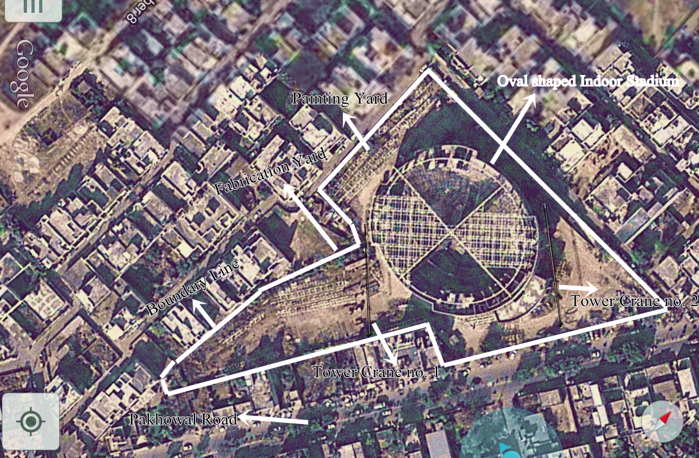
A Google eye picture of Indoor Stadium-

Slide 4
Salient Features
Sports (Non-Commercial) - Indoor Arena for Multi Sports including Basket Ball; Badminton; Fencing; Volleyball; Table Tennis; Boxing; Gymnastics; etc. & Outdoor Fields for Tennis & Mini Swimming Pool.
In total there will be 3 Basketball courts. One will be main and other two will be practice courts.
Commercial - Offices; Shops; Restaurants; Cafe; Corporate Suites; Parking; Advertisement Kiosks; etc.
Social (Semi-Commercial) - Club for leisure; Mini Convention Centre for Theatre/ Cultural Shows; Exhibitions - Musical Concerts; Trade Shows to be held in Open Fields and Indoor Arena.

Slide 5
Salient features cont.
Arena Area - 40 x 27 meters.
Provision for Air conditioning, Basement Ventilation and Lifts/ Elevators has been made.
An estimate amounting to Rs. 32.0 cr. was sanctioned in 2013 for phase-2 work of remaining civil, electrical, fire fighting and the work of air-conditioning and lifts and tenders have been called on 26/5/2014
Proposals from consultants have been received and are being processed

Slide 6
Project Overview-
Scope includes civil, mechanical and architecture related.
Steel fabrication
Truss Erection
Steel ring beams
Testing
And main Spherical Roof Dome Trusss.

Slide 7
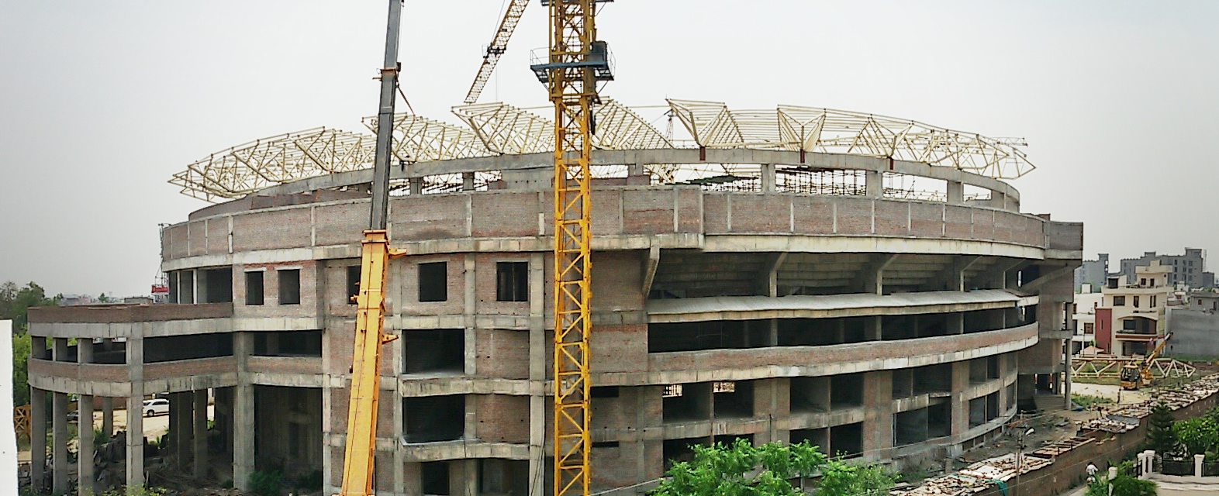
Spherical Dome Roof Truss

Slide 8
Truss and its members
Truss here is a space frame.
In architecture and structural engineering, a space frame or space structure is a truss -like, lightweight rigid structure constructed from interlocking struts in a geometric pattern.
Like a Truss, a space frame is strong because of the inherent rigidity of the triangle; flexing loads(bending moments) are transmitted as tension and compression loads along the length of each strut
When a roof is to be provided for a building which does not have interior supports, but the exterior walls are more than 12 meters apart, some system of framing would be economical than simple beams. Such a frame is called a truss.

Slide 9
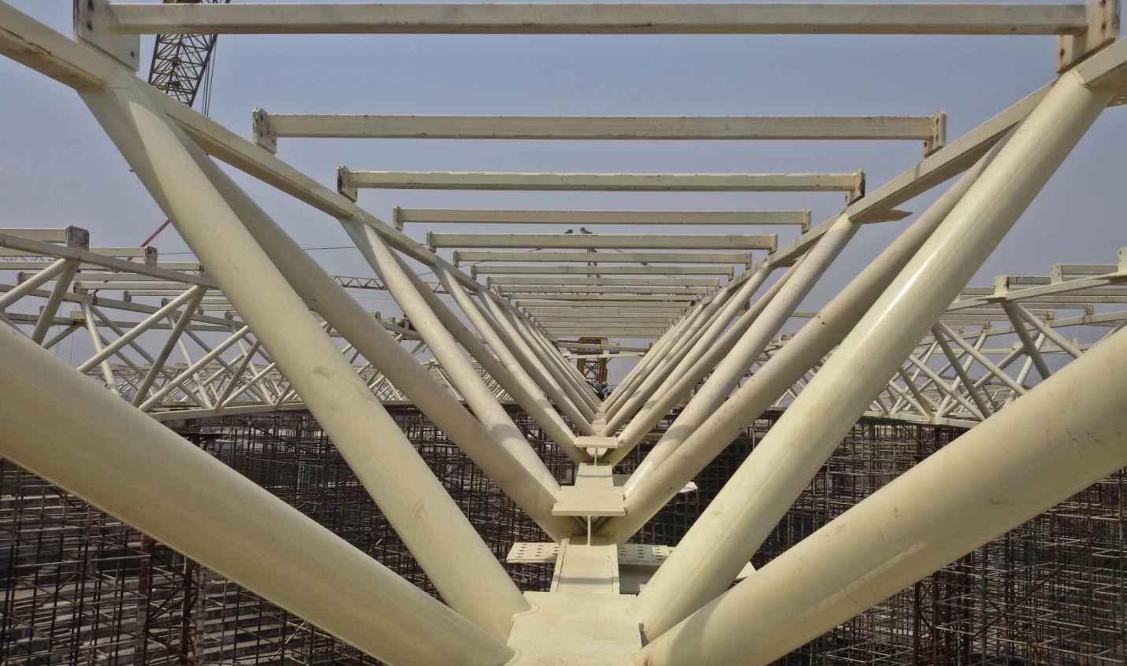
Picture of a truss -

Slide 10
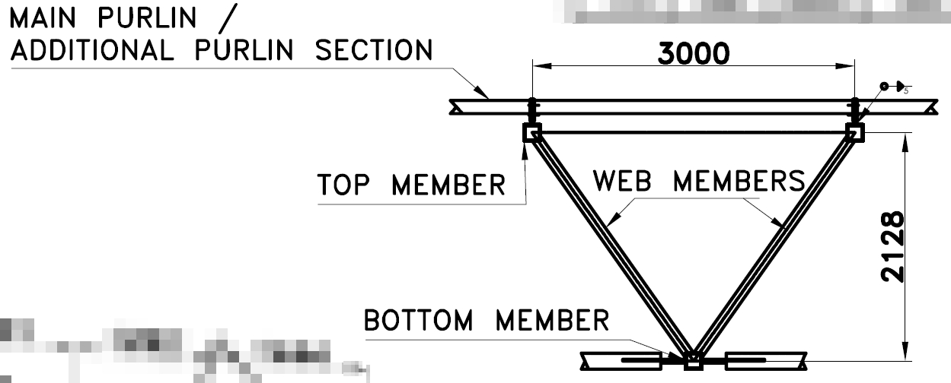
Parts of a Truss
A truss consists essentially of the following parts-
Upper chord members,
Bottom chord members,
Web members.
Camber.

Slide 11
Parts of a Truss
The uppermost line of members that extend from one support to the other through the apex is called the upper chord.
Whereas the bottom chord consists of the lowermost line of members extending from one support to the other.
The top and bottom chord members are connected by vertical or diagonal members called web members.
Usually in all simply supported trusses, members in the bottom chord are subjected to tension and the members in the upper chord are subjected to compression.

Slide 12
Camber in Trusses
An upward vertical displacement built into a truss bottom chord to compensate for deflection due to dead load. Trusses are built with a camber in bottom chord. The camber is designed to suit the span and load. A girder truss will have more camber than other trusses. In all trusses here at the site a camber of 6" is normally designed by the designer.

Slide 13
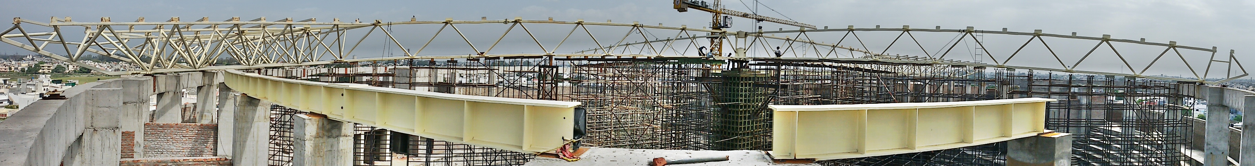
Picture of camber at site-

Slide 14
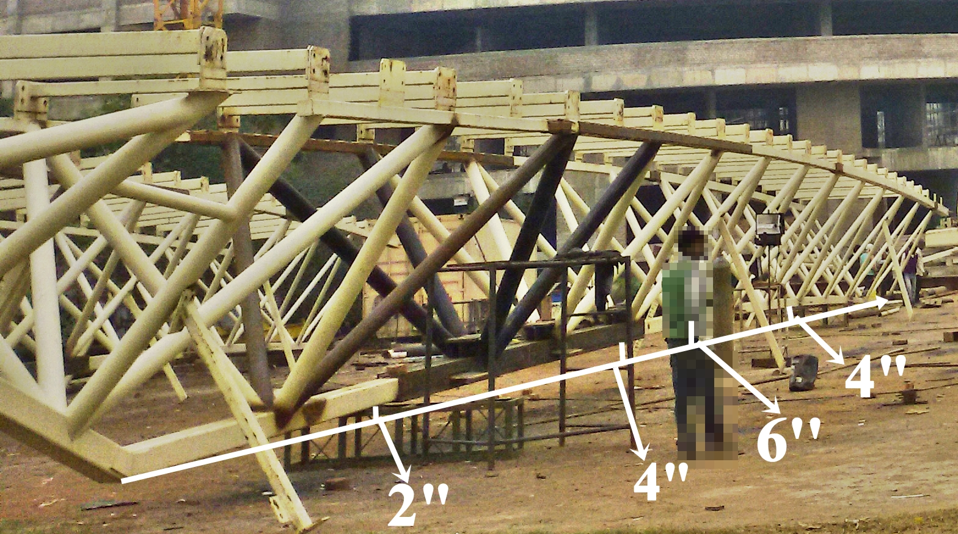
Actual camber-

Slide 15
Bearings-
Bearings are necessary to be provided at the supports of truss; often it becomes necessary to make provision for the end supports of the structure so as to allow certain small movements.
For example, it is necessary that one end of a truss should be supported on bearing to allow for changes in the span length due to temperature variations.
For steel sliding on steel, hard cast iron the bearing stress shall not exceed 30N/mm².

Slide 16
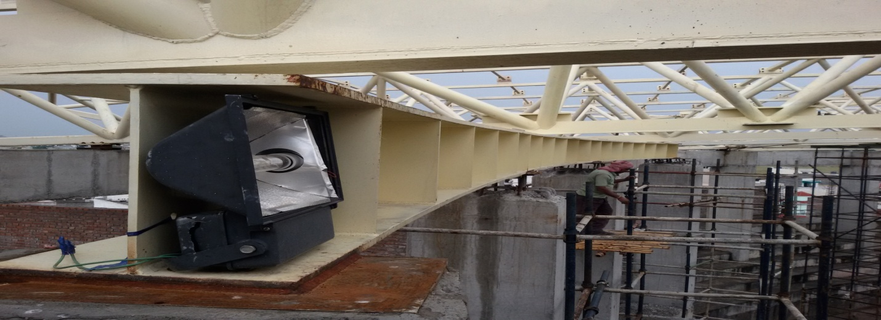
Steel Ring Beams-
Section of steel ring beam is I section with upper dimension400mm and height of 450mm. Weight of one such beam is 4631.34 Kg.

Slide 17
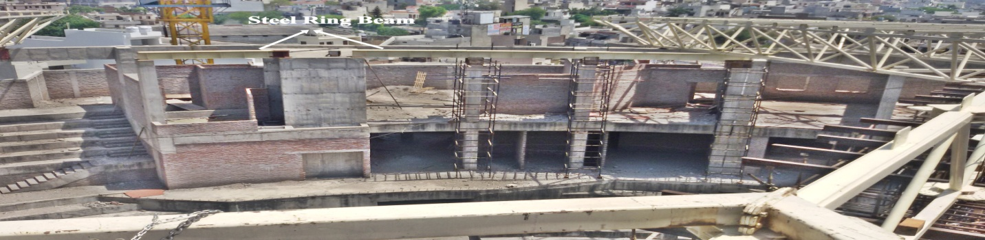
Pictures of steel ring beam-

Slide 18
Temporary structures at site to support spherical dome roof truss-
Scaffolding- For the support of materials used in erection.
Derek- Derek which is made with steel cribs of size 450×450×1800, fabricated with L50×50×6 and bracing rod 12 mm diameters in end panels or L50×50×5. These cribs were fabricated in 2 months and approximately 980 cribs are made in fabrication yard. And Weight of such one crib is 80 Kg.
Temporary towers- Four temporary towers are erected to a height of 28metres with help of tower crane with section 150×150×6mm box.

Slide 19
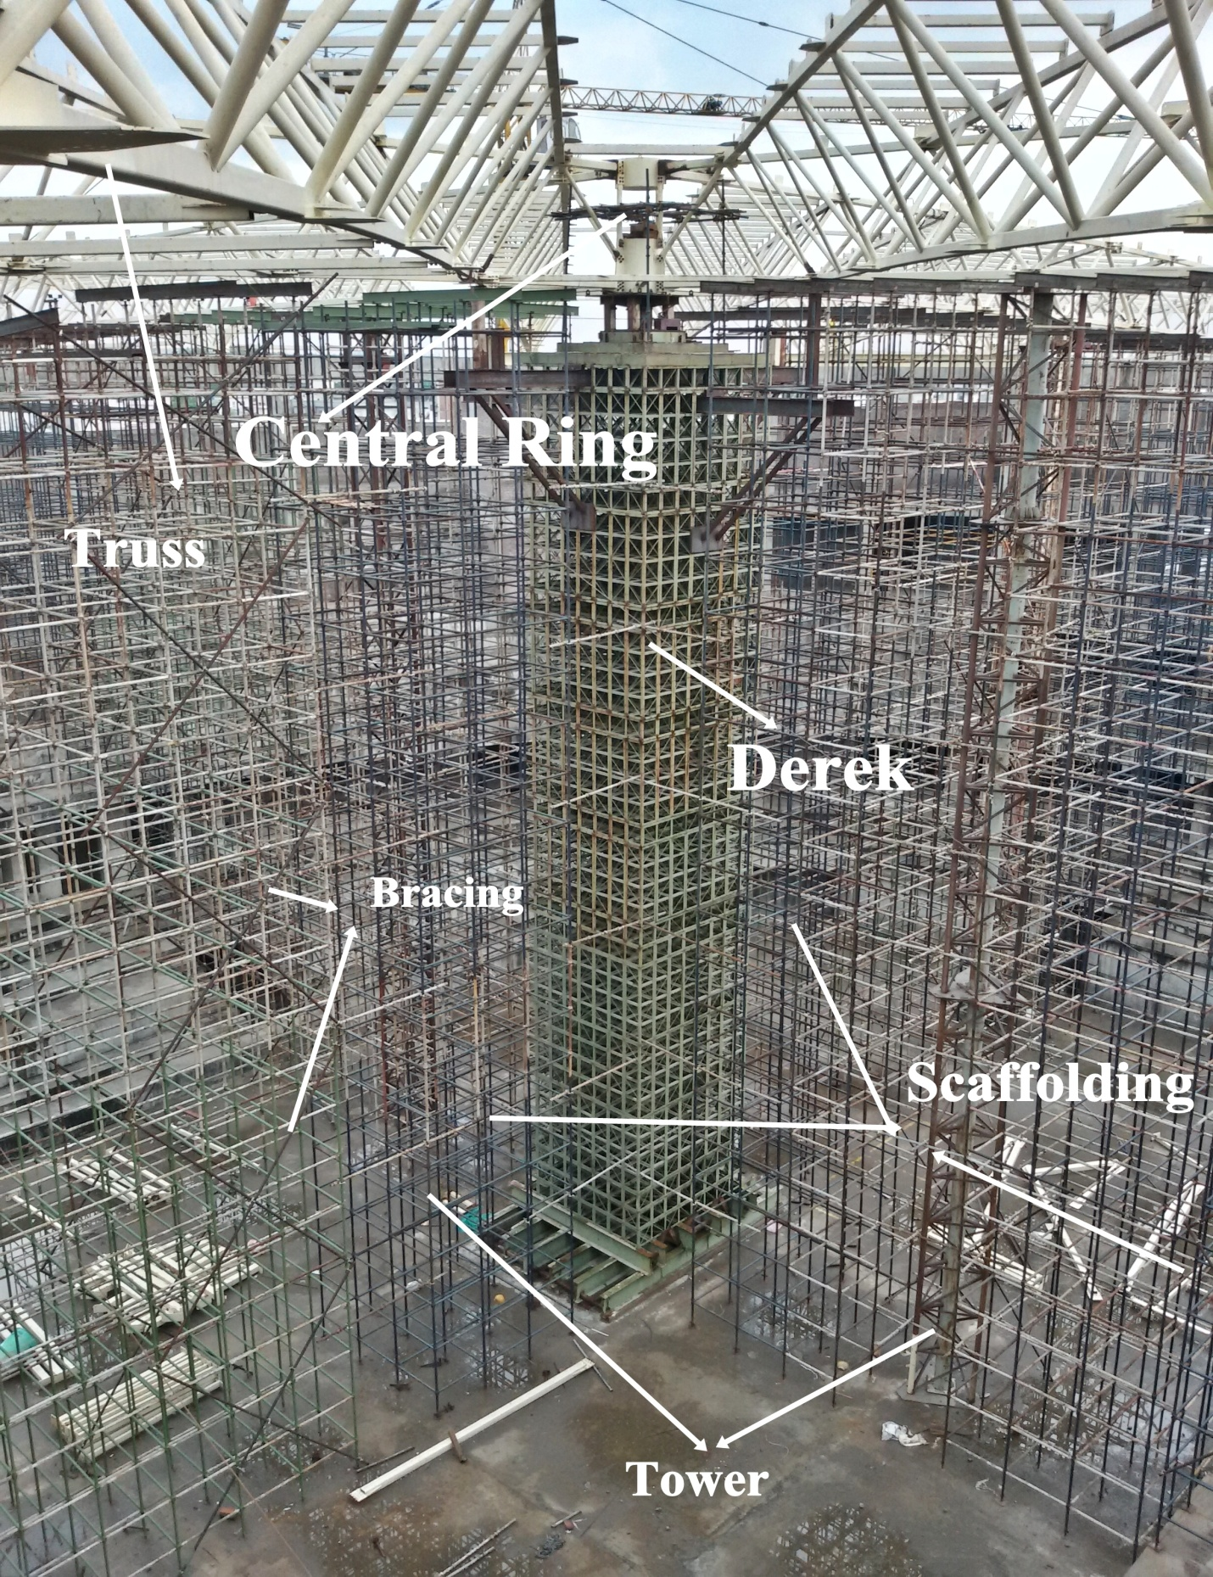
Photo of temporary structure-

Slide 20
Fabrication Work-
Metal Fabrication is the building of metal structures by cutting, welding, bending, grinding, chipping, drilling and assembling processes which together make it an important thing.
Welding on site is of two types- Arc welding and MIG welding.
Cutting is done manually by hand and mechanically by pug cutting machine, by use of LPG and oxygen.

Slide 21
About Arc welding-
Arc welding is mainly electrically operated. Two types of machines are used first is Arc welding set and the second one is Rectifier. Electrodes used are mainly E6013 and 7018. E6013 does not require any preheating, while electrodes like 7018 are kept in oven and after that welding is done. Weld produced by 7018 electrode is more effective and strong as compared to 6013 electrode. Size of weld used for fabrication work is mainly 4mm weld which require 140-180 Amperes.

Slide 22
MIG Welding-
MIG welding is the other type of welding used here. Instead of electrodes, here mig wire of 1.20mm diameter is used; whose weight is nearly 12.50kg. Mig welding is also electrically operated and operates in 120-300 Ampere current range and require carbon dioxide as a shielding gas here. For continues welding silicon spray is used as it prevents metal from adhering.

Slide 23
Difference between MIG welding and Arc Welding-
MIG welding is not economic but MIG welding has some advantages over arc welding which are listed below-
a) Joint produced is stronger.
b) Production is more as it does not require frequent change of electrodes.
c) Time consumed is less.
In MIG welding we use bare electrode wire, while in arc welding we use coated electrodes.

Slide 24
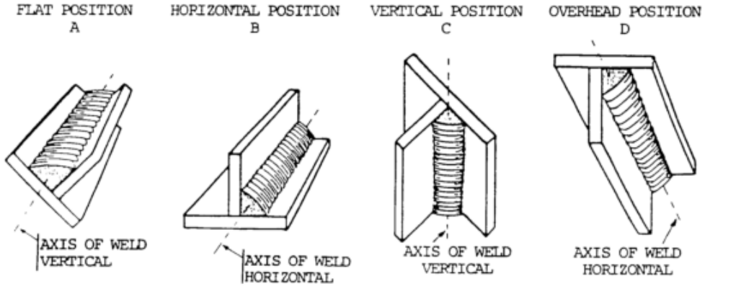
Welding Positions-

Slide 25
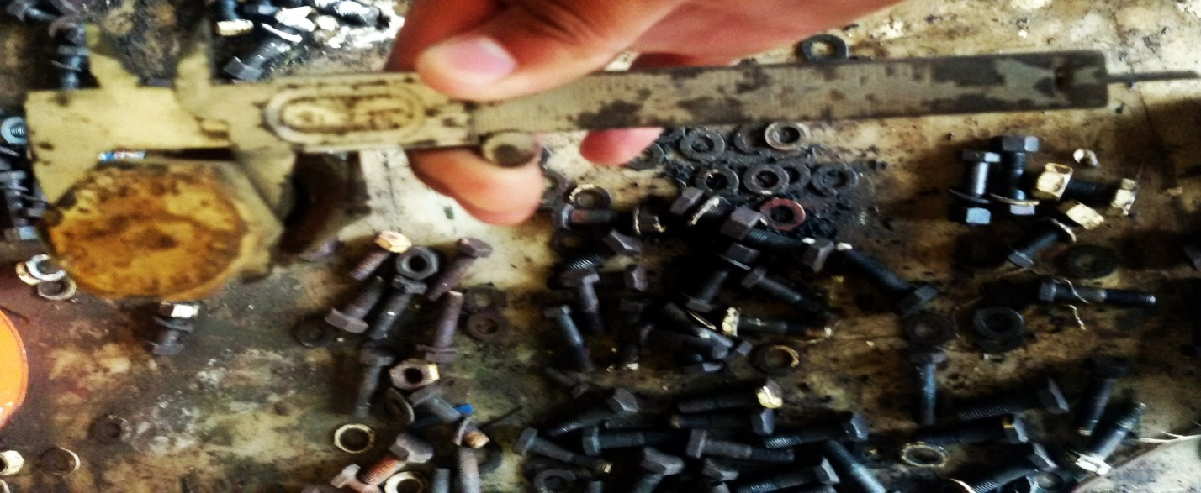
Bolts to be used here at site for Spherical Roof Dome Truss-
Bolts used here are HSFG (High Strength Friction Grip) Bolts of Grade 10.9
20mm diameter bolts of length 75mm are used.
25mm diameter bolts of length 60mm are used.

Slide 26
Advantages of HSFG bolts-
The performance of preloaded HSFG bolts under fatigue loading is good because the prestressed bolts are subjected to reduced stress range during each loading cycle when compared with unloaded bolts.
For structures adjacent to machinery which generate substantial vibration, preloading bolts can help to avoid the loosening of bolts.
HSFG bolts are used in connections where any slight slip movement would render the integrity of the whole structures break down.
Owing to its high tensile strength, it is commonly used in connections which require the taking up of high flexure and the tensile stress generated could be readily resisted by it high tensile strength.

Slide 27
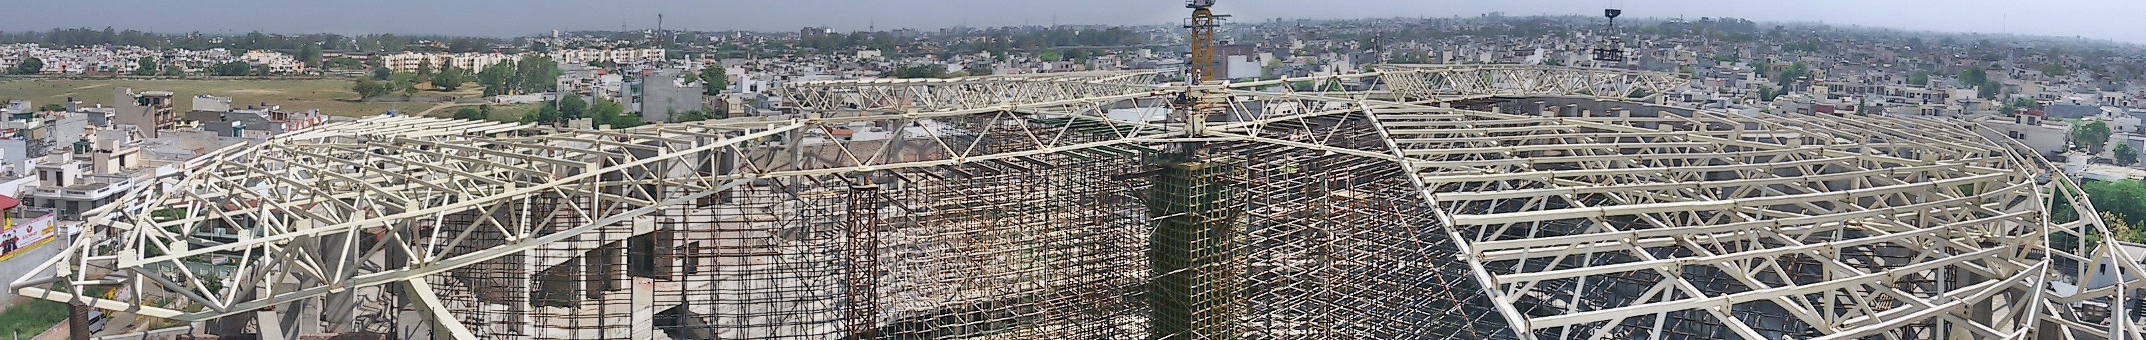
Erection Work-

Slide 28
Erection Process-
Erection on site was done with help of 2 Tower cranes of capacity 8 ton with counterweight of 16 ton.
For heavy trusses like T4,T5 and T6 erection is done with Tower crane and Mobile crane of 165 ton capacity named Krupp GMT 165.
In fabrication yard A Hydra is used for various purposes like overturning of truss, machinery shifting from one place to another. The capacity of Hydra is 12 ton with counterweight of 11 ton.

Slide 29
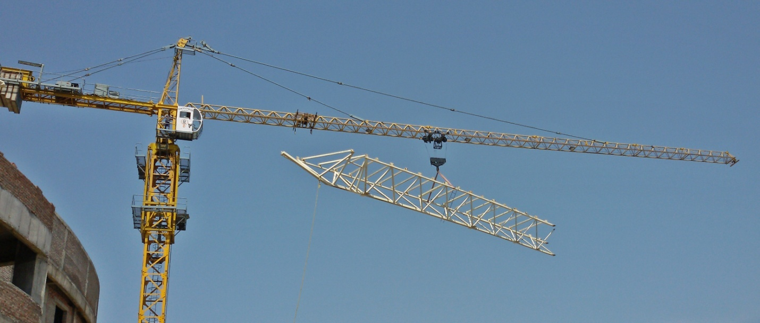
Tower Crane of 8 ton capacity-

Slide 30
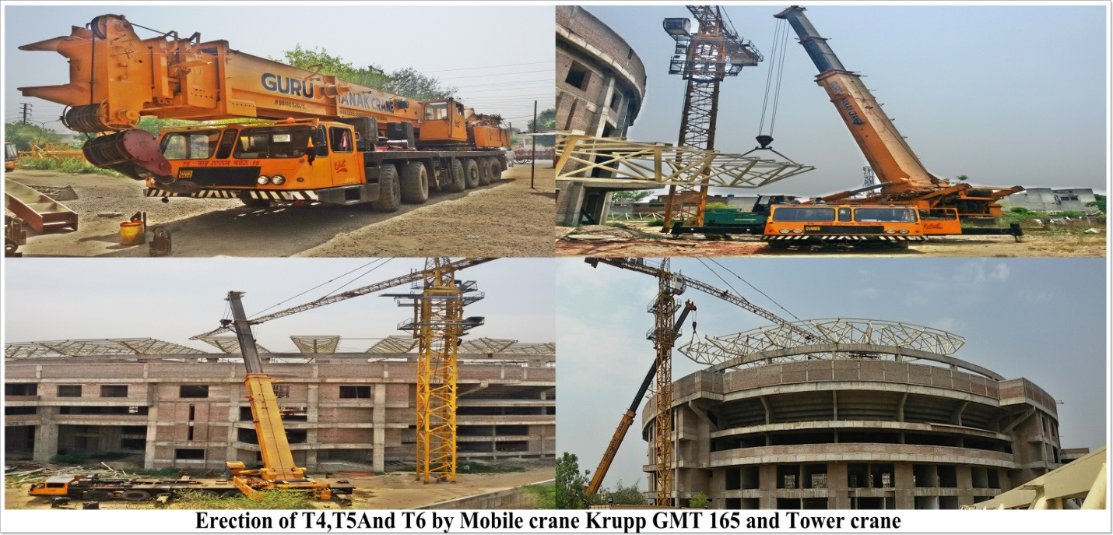
Mobile crane- Krupp GMT 165 ton capacity-

Slide 31
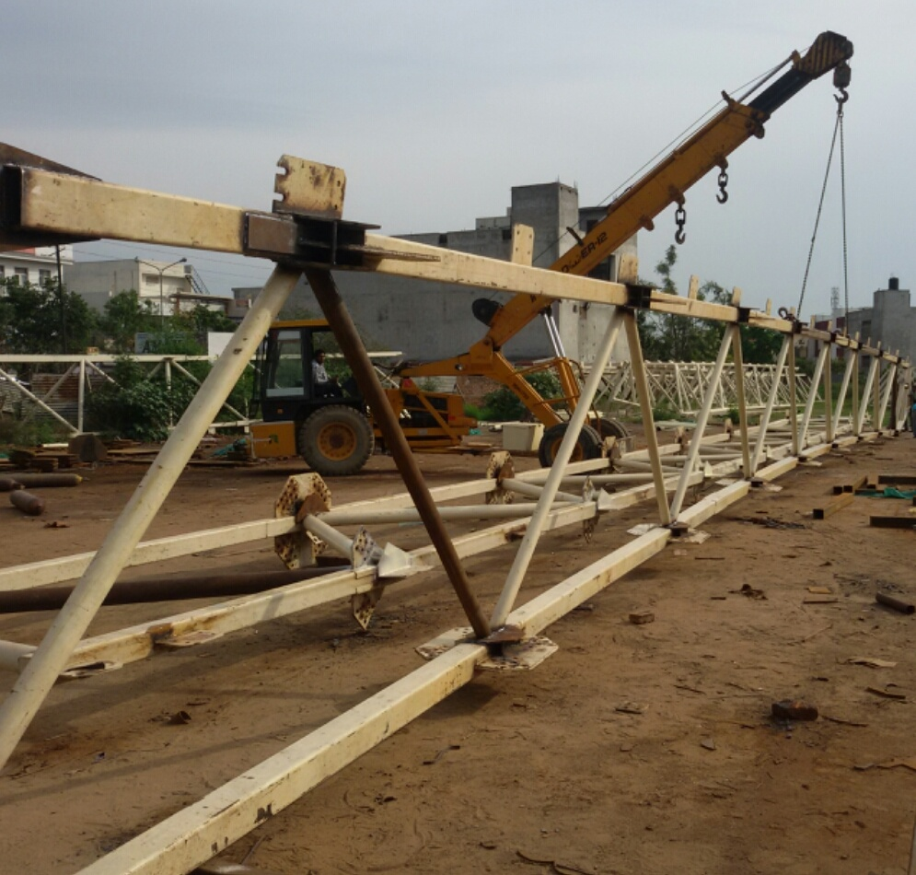
Hydra of 12 ton capacity-

Slide 32
Various Tests done-
Various Tests/Experiments were also done at the site like:-
DP Test for checking quality of welding.
Compression Test of Concrete cubes.
Compression test of bricks.
Water absorption test of brick.
Impact test of road aggregates.
Slump test for checking of workability of fresh concrete.
Sieve test.
Other tests like hardness and structure test of bricks.

Slide 33
Sieve Analysis-
The sieve analysis determines the gradation (the distribution of aggregate particles, by size, within a given sample) in order to determine compliance with design, production control requirements, and verification specifications.
Fineness modulus(FM) is defined as an empirical figure obtained by Totaling of cumulative % weight retained and then dividing it by 100.
In general small value indicates finer aggregate and higher value indicated coarser aggregate.
Fine aggregates range from a FM of 2.00 to 4.00 and coarse aggregates smaller than 38.1mm will range from 6.50 to 8.00
Sieves used- 10mm, 4.75mm, 2.36mm, 1.18mm, 600µ, 300µ, 150µ, 75µ and pan.

Slide 34
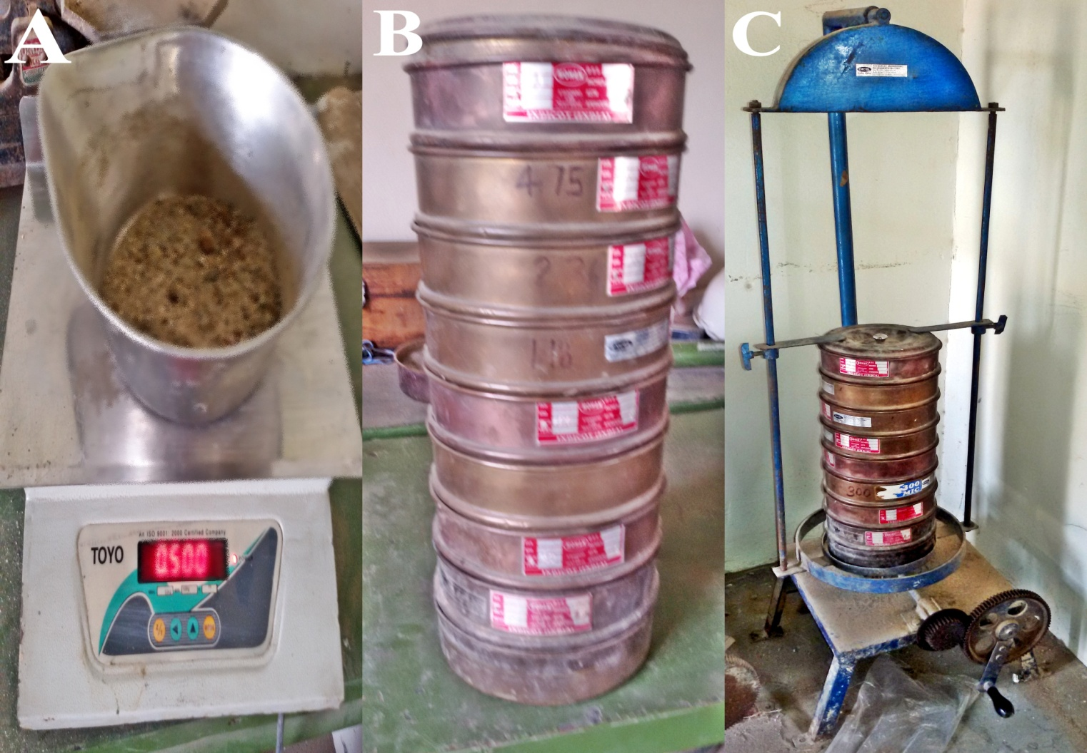
Picture of sieve analysis-

Slide 35
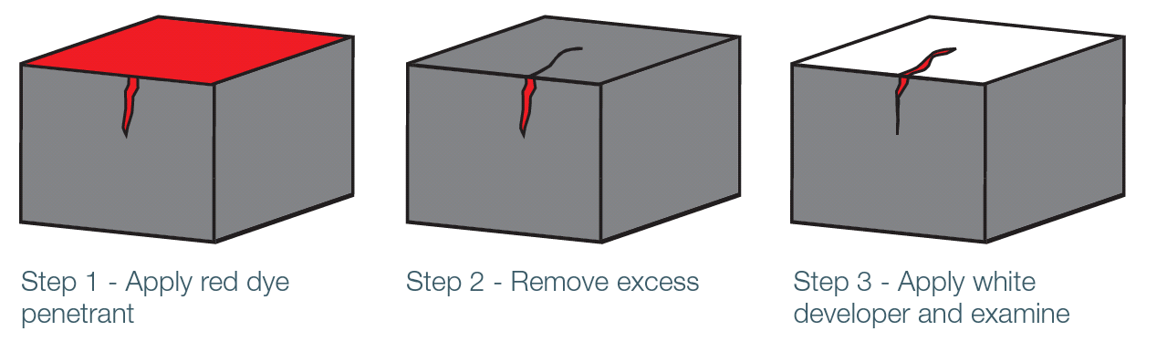
Dry Penetrant test for quality of welding-
DP(Dye Penetrant) test is a form of NDT which stands for non destructive testing. DP is dye-pen where a white liquid formation is placed over the weld and a normally red enhancer is then placed over the top, this identifies surface cracks.

Slide 36
Aggregate Impact Test-
Toughness is the property of a material to resist impact. Due to traffic loads, the road stones are subjected to the impact action and there is possibility of stones breaking into smaller pieces. The road stones should therefore be tough enough to resist fracture under impact.
Chief advantage of this test is that equipment and the test procedure are quite simple and it determines the resistance to impact of stones simulating field condition. Generally it is observed well shaped cubical stones provide higher resistance to impact when compared with flaky and elongated stones.

Slide 37
Aggregate impact value-
The aggregate impact value is expressed as the percentage of the fines formed in terms of the total weight of the sample.
Let if, The original weight of the oven dry sample- x kg
Weight of fraction passing 2.36mm IS sieve- y kg
Aggregate impact value= 100× y/x
< 10% | 10-20% | 10-30% | >35%
Exceptionally Strong | Strong | Satisfactory for road surfacing | Weak for road surfacing

Slide 38
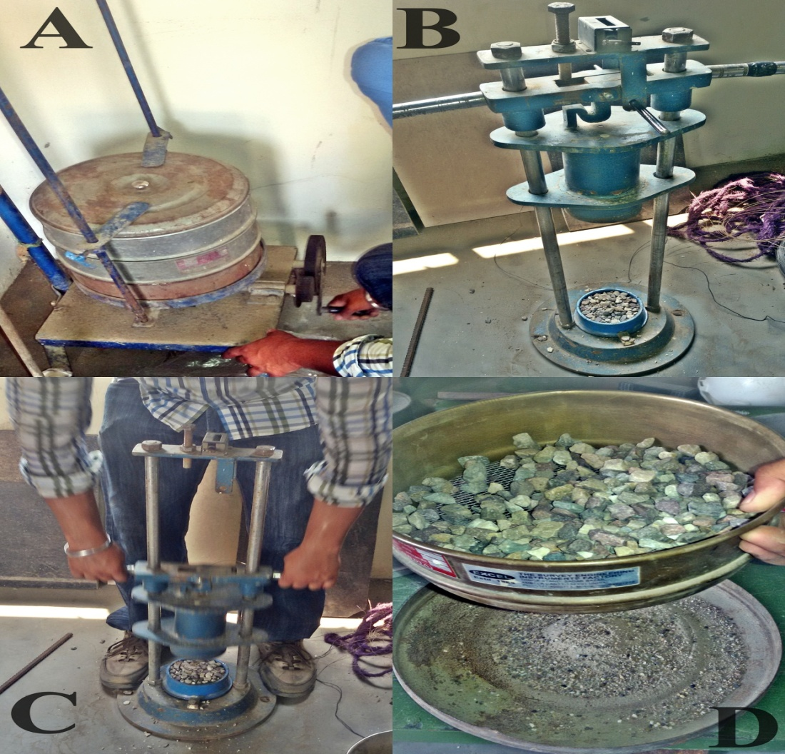
Pictures of aggregate Impact Test-

Slide 39
Water Absorption Test Of bricks-
This test is done to check the quality of brick. The less water absorbed by brick the greater its quality. Good quality brick doesn't absorb more than 20% water of its own weight and 15% by weight for higher class.
Water Absorption | >20% | 20-15% | <15%
Brick Quality | Bad Quality | Good Quality | Very good Quality

Slide 40
Compression test of concrete cubes-
This test is done to know the compressive strength of concrete cubes. It is also called crushing strength of concrete. Generally 3 specimens of concrete cubes are taken to laboratory for testing and tested one by one. Concrete cube testing is a simple, cost effective test of the compressive strength of concrete, providing you peace of mind that your concrete is fit for purpose and in line with IS standards.

Slide 41
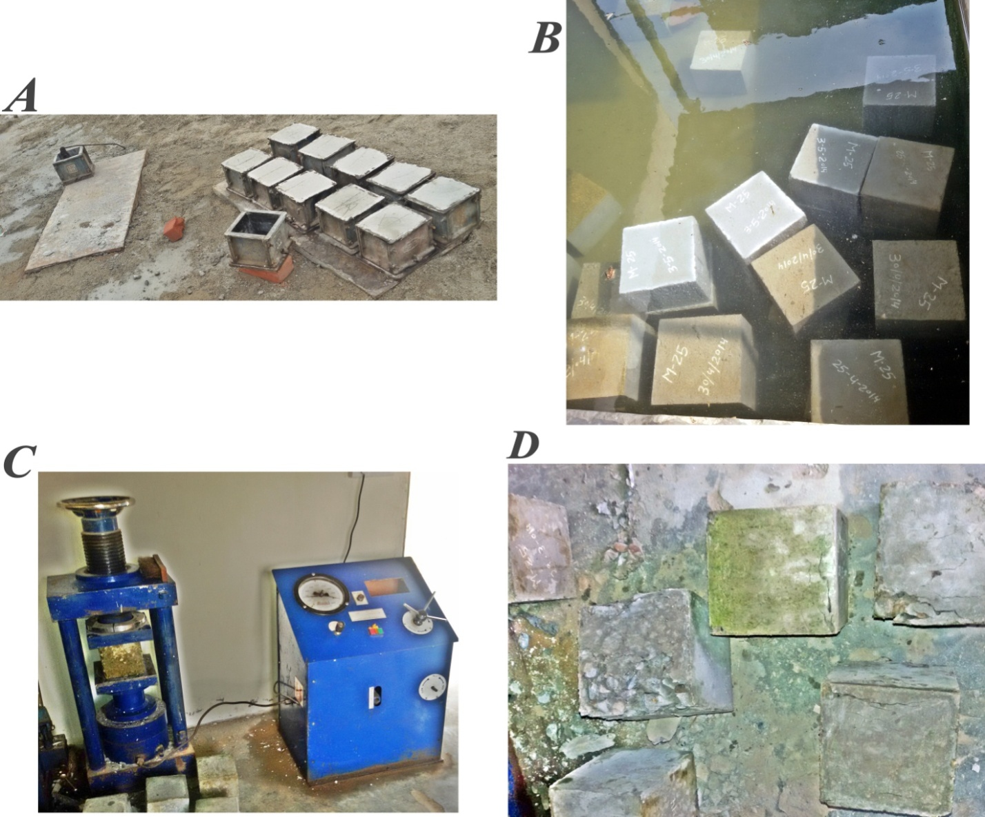
Pictures of compression test of concrete cubes-

Slide 42

Hope you have liked it-

