Slide 1
Service Yard & Quality
Chandigarh International Airport Project
SUBMITTED BY – LOVE RATTAN (100145)
- SWINDERJEET BRAR (100146)

Slide 2
About L&T CONSTRUCTIONS LIMITED
Larsen & Toubro Limited (L&T) is a technology, engineering, construction and manufacturing company. It is one of the largest and most respected companies in India's private sector.
More than seven decades of a strong, customer-focused approach and the continuous quest for world-class quality have enabled it to attain and sustain leadership in all its major lines of business.
L&T has an international presence, with a global spread of offices. A thrust on international business has seen overseas earnings grow significantly. It continues to grow its global footprint, with offices and manufacturing facilities in multiple countries.

Slide 3
The company's businesses are supported by a wide marketing and distribution network, and have established a reputation for strong customer support.
L&T believes that progress must be achieved in harmony with the environment. A commitment to community welfare and environmental protection are an integral part of the corporate vision.
In response to changing market dynamics, L&T has gone through a phased process of redefining its organisation model to facilitate growth through greater levels of empowerment. The new structure is built around multiple businesses that serve the needs of different industries.

Slide 4
Commercial Buildings & Airports BU undertakes design and turnkey construction of institutional and commercial buildings. Projects are executed using the latest construction equipment and project management tools for quality, safety and speed.

Slide 5
STATUS OF PROJECT BEFORE MY JOINING.

Slide 6
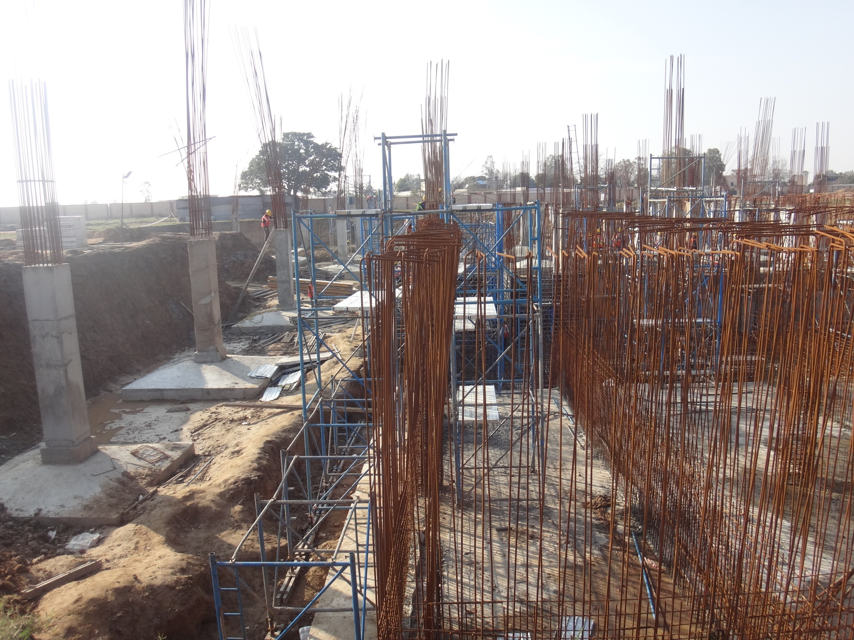
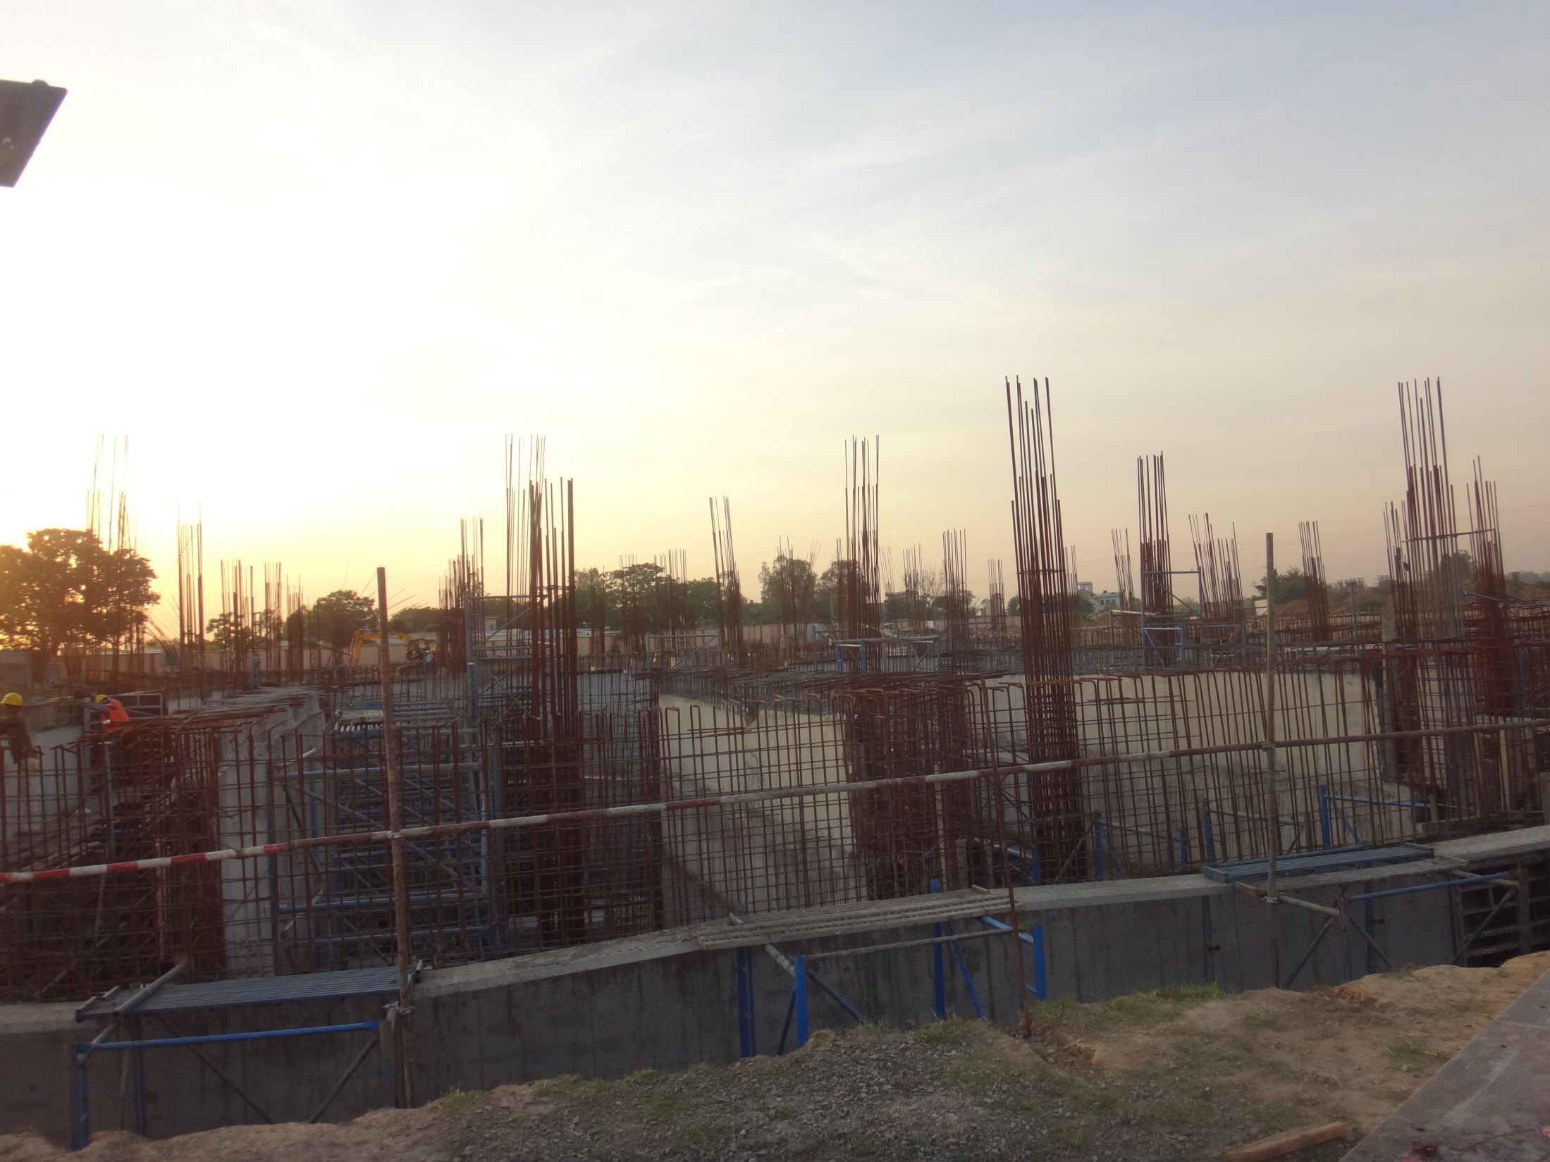
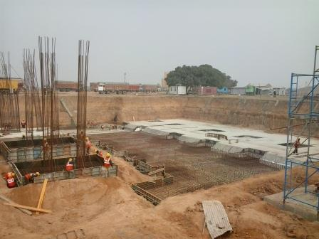
Shuttering and rebar works are in under progress at Pump and water tank room area.
Footing work has been completed at D.G. room area and column works are in under progress.
Retaining wall of water tank area
76% Retaining wall of UG tank completed up to final lift

Slide 7
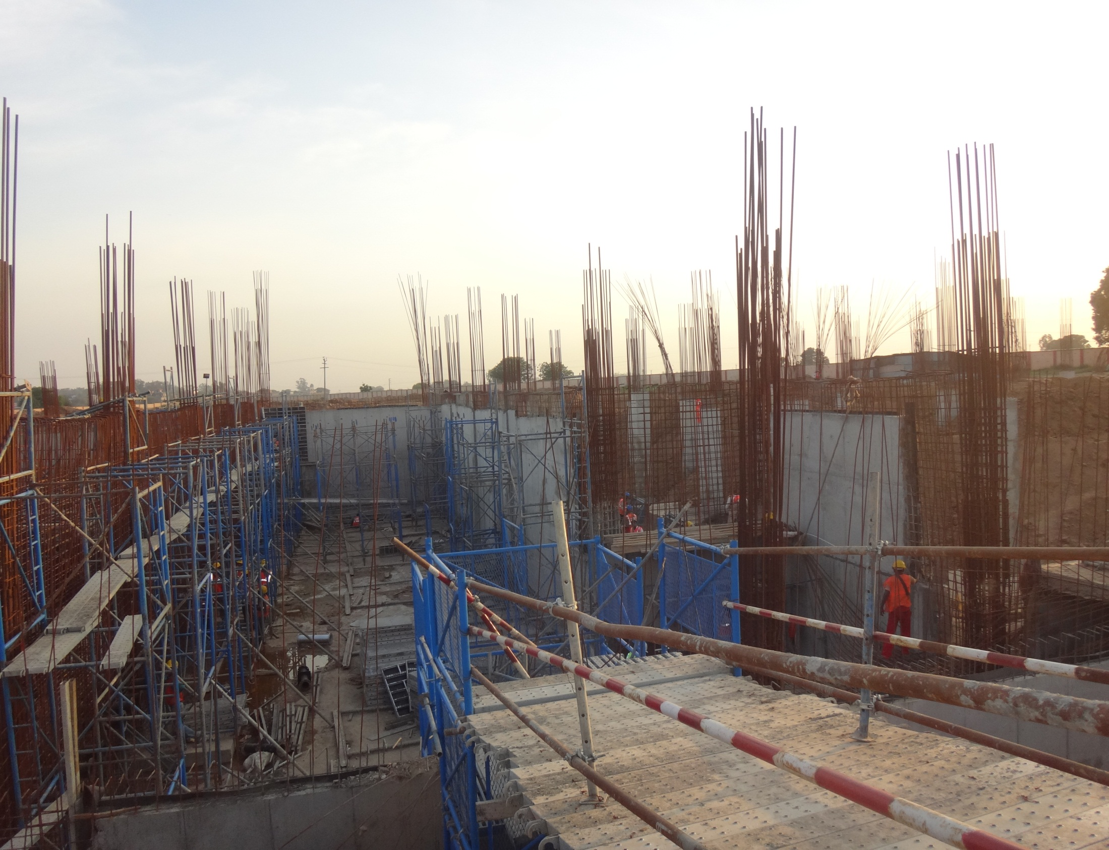
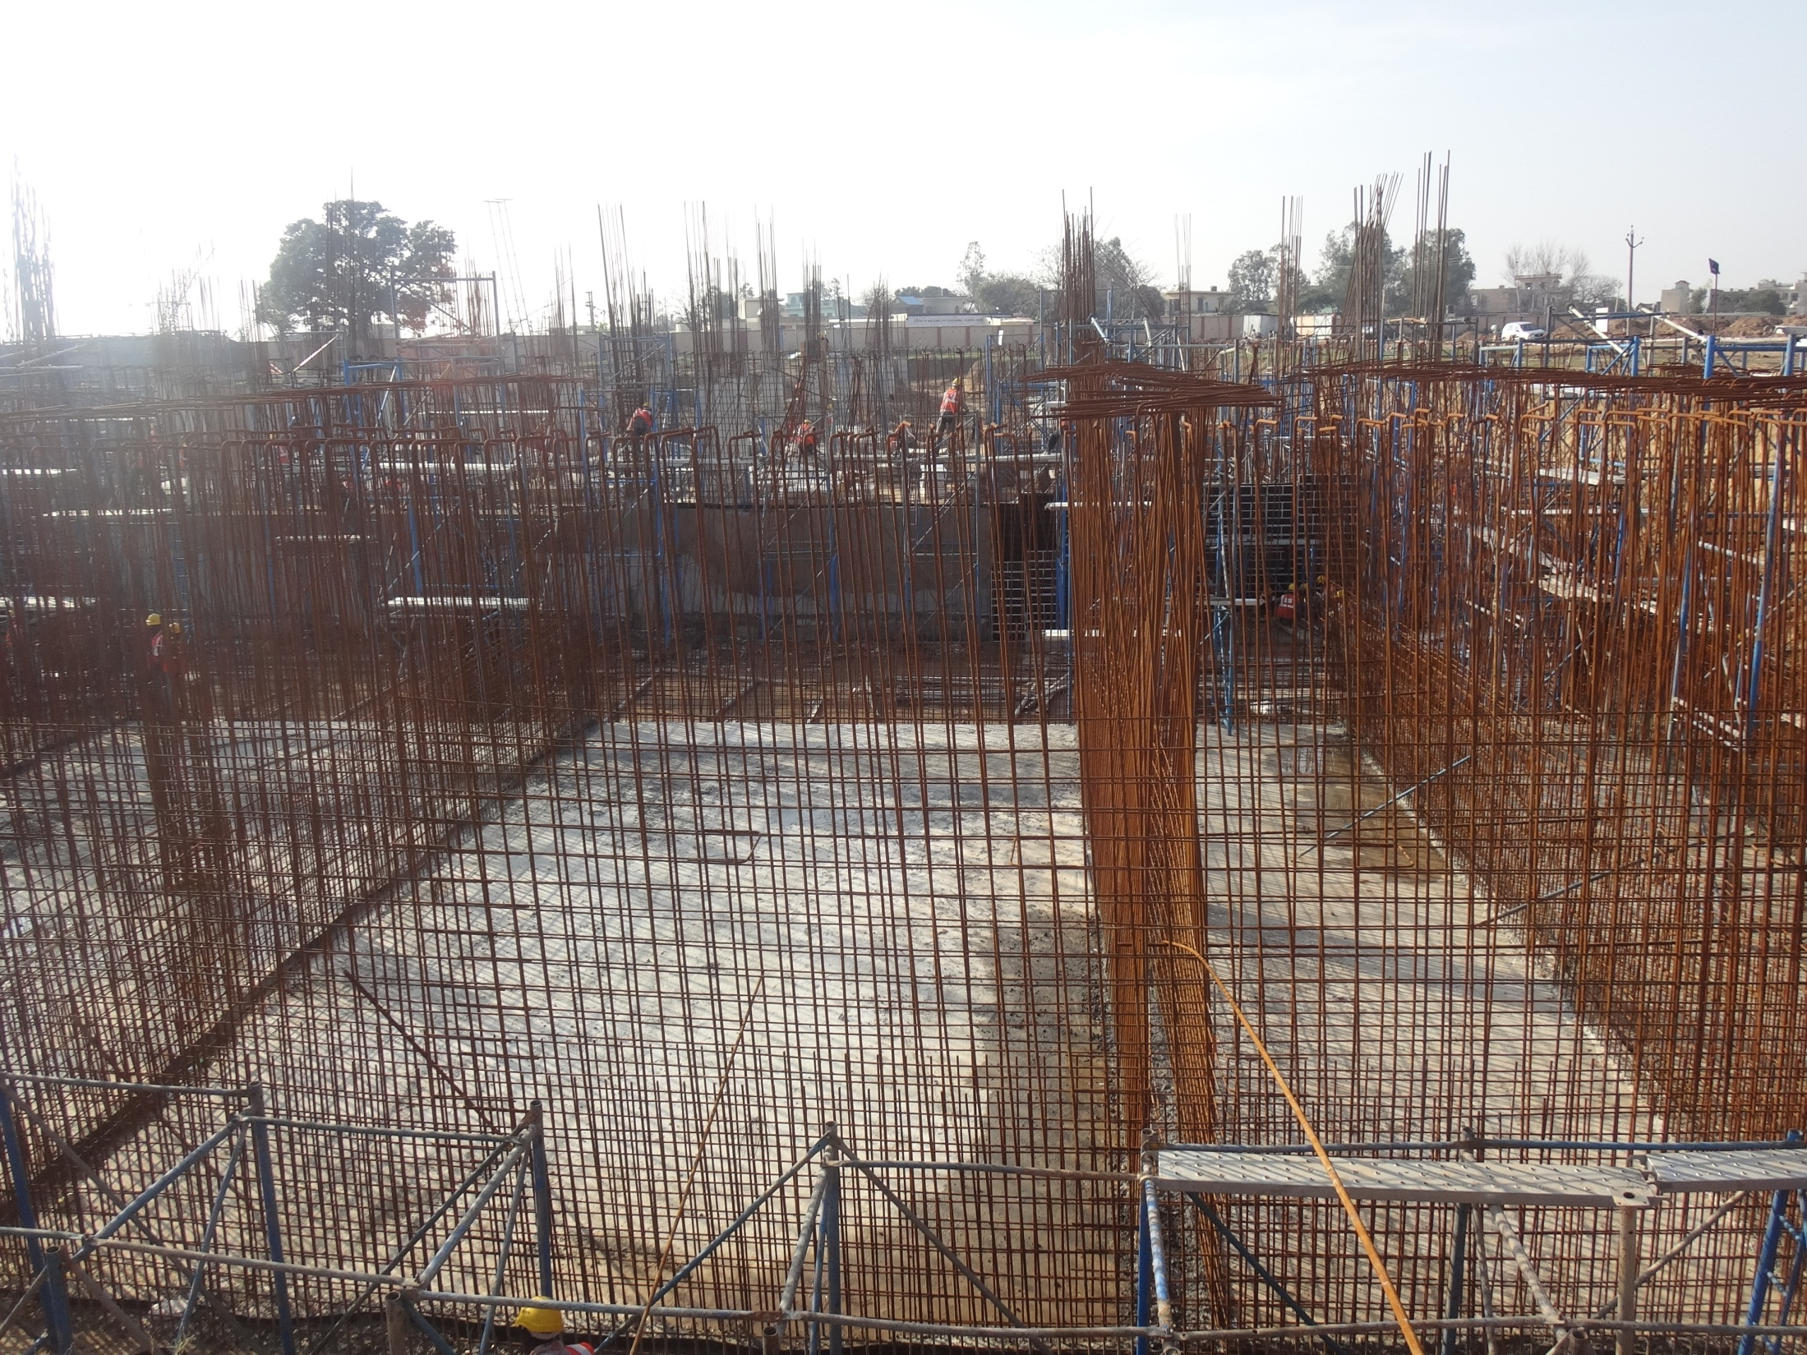
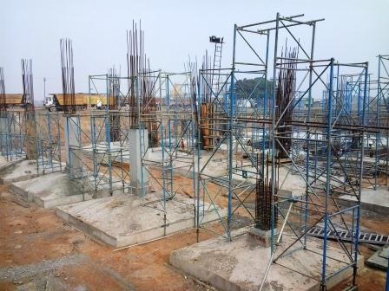
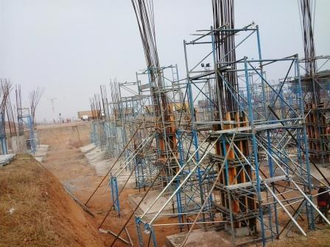
Column shuttering work is going on at panel room.
Pump room area
55% Retaining wall of pump room completed.

Slide 8
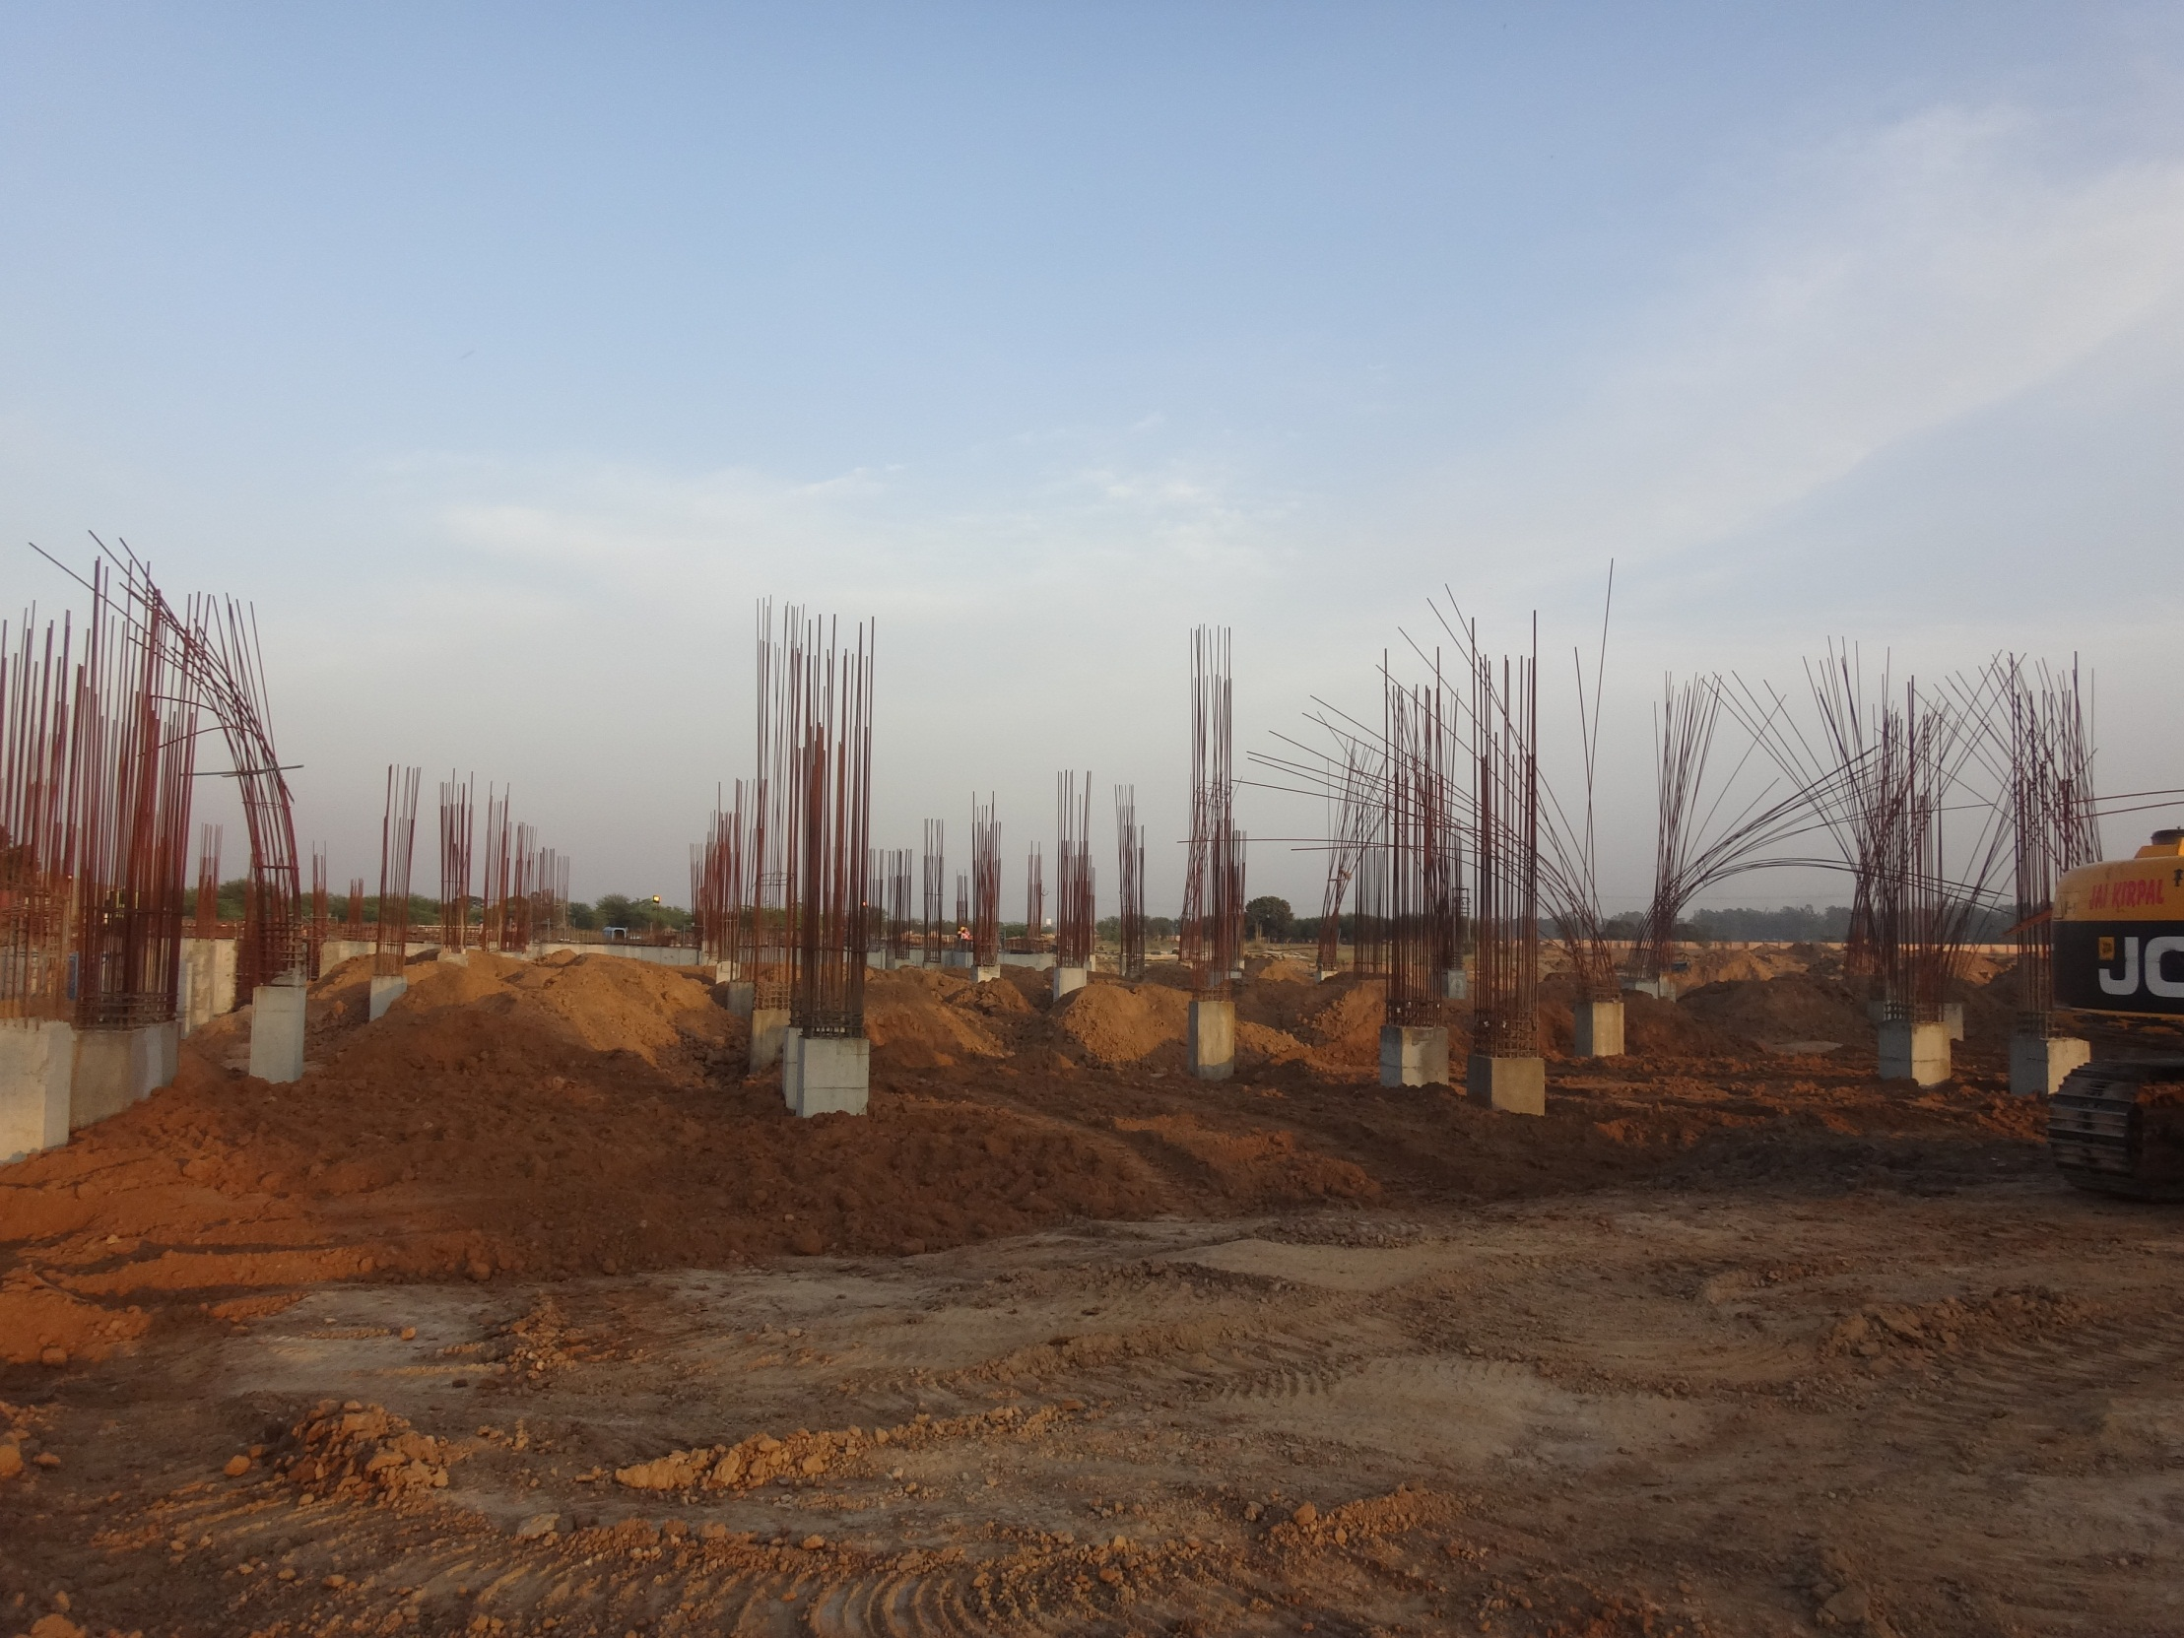
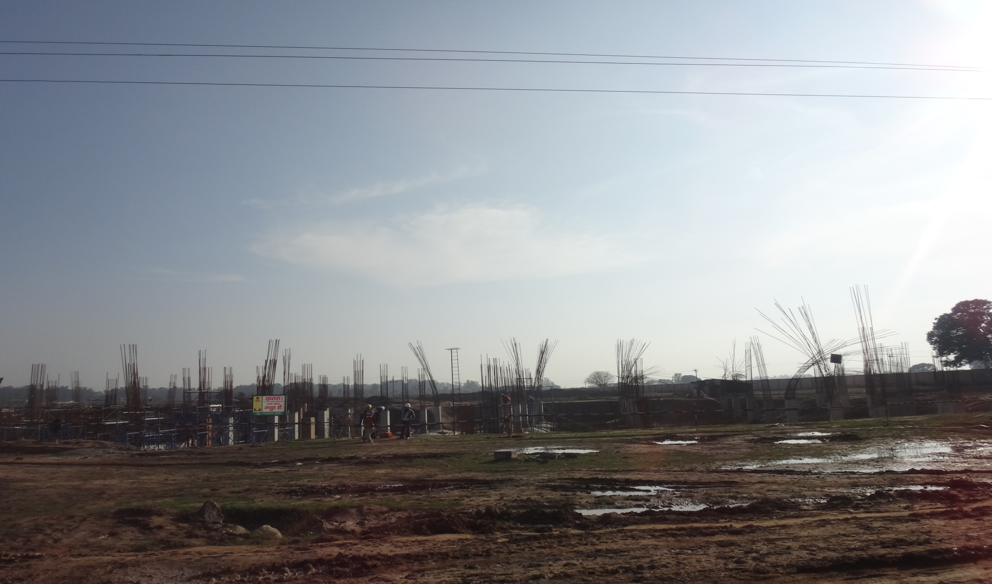
Back filling work in progress
Back filling work is going on.

Slide 9
SERVICE YARD ORGANISATIONAL CHART
CONSTRUCTION ENGINEER - R. PALNIVELU
SITE ENGINEER – VISHWAJEET SARKAR
CONTRACTOR – ANIL TIWARI

Slide 10
Organizational Chart
Manoj Kumar Akela
Vinod kumar
Imtiyaz

Slide 11
SERVICE YARD

Slide 12
Executive Summary (Service Yard)
Major Scope | UOM | Scope | Completed | Balance
Excavation | Cum | 24575 | 100% | 0%
PCC | Cum | 276.84 | 81.25% | 18.75%
Horizontal water proofing | Sq. | 1477.83 | 100% | 0%
Vertical water proofing | Sq. | 1412.82 | 73.5% | 26.5%
Isolated footing concrete | Cum | 679.82 | 100% | 0%
Raft | Cum | 843.9 | 100% | 0%
Retaining wall | Cum | 700.105 | 100% | 0%
Column up to plinth | Cum | 233.4 | 100% | 0%
Back filling | Cum | 15212.3 | 78.95% | 21.05%
Plinth beam | Cum | 463.3 | 0% | 100%
Screed concrete | Cum | 36.94 | 100% | 0%

Slide 13
Executive Summary (Service Yard)
Major Scope | UOM | Scope | Completed | Balance
Column above plinth beam | Cum | 233.4 | 90% | 10%
Slab +400 level basement | Cum | 385.37 | 100% | 0%
Slab +4200 level mezzanine floor | Cum | 76.88 | 100% | 0%
Slab +6500 level lower terrace 1st | Cum | 467.2 | 100% | 0%
Slab +7950 level lower terrace 2nd | Cum | 76.88 | 100% | 0%
Slab +10500 level upper terrace 1st | Cum | 468.3 | 69.35% | 30.65%
Slab +14900 level upper terrace 2nd +13000 Beam framing for chillers | Cum Cum | 135.7 135.75 | 85.25% 0% | 14.75% 100%
Cable Trench | Rmt | 464.25 | 20% | 80%
Stitch Slab PCC | Cum | 195.25 | 0% | 100%
Stitch Slab RCC | Cum | 405.25 | 0% | 100%
Water Tank | Cum | 35.25 | 0% | 100%

Slide 14
Finishing Item ( Service Yard)
Major Scope | UOM | Scope | Completed | Balance
Flooring 62 mm thick CC at G.F. (+500) | Sq. | 3051.25 | 0% | 100%
Rolling Shutter at G.F. ( +500) | Nos | 12 | 0% | 100%
Fire Door at G.F.(+500) | Nos | 14 | 0% | 100%
Flush Door at G.F.(+500) | Nos | 11 | 0% | 100%
Aluminum at G.F.(+500) | Nos | 13 | 0% | 100%
Brick work | cum | 1512 | 11% | 89%
External plaster | Sqm
Internal plaster | Sqm
External paint (Texture)) | Sqm
Internal paint | Sqm

Slide 15
Executive Summary (Service Tunnel)
Major Scope | UOM | Scope | Completed | Balance
Excavation | Cum | 18601.15 | 100.0% | 0.0%
PCC | Cum | 463.6 | 83.4% | 16.6%
Raft (Footing) | Cum | 830.0 | 88.5% | 11.5%
Wall pedestal | Cum | 162.66 | 87.09% | 12.91%
Wall | Cum | 850.6 | 80.65% | 19.35%
Horizontal water proofing | Sq. | 6624.1 | 76.09% | 23.91%
Vertical water proofing | Sq. | 2589.0 | 78.72% | 21.28%
Stitch slab | Cum | 410.0 | 74.39% | 25.61%
Back filling | Cum | 15212.3 | 50.5% | 49.5%
Slab with beams | Cum | 838.9 | 80.5% | 19.5%
Scree ding concrete | Cum | 83.70 | 87.53% | 12.47%

Slide 16
Progress Summary (SY + ST)
Work Break Down | Planned Progress | Actual Progress | In charge
Raft | 1673.9 | 80.18% | Imtiyaz
Excavation | 43176.0 | 89.69% | Imtiyaz
PCC | 740.44 | 66.02% | Imtiyaz
Water proofing | 8101.93 | 39.95% | Imtiyaz
Scree ding | 120.64 | 66.95% | Imtiyaz

Slide 17
Service Yard
Reconciliation of Site Work Till 31st march 2013
Sr.No. | Description of item | UOM | Actual Qty. | Received Qty. | Deference | % | Remarks
1 | PCC | Cum | 276.84 | 288.56 | 3.46 | 1.25 | These are all Qty of raft, isolated & combine footing (Ratio-1:4:8)
2 | RCC( M-30) | Cum | 2144.178 | 2156.568 | 12.007 | 0.56 | These are all Qty of raft,pedastal,retaining wall, isolated or combine footing
3 | RCC(M-35) | Cum | 112.78 | 114.81 | 2.03 | 1.8 | Out of 89 column only 77 no's column and pedestal
4 | Scree ding | Cum | 36.94 | 37.50 | 0.738 | 2.0

Slide 18
Safety KPI
Description | Average Score of Section | Average Score of Project
Excavation | 79 | 66%
Blasting
Piling
Scaffolds | 70 | 65%
Concreting | 65 | 50%
Work at Height | 60 | 59%
Material Handling | 75 | 70%
Grinding
Welding & Gas Cutting | 72 | 58%
Plant & Machinery
Electrical Safety | 75 | 59%
Fire Protection | 75 | 74%
Housekeeping | 90 | 53%
Personal Protective Equipment | 95 | 88%
Health & Hygiene | 75 | 87%
Environment | 50 | 55%
Score | 73.41% | 66%

Slide 21
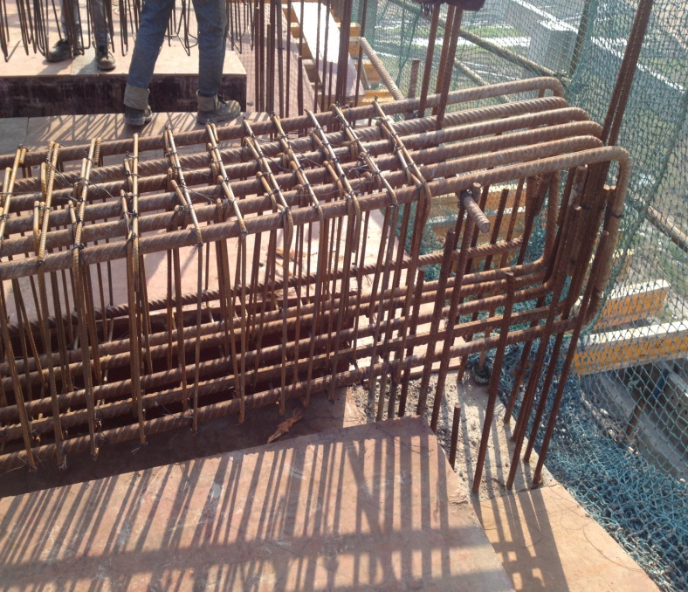
WATER TANK REINFORCEMENT
ELEVATION
REINFORCEMENT

Slide 22
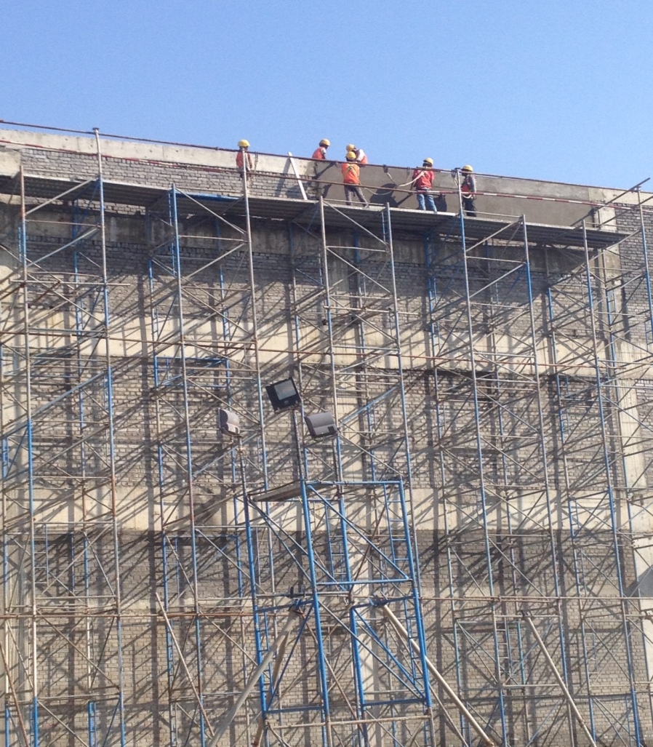
PLASTERING

Slide 23
QUALITY OFFICE

Slide 24
Quality Department Organisational Chart
QUALITY HEAD – PULKIT GOMBER
LAB INCHARGE – MADAN LAL
LAB ATTENDENT – SUMAN

Slide 25
TESTS ON CEMENT
FINENESS
AIM
To determine the fineness of cement by dry sieving as per IS: 4031 (Part 1) - 1996.
PRINCIPLE
The fineness of cement is measured by sieving it through a standard sieve. The proportion of cement, the grain sizes of which, is larger than the specified mesh size is thus determined.

Slide 26
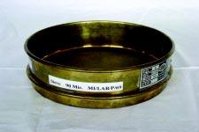
APPARATUS
FIG. 1 : IS SIEVE
90µm IS Sieve
Balance capable of weighing 10g to the nearest 10mg
A nylon or pure bristle brush, preferably with 25 to 40mm bristle, for cleaning the sieve

Slide 27
CONSISTENCY TEST
AIM
To determine the quantity of water required to produce a cement paste of standard consistency as per IS: 4031 (Part 4) - 1988.
PRINCIPLE
The standard consistency of a cement paste is defined as that consistency which will permit the Vicat plunger to penetrate to a point 5 to 7mm from the bottom of the Vicat mould.

Slide 28
FIG. 2 : VICAT APPARATUS
Vicat apparatus conforming to IS: 5513 - 1976
Balance, whose permissible variation at a load of 1000g should be +1.0g
Gauging trowel conforming to IS: 10086 - 1982

Slide 29
INITIAL AND FINAL SETTING TIME
AIM
To determine the initial and the final setting time of cement as per IS: 4031 (Part 5) - 1988.
APPARATUS
Vicat apparatus conforming to IS: 5513 - 1976
Balance, whose permissible variation at a load of 1000g should be +1.0g
Gauging trowel conforming to IS: 10086 - 1982

Slide 30
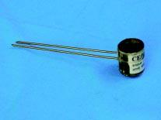
SOUNDNESS TEST
AIM
To determine the soundness of cement by Le-Chatelier method as per IS: 4031 (Part 3) - 1988.
APPARATUS

Slide 31
The apparatus for conducting the Le-Chatelier test should conform to IS: 5514 - 1969
Balance, whose pemissible variation at a load of 1000g should be +1.0g
Water bath

Slide 32
TESTS ON AGGREGATES
SIEVE ANALYSIS
AIM
To determine the particle size distribution of fine and coarse aggregates by sieving as per IS: 2386 (Part I) - 1963.
PRINCIPLE
By passing the sample downward through a series of standard sieves, each of decreasing size openings, the aggregates are separated into several groups, each of which contains aggregates in a particular size range

Slide 33
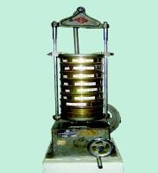
APPARATUS

Slide 34
WATER ABSORPTION
AIM
To determine the water absorption of coarse aggregates as per IS: 2386 (Part III) - 1963.
APPARATUS
Wire basket - perforated, electroplated or plastic coated with wire hangers for suspending it from the balance
Water-tight container for suspending the basket
Dry soft absorbent cloth - 75cm x 45cm (2 nos.)
Shallow tray of minimum 650 sq.cm area
Air-tight container of a capacity similar to the basket
Oven

Slide 35
AGGREGATE ABRASION VALUE
AIM
To determine the abrasion value of coarse aggregates as per IS: 2386 (Part IV) - 1963.
APPARATUS
Los Angles abrasion testing machine
IS Sieve of size - 1.7mm
Abrasive charge - 12 nos. cast iron or steel spheres approximately 48mm dia. and each weighing between 390 and 445g ensuring that the total weight of charge is 5000 + 25g
Oven

Slide 36
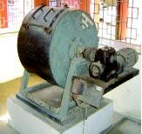
LOS ANGLES MACHINE

Slide 37
AGGREGATE IMPACT VALUE
AIM
To determine the aggregate impact value of coarse aggregates as per IS: 2386 (Part IV) - 1963.
APPARATUS
Impact testing machine conforming to IS: 2386 (Part IV)
IS Sieves of sizes - 12.5mm, 10mm and 2.36mm
A cylindrical metal measure of 75mm dia. and 50mm depth
A tamping rod of 10mm circular cross section and 230mm length, rounded at one end
Oven

Slide 38
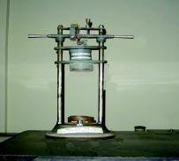
AGGREGATE IMPACT TEST MACHINE

Slide 39
AGGREGATE CRUSHING VALUE
AIM
To determine the aggregate crushing value of coarse aggregates as per IS: 2386 (Part IV) - 1963.
APPARATUS
Cylindrical measure and plunger
Compression testing machine
IS Sieves of sizes - 12.5mm, 10mm and 2.36mm

Slide 40
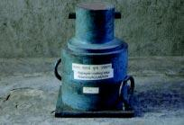
CYLINDRICAL MEASURE AND PLUNGER

Slide 41
TESTS ON FRESH CONCRETE
WORKABILITY
SLUMP
AIM
To determine the workability of fresh concrete by slump test as per IS: 1199 - 1959.
APPARATUS
Slump cone
Tamping rod

Slide 42
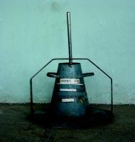
SLUMP CONE

Slide 43
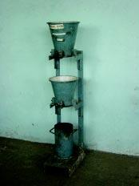
COMPACTING FACTOR
FACTOR AIM
To determine the workability of fresh concrete by compacting factor test as per IS: 1199 - 1959.
APPARATUS
COMPACTING FACTOR APPARATUS

Slide 44
TESTS ON SOIL
WATER CONTENT
OVEN DRYING METHOD
AIM
To determine the water content in soil by oven drying method as per IS: 2720 (Part II) - 1973.
PRINCIPLE
The water content (w) of a soil sample is equal to the mass of water divided by the mass of solids

Slide 45
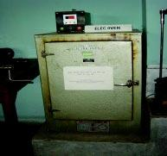
OVEN DRYING MACHINE

Slide 46
LIQUID LIMIT
AIM
To determine the liquid limit of soil as per IS: 2720 (Part 5) - 1985.
PRINCIPLE
The liquid limit of fine-grained soil is the water content at which soil behaves practically like a liquid, but has small shear strength. It's flow closes the groove in just 25 blows in Casagrande’s liquid limit device.
APPARATUS
Casagrande’s liquid limit device
Grooving tools of both standard and ASTM types
Oven

Slide 47
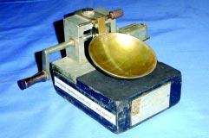
CASAGRANDE'S LIQUID LIMIT DEVICE

Slide 48
PLASTIC LIMIT
AIM
To determine the plastic limit of soil as per IS: 2720 (Part 5) - 1985.
PRINCIPLE
The plastic limit of fine-grained soil is the water content of the soil below which it ceases to be plastic. It begins to crumble when rolled into threads of 3mm dia.

Slide 49
APPARATUS
Porcelain evaporating dish about 120mm dia.
Spatula
Container to determine moisture content
Balance, with an accuracy of 0.01g
Oven
Ground glass plate - 20cm x 15cm
Rod - 3mm dia. and about 10cm long

Slide 50
SPECIFIC GRAVITY
AIM
To determine the specific gravity of fine-grained soil by density bottle method as per IS: 2720 (Part III/Sec 1) - 1980.
PRINCIPLE
Specific gravity is the ratio of the weight in air of a given volume of a material at a standard temperature to the weight in air of an equal volume of distilled water at the same stated temperature.

Slide 51
APPARATUS
Two density bottles of approximately 50ml capacity alongwith stoppers
Constant temperature water bath (27.0 + 0.2ºC)
Vacuum desiccator
Oven, capable of maintaining a temperature of 105 to 110ºC
Weighing balance, with an accuracy of 0.001g
Spatula

Slide 52
PASSENGER TERMINAL BUILDING

Slide 53
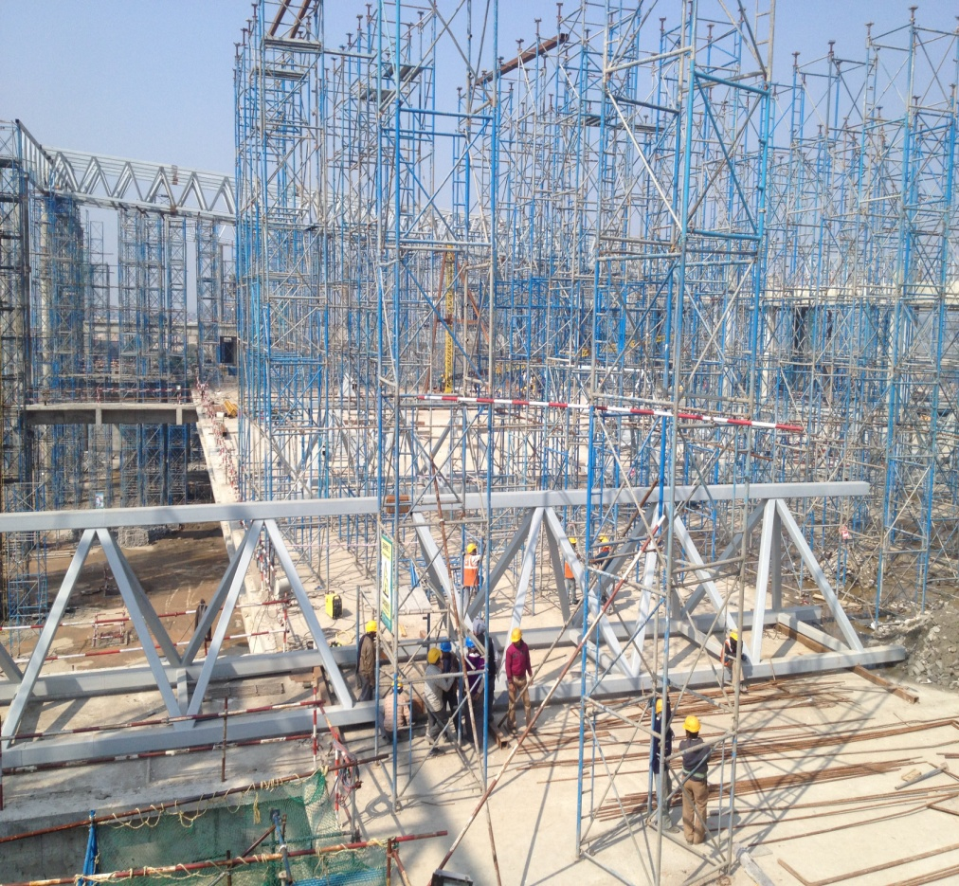
SPACE FRAME AND TRUSS

Slide 54
ELEVATED ROAD

Slide 55
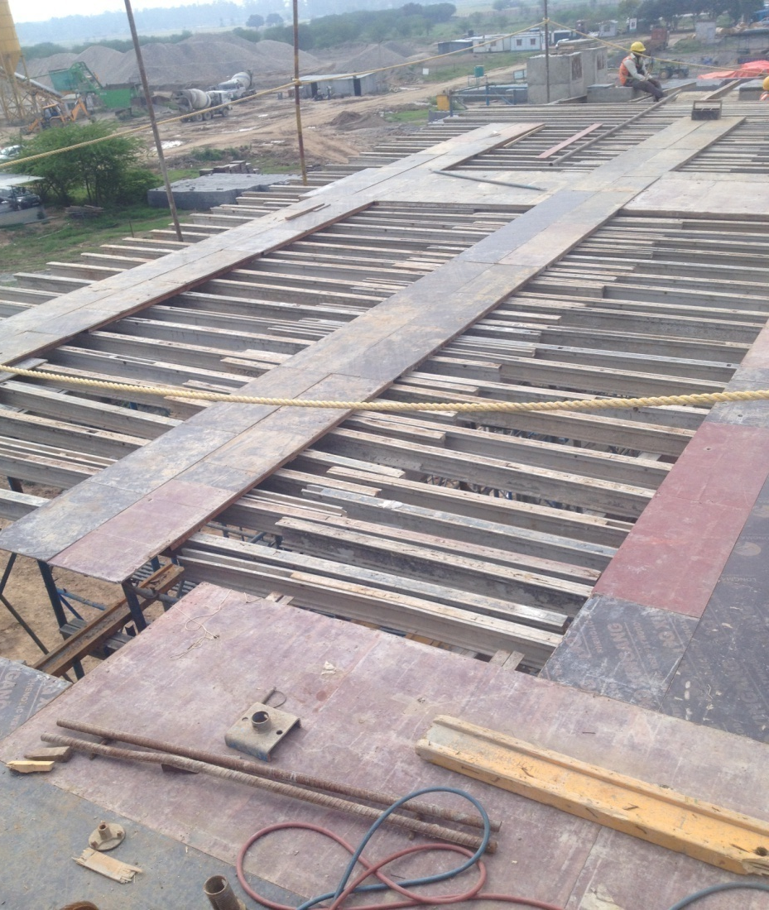
FORMWORK & SHUTTERING OF ELEVATED ROAD

Slide 56
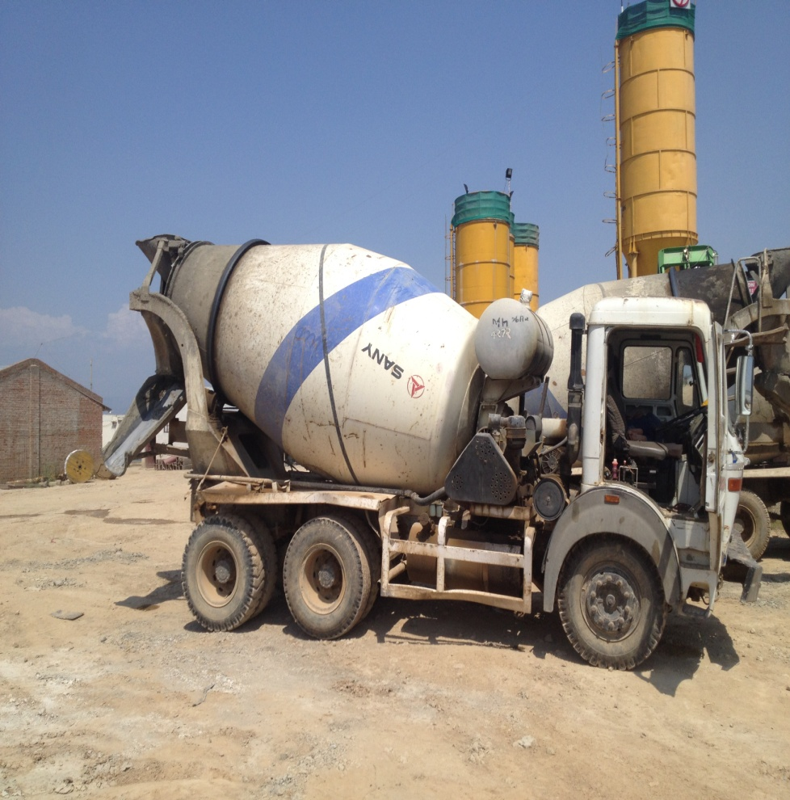
BOOM PLACER AND TRANSIT MIXER

Slide 57
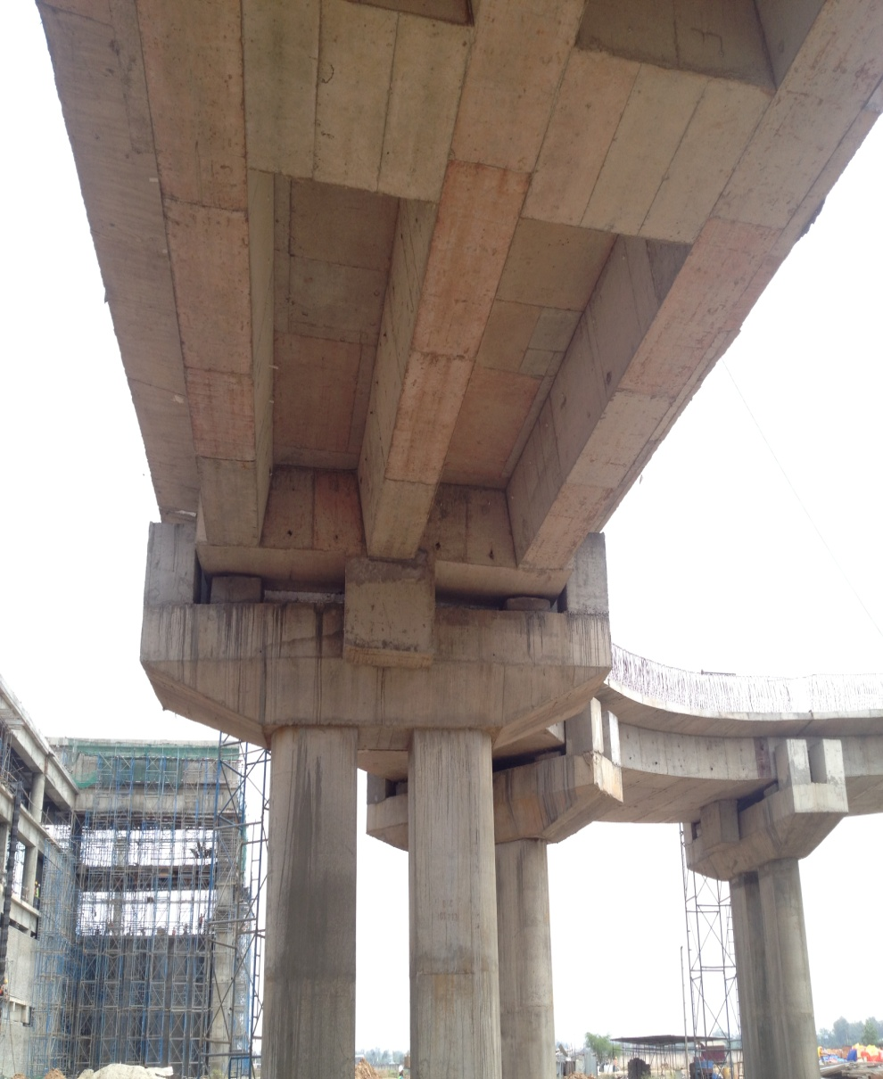
ELEVATION OF ELEVATED ROAD

Slide 58
BATCHING PLANT

Slide 59
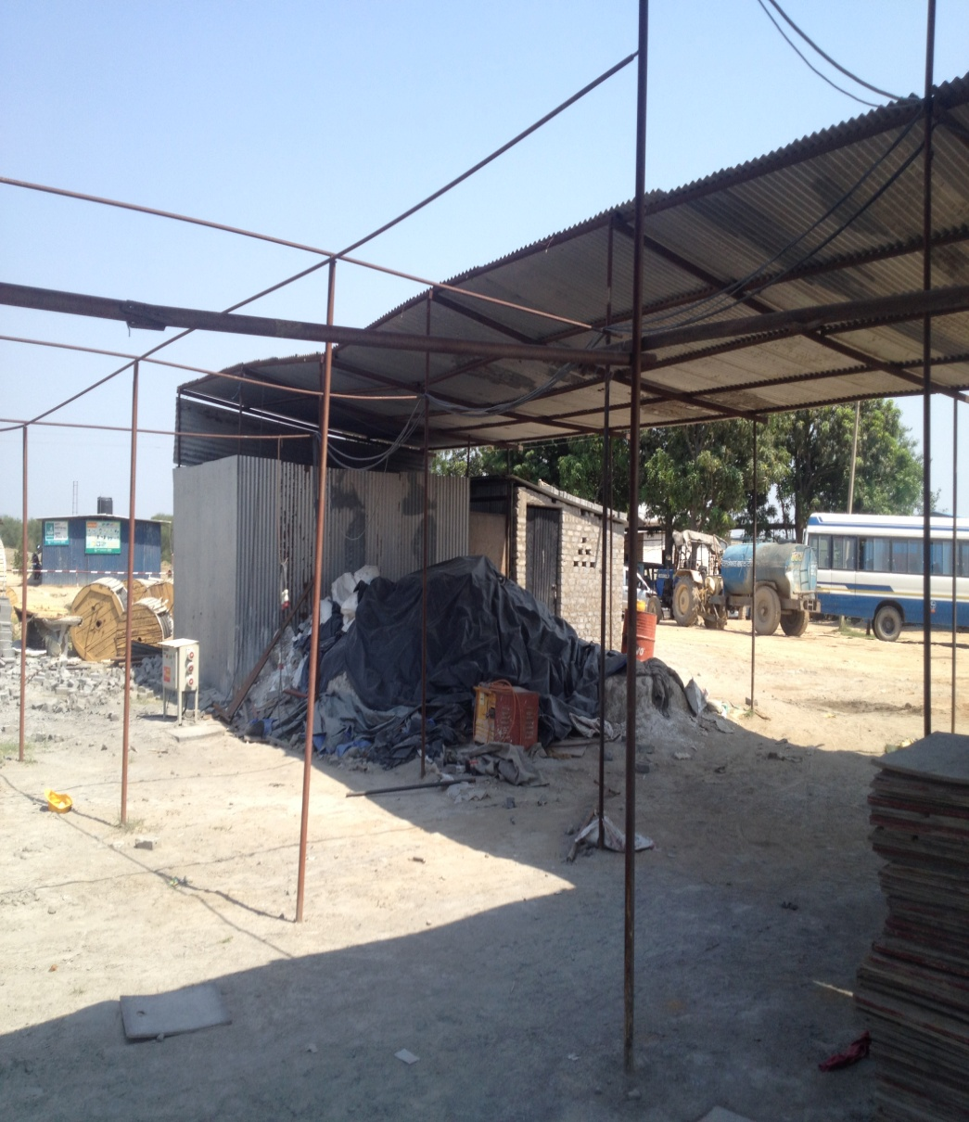
BRICK YARD

Slide 60
HVAC DEPARTMENT

Slide 61
AUTO LEVEL

Slide 62
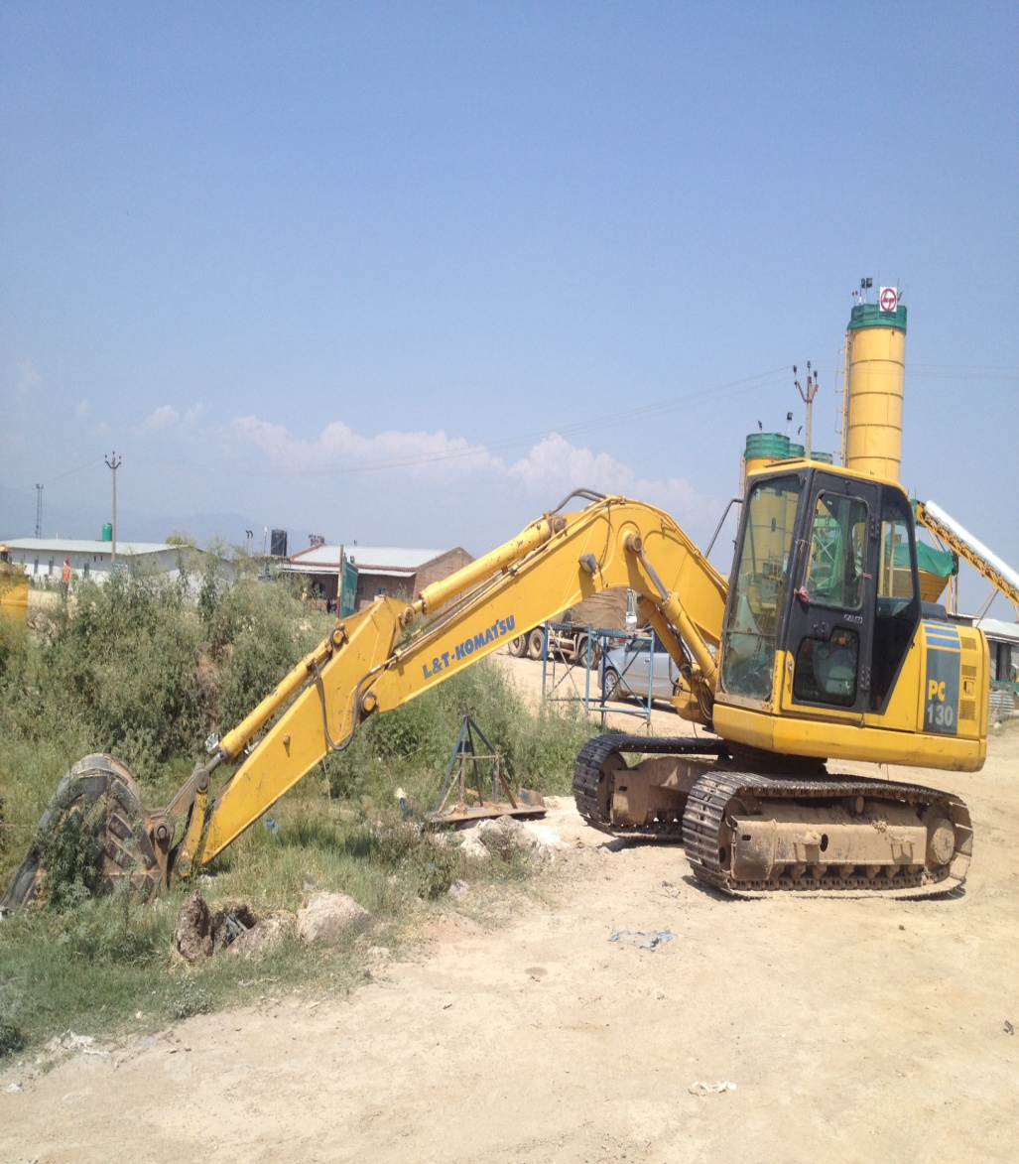
ROAD ROLLER & JCB CRANE

Slide 63
EMERGENCY MEDICAL FACILITY

Slide 64
THANK YOU

