Slide 1

PRESENTATION
SIX MONTHS INDUSTRIAL TRAINING
AT B.S.S. POLYTECHNIC COLLEGE , BANGA
(From 6th JANUARY 2014 to 20th MAY 2014)
BY: GURDEEP SINGH
UNIVERSITY ROLL NO. 100370101111
Roll No. 100173

Slide 2
COMPANY PROFILE
A.S. CONSTRUCTION COMPANY
Established in: 1993
Entrepreneur: Mr. MANJEET SINGH
Motive of Company: To undertake various business contracts and construction.
Location : AMRITSAR
Various projects accomplished by the company are as follows-
Sugar mill , Amritsar
Shaheed baba jeevan singh polytechnic college , attari
Vatenary hospital , Amritsar
Law college , Amritsar

Slide 3
OVERVIEW OF PROJECT
AREA OF GROUND FLOOR:8000 SQ.FT
ESTIMATED INVESTMENT: 6 CRORE
DESIGNED FOR: G+3
DURATION OF PROJECT: 3 YEAR
PROJECT STARTED: JULY 2011

Slide 4
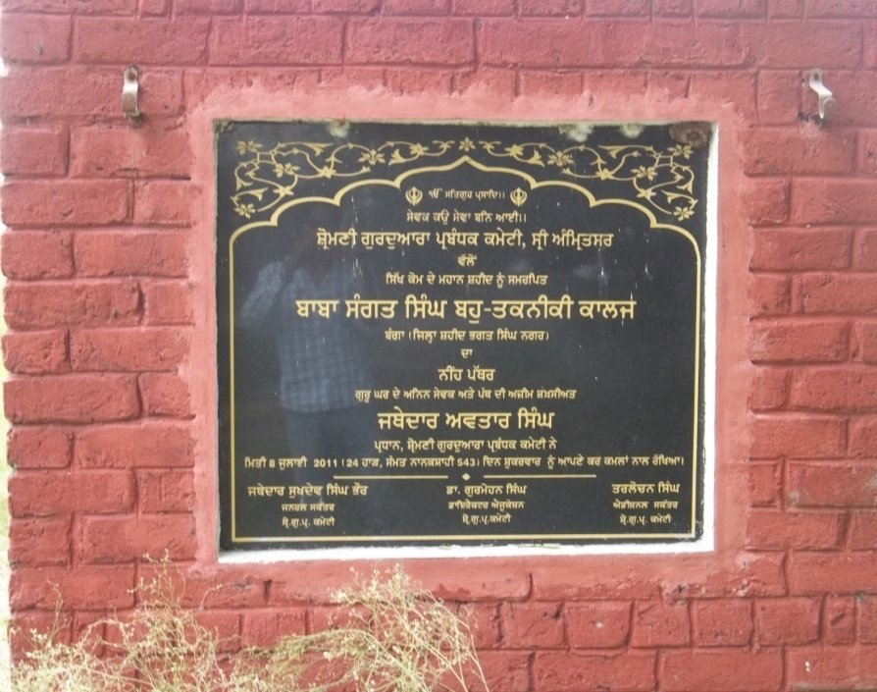
INTRODUCTION TO PROJECT
Name Project: Construction of COLLEGE building
Owner: Shiromani Guruduwara Parbandhak Committee, Amritsar
Main Contractor: A. S. construction company
Structure: RCC Frame structure
Project Supervision: S.G. P.C .

Slide 5
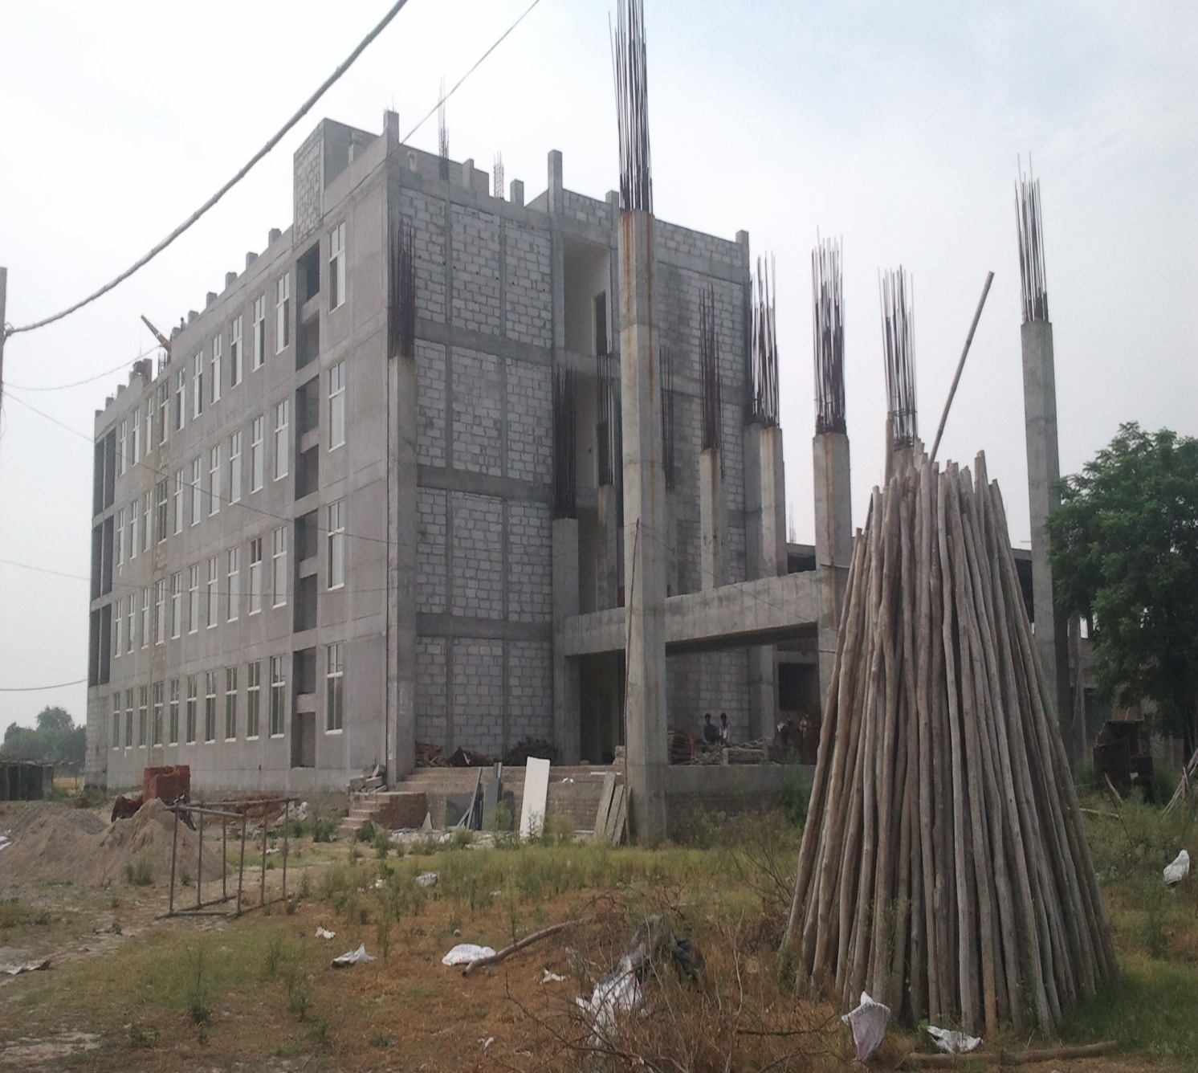

Slide 6
STATUS AT JOINING
EXCAVATION AND FOUNDATION ARE COMPLETRD.
GROUND FLOOR IS COMPLETED
FIRST FLOOR IS UNDER CONSTRUSTION
STEEL REINFORCEMENT OF COLUMN IS IN PROGRESS.

Slide 7
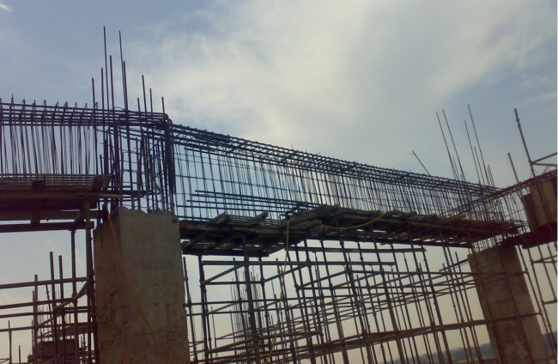
WORK PREFORMED
STEEL REINFORCEMENT
Fe-500
Dia used:-
8mm
10mm
12mm
16mm
20mm

Slide 8
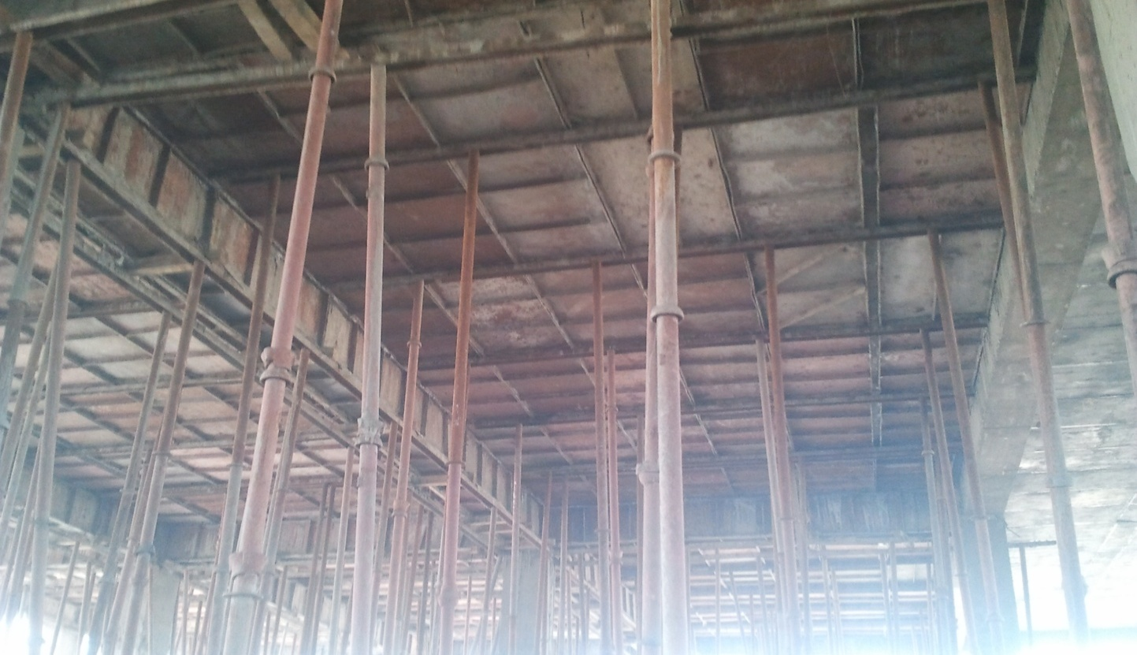
SHUTTERING

Slide 9
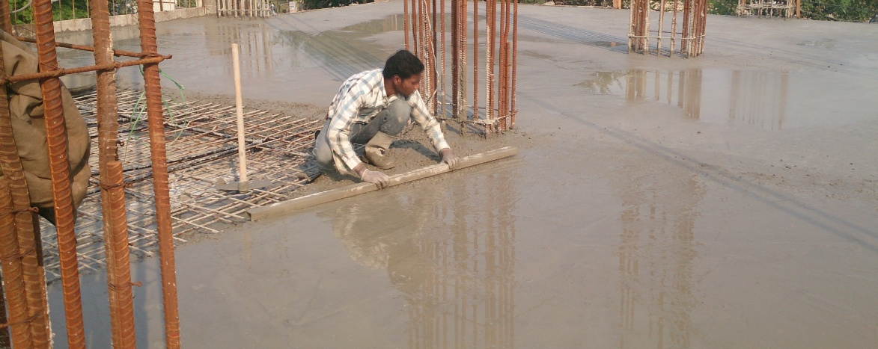
CONCRETING(M-25)

Slide 10
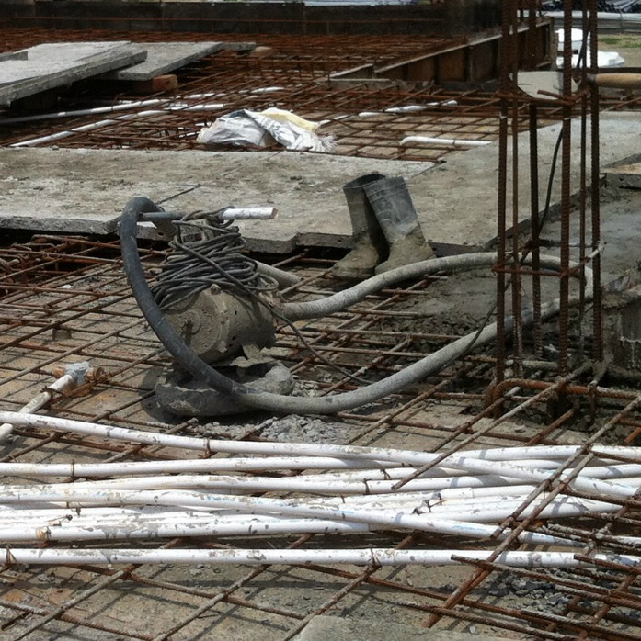
COMPACTION

Slide 11
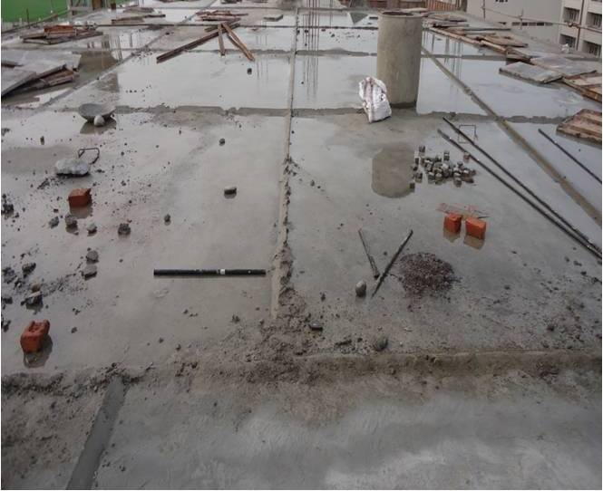
Curing

Slide 12
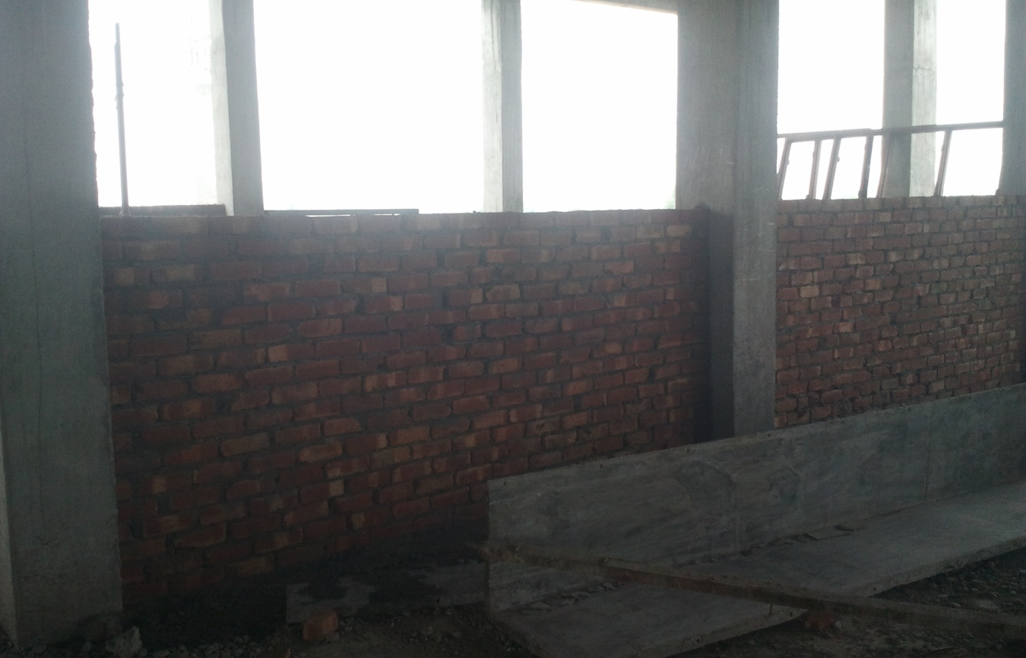
BRICK WORK

Slide 13
PARTS OF STRUCTURE
A. Column
Fe-500
Grade of concrete: M-25(design mix).
Clear cover: 40mm.
Compaction of concrete was done by electrical vibrator.

Slide 14
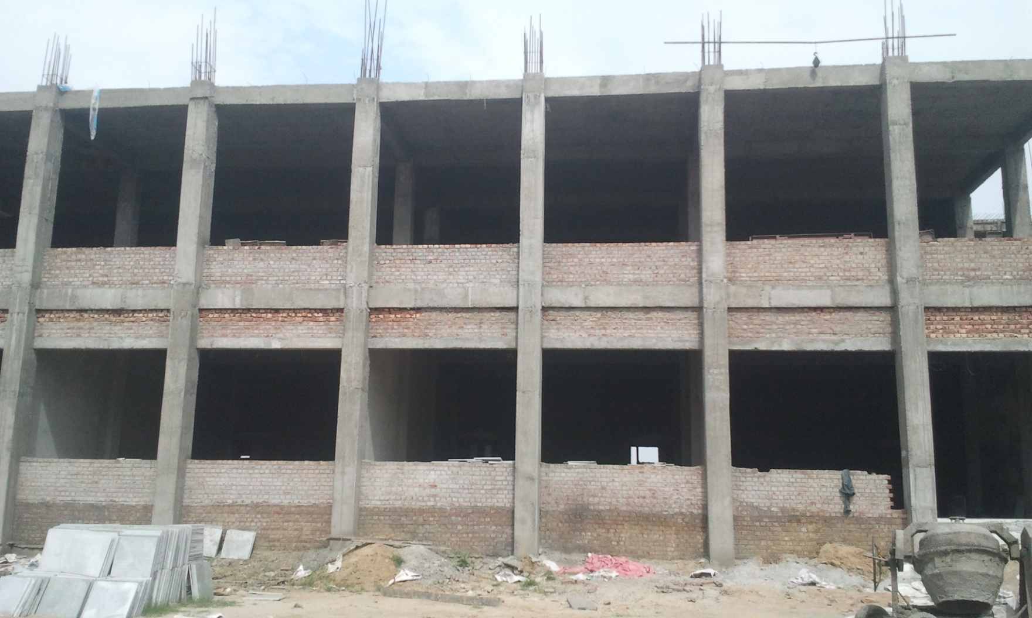

Slide 15
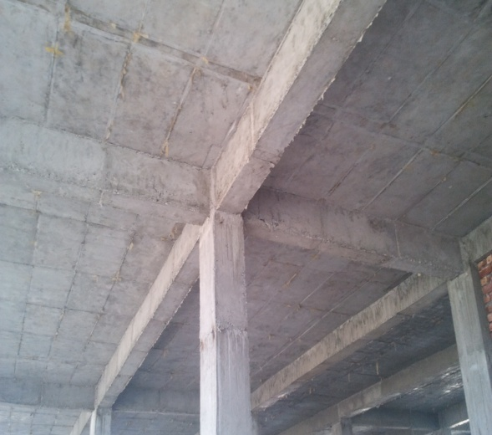
Beam
Fe-500.
Grade of concrete used: M-25.
Clear cover: 25mm.

Slide 16
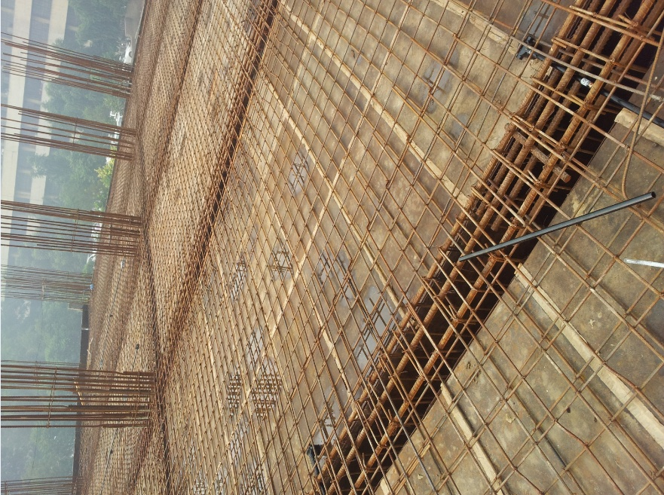
Slab
Fe-500
Grade of concrete used: M-25
Thickness of slab: 120 mm.
Clear cover : 25mm
Electric vibrator was used for compaction purpose.

Slide 17
MATERIAL USED
BRICKS
CEMENT
STEEL BARS
AGGREGATES
a. Fine
b. Coarse

Slide 18
VARIOUS TEST PERFORMED
BRICK TEST
CONCRETE TEST

Slide 19
BRICK TEST
Compression test
Shape test

Slide 20
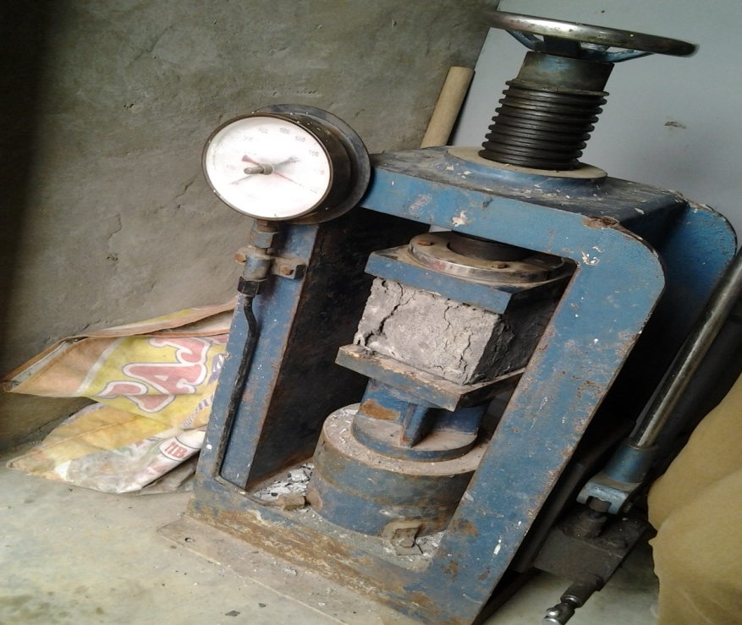
CONCRETE TEST
Cube test

Slide 21
Slump test
Slump test helps to determine the nature of concrete mix.
SLUMP NATURE OF CONCRETE MIX
NO SLUMP EXTRA STIFF MIX
FROM 10mm -30mm POORLY MOBILE MIX
FROM 40mm – 150mm MOBILE MIX
OVER 150mm LAST MIX

Slide 22
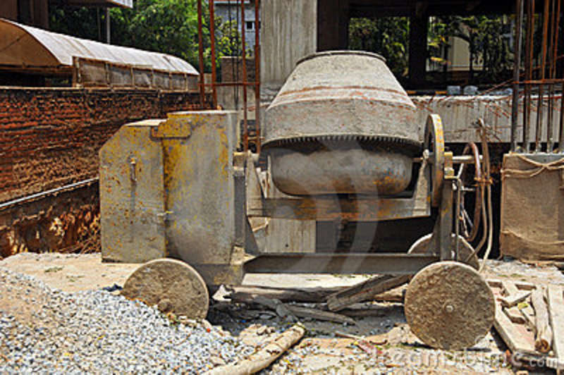
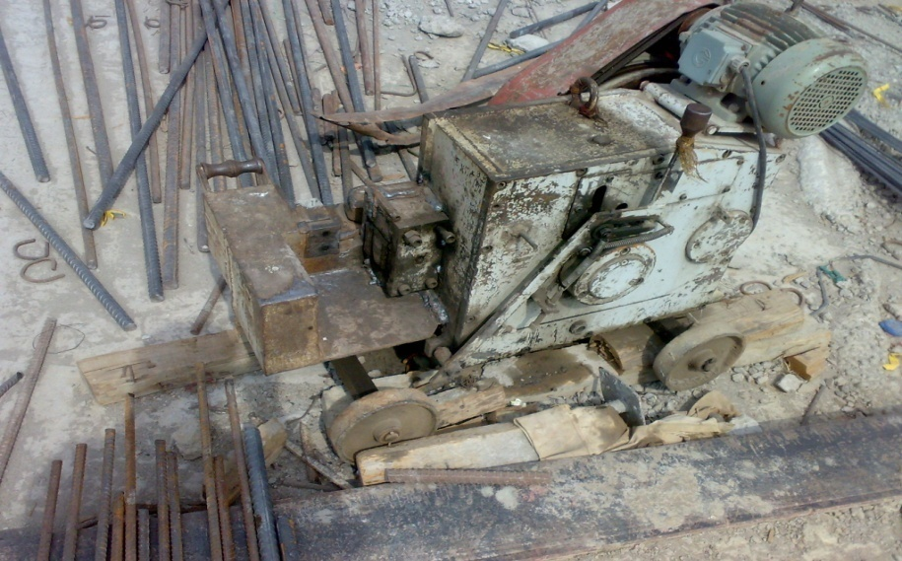
EQUIPMENT USED
Welding set
Concrete mixer
Vibrator
Steel bar cutter

Slide 23
THANKS

